Slide 1
SPHINCS: practical stateless hash-based signatures
D. J. Bernstein, D. Hopwood, A. Hülsing,
T. Lange, R. Niederhagen, L. Papachristodoulou,
P. Schwabe, and Z. Wilcox O'Hearn

Slide 2





Digital Signatures are Important!
Software updates
E-Commerce
… and many others

Slide 3
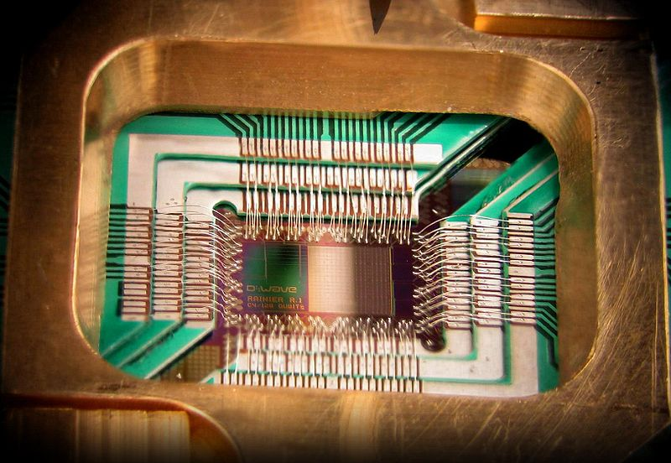
What if…

Slide 4





Problem?
RSA
DL
Pairings
DH
…

Slide 5
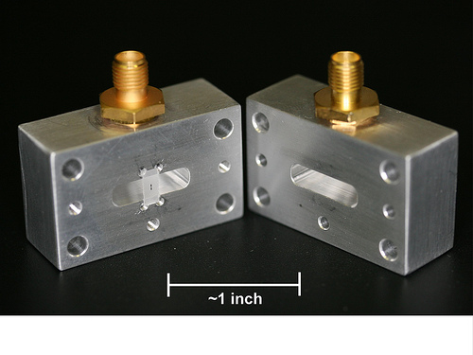
IBM 2012: „…optimism about superconducting qubits and the possibilities for a future quantum computer are rapidely growing.“

Slide 6
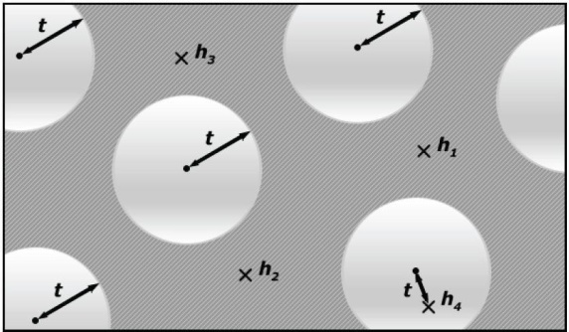

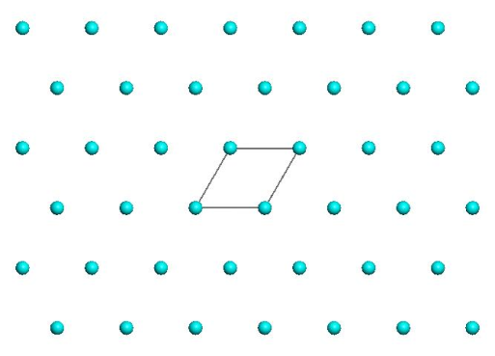
Post-Quantum Signatures
Lattice, MQ, Coding
Signature and/or key sizes
Runtimes
Secure parameters

Slide 7
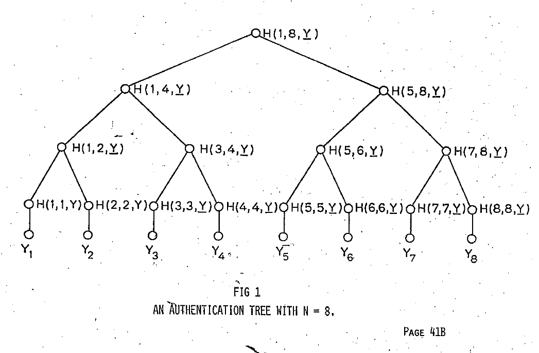
Hash-based Signature Schemes [Mer89]
Security well understood
Fast
Post quantum
Only secure hash function
Stateful

Slide 8
Lamport-Diffie OTS [Lam79]
Message M = b1,…,bn, OWF H = n bit
SK
PK
Sig
*
sk_{1,0}
sk_{1,1}
sk_{n,0}
sk_{n,1}
H
H
H
H
H
H
pk_{1,0}
pk_{1,1}
pk_{n,0}
pk_{n,1}
b1
Mux
b2
Mux
bn
Mux
sk_{1,b1}
sk_{n,bn}

Slide 9




Merkle’s Hash-based Signatures
Digital Signature
PK
SIG = (i=2, , , , , )
Encryption
H
OTS
H
H
Cryptography
H
H
H
H
H
H
H
H
Legality
H
H
H
H
Hash Function
OTS
OTS
OTS
OTS
OTS
OTS
OTS
OTS
MAC
SK

Slide 10





Known Improvements [BGD⁺06]
Pseudorandom Key Generation:
SK
Hypertree:
Key generation
(== Building Trees on one path)
O(2^{h}) → O(d2^{h/d})
F
F
F
F
F
F

Slide 11
Known Improvements, cont’d
Winternitz OTS [Mer‘89, …, BDE⁺11,Hül13]
  Smaller Sigs
  Minimum Security Assumptions
Minimum Security Assumptions / Collision-Resilient Scheme [BDH11]
  XMSS requires only PRF & SPR

Slide 12
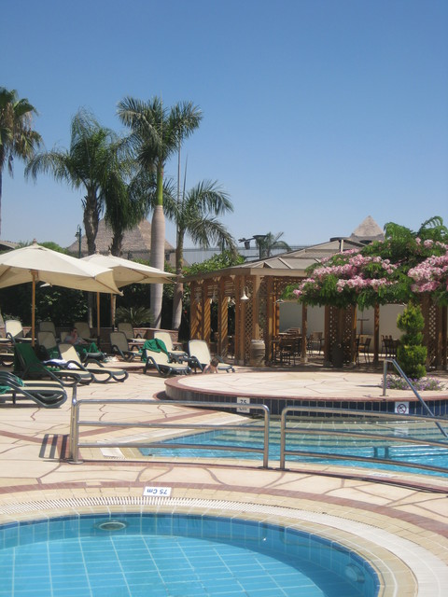
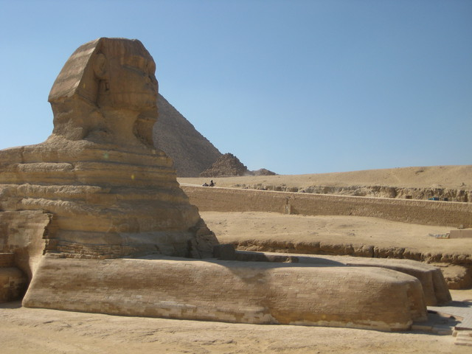
SPHINCS: Stateless Practical Hash-based Incredibly Nice Cryptographic Signatures

Slide 13
Goals
Stateless
128bit Quantum Security
Practical Speed
Practical Signature Size

Slide 14

How to Eliminate the State

Slide 15
Trial & Error:
Run MSS without State
Digital Signature
PK
SIG = (i=2, , , , , )
Encryption
H
H
H
Cryptography
H
H
H
H
H
H
H
H
Legality
H
H
H
H
Hash Function
OTS
OTS
OTS
OTS
OTS
OTS
OTS
OTS
MAC
SK

Slide 16
Approach 1: Goldreich
i = Integer.getValue(Hash(Message));
128bit Quantum Sec.
→ n = 256 bit Hash [Ber09]
→ #Indices = 2²⁵⁶
→ h = n = 256
h depends on n!

Slide 17
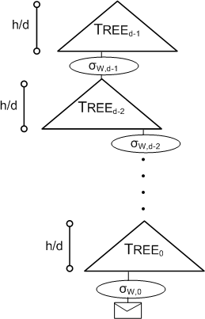
Approach 1, cont’d
d > 1, otherwise
t_{Sign} = exp(n)

Slide 18
Approach 1, cont’d
i = Integer.getValue(Hash(Message));
h = n = 256
Impossible to make this efficient:
  t_{Sign} ≈ d2^{n/d} (t_{Hash} + t_{OTS_KeyGen}) ≈ d2^{n/d}n t_{Hash}
  |Sig| ≈ d |OTS_Sig| (+ n², if d<n) ≈ dn²
E.g. d = n / log n:
    t_{Sign} ≈ n³ / log n t_{Hash}; |Sig| ≈ n³ / log n
Goldreich: d = n
    t_{Sign} ≈ 2n² t_{Hash}; |Sig| ≈ n³
    |Sig| > 1MB for n = 256

Slide 19
Approach 2: Random Index
128bit Quantum Sec.
→ Sampled by Signer
→ #Indices determined by collision prob.
→ #Indices = 2²⁵⁶
→ h = 256
Impossible to make this efficient, again… BUT
  h independent of n
  Statistical collision probability NOT collision resistance

Slide 20
Sphincs
Approach 2 + Few-Time Signature Scheme (FTS)
Next: Introduce new FTS
HORS with Trees (HORST)
Preview: Allows h = 60 for any n
  t_{Sign} ≈ d2^{60/d} (t_{Hash} + t_{OTS_KeyGen}) ≈ d2^{60/d}n t_{Hash}
  |Sig| ≈ d |OTS_Sig| (+ n², if d<n) ≈ dn²
  E.g. d = 12:
    t_{Sign} ≈ 384n t_{Hash}; |Sig| ≈ 12n² (without HORST)

Slide 21
Few-Time Signature Schemes

Slide 22
Recap LD-OTS
Message M = b1,…,bn, OWF H = n bit
SK
PK
Sig
*
sk_{1,0}
sk_{1,1}
sk_{n,0}
sk_{n,1}
H
H
H
H
H
H
pk_{1,0}
pk_{1,1}
pk_{n,0}
pk_{n,1}
b1
Mux
b2
Mux
bn
Mux
sk_{1,b1}
sk_{n,bn}

Slide 23
HORS [RR02]
Message M = b₁,…,b_{m}, OWF H = n bit
Parameters t=2ª,k, with m = ka (typical a=16, k=32)
SK
PK
M
Sig
*
sk₁
sk₂
sk_{t-1}
sk_{t}
H
H
H
H
H
H
pk₁
pk₁
pk_{t-1}
pk_{t}
b₁
b₂
b_{a}
b_{a+1}
b_{ka-2}
b_{ka-1}
b_{ka}
i₁
Mux
Mux
i_{k}
sk_{i1}
sk_{ik}

Slide 24
HORS Security
Message M = Hash(msg)
M mapped to k element index set M^{i} є {1,..,t}^{k}
Each signature publishes k out of t secrets
Either break one-wayness or…
r-Subset-Resilience: After seeing index sets M^{i}_{j} for r messages msg_{j}, 1 <= j <= r, hard to find msg_{r+1} ≠ msg_{j} such that M^{i}_{r+1} є U_{1<=j<=r} M^{i}_{j} .
Best generic attack: Succ_{r-SSR}(A,q) = q(rk / t)^{k}
→ Security shrinks with each signature!

Slide 25
HORST
Using HORS with MSS requires adding PK (tn) to MSS signature.
HORST: Build a Merkle Tree on top of PK
  PK = Root
  Publish Authentication Paths for HORS signature values
  PK can be computed from Sig
  With optimizations: tn → (k(log t − x + 1) + 2^{x})n
    E.g. SPHINCS-256: 2 MB → 16 KB

Slide 26
SPHINCS

Slide 27
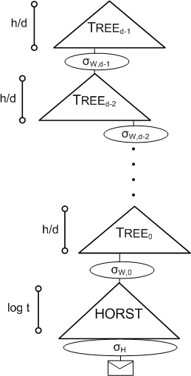
SPHINCS Signature

Slide 28
SPHINCS Key Ideas
Use HORST key pairs to sign messages
Authenticate HORST key pairs using hypertree (of MSS trees)
Use random index
Select h,k,t,m such that
sum_{r є [0,∞)}(Pr[r-times index collision] *
Succ_{r-SSR}(A)) = negl(n)

Slide 29
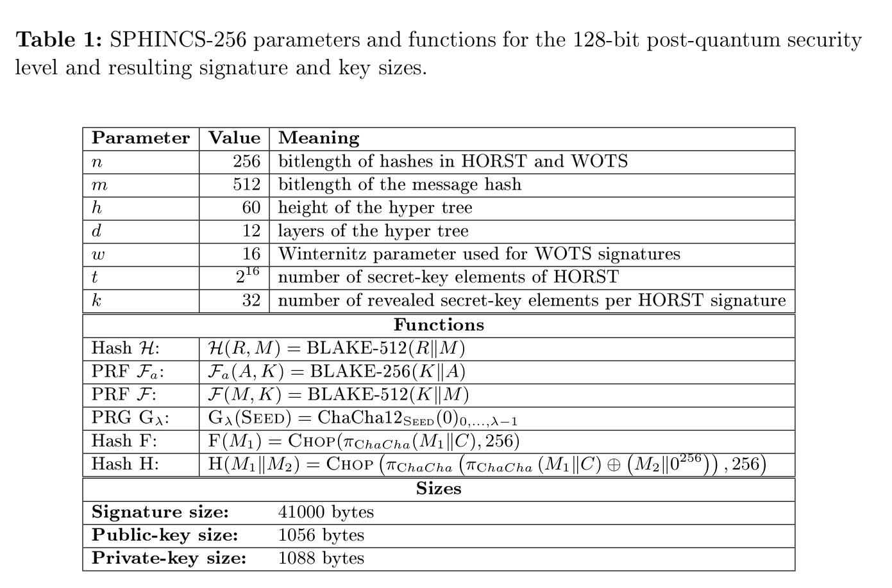
SPHINCS-256

Slide 30
SPHINCS-256 Speed
Key generation: 3,051,562 cycles
Verification: 1,369,060 cycles
Signature: 47,466,005 cycles
Still hundreds of messages per second on a modern 4-core 3.5GHz Intel CPU (13ms / Sig)

Slide 31
In Paper (online soon)
Standard model security reduction without collision resistance
Complexity of generic quantum attacks
Efficient fixed-input length hashing
Optimized implementation

Slide 32
Conclusion
Stateless Hash-based Signatures
Performance like RSA or BLISS? No!
First stateless signature scheme with post-quantum secure parameters
Practical Speed and Sizes

Slide 33

Thank you!
Questions?

