Slide 1
Hash-based Signatures
Andreas Hülsing

Slide 2
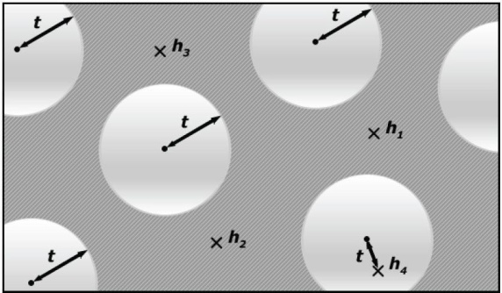

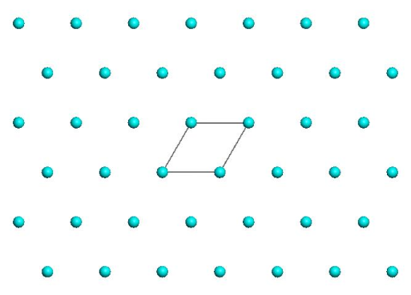
Post-Quantum Signatures
Lattice, MQ, Coding
Signature and/or key sizes
Runtimes
Secure parameters

Slide 3
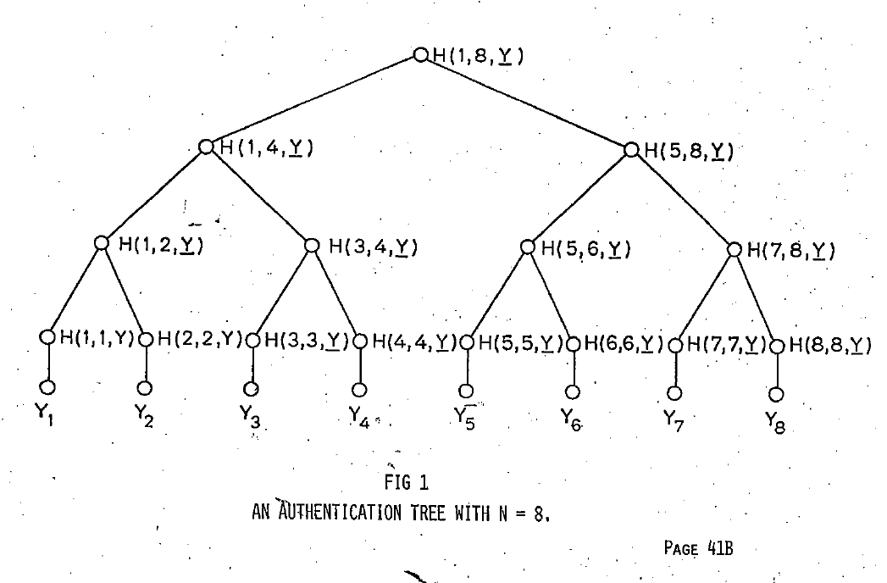
Hash-based Signature Schemes [Mer89]
Post quantum
Only secure hash function
Security well understood
Fast

Slide 4
RSA – DSA – EC-DSA...
Intractability Assumption
Cryptographic
hash function
RSA, DH, SVP, MQ, …
Digital signature scheme

Slide 5




(Hash) function families
$H_{n}≔\left\{h_{k}:{\text{\{0,1\}}}^{m\left(n\right)}→{\text{\{0,1\}}}^{n}\right\}$
$m(n)≥n$
„efficient“
$${\text{\{0,1\}}}^{n}$$
$$h_{k}$$
$${\text{\{0,1\}}}^{m\left(n\right)}$$

Slide 6
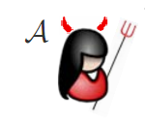



One-wayness
$$H_{n}≔\left\{h_{k}:{\text{\{0,1\}}}^{m\left(n\right)}→{\text{\{0,1\}}}^{n}\right\}$$
$$h_{k}\underset{←}{\$}H_{n}$$
$$x\underset{←}{\$}{\text{\{0,1\}}}^{m\left(n\right)}$$
$$y_{c}←h_{k}\left(x\right)$$
Success if $h_{k}\left(x^{∗}\right)=y_{c}$
$$y_{c},k$$
$$x^{∗}$$

Slide 7

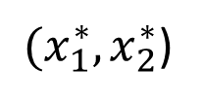

Collision resistance
$$H_{n}≔\left\{h_{k}:{\text{\{0,1\}}}^{m\left(n\right)}→{\text{\{0,1\}}}^{n}\right\}$$
$$h_{k}\underset{←}{\$}H_{n}$$
Success if
$$h_{k}\left(x_{1}^{∗}\right)=h_{k}\left(x_{2}^{∗}\right)$$
$$k$$
${(x}_{1}^{∗},x_{2}^{∗}$)

Slide 8



Second-preimage resistance
$$H_{n}≔\left\{h_{k}:{\text{\{0,1\}}}^{m\left(n\right)}→{\text{\{0,1\}}}^{n}\right\}$$
$$h_{k}\underset{←}{\$}H_{n}$$
$$x_{c}\underset{←}{\$}{\text{\{0,1\}}}^{m\left(n\right)}$$
Success if
$$h_{k}\left(x_{c}\right)=h_{k}\left(x^{∗}\right)$$
$$x_{c},k$$
$$x^{∗}$$

Slide 9

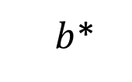

Undetectability
$$H_{n}≔\left\{h_{k}:{\text{\{0,1\}}}^{m\left(n\right)}→{\text{\{0,1\}}}^{n}\right\}$$
$$h_{k}\underset{←}{\$}H_{n}$$
$$b\underset{←}{\$}\{0,1\}$$
If $b=1$
$x\underset{←}{\$}{\text{\{0,1\}}}^{m\left(n\right)}$
$y_{c}←h_{k}(x)$
else
$y_{c}\underset{←}{\$}{\text{\{0,1\}}}^{n}$
$$y_{c},k$$
$b$*

Slide 10






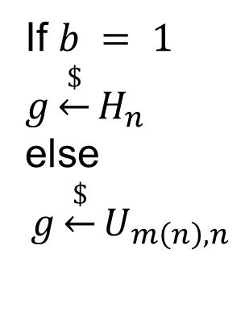
Pseudorandomness
$$H_{n}≔\left\{h_{k}:{\text{\{0,1\}}}^{m\left(n\right)}→{\text{\{0,1\}}}^{n}\right\}$$
$$1^{n}$$
$$b$$
$$x$$
If $b = 1$
$$g\underset{←}{\$}H_{n}$$
else
$$g\underset{←}{\$}U_{m\left(n\right),n}$$
g
$$y = g(x)$$
$b$*

Slide 11
Hash-function properties
stronger / easier to break
Collision-Resistance
Assumption / Attacks
2nd-Preimage-Resistance
One-way
Pseudorandom
weaker /
harder to break

Slide 12
Attacks on Hash Functions
MD5
Collisions
(theo.)
MD5
Collisions
(practical!)
SHA-1
Collisions
(theo.)
MD5 & SHA-1
No (Second-) Preimage Attacks!
2004
2005
2008
2015

Slide 13

Basic Construction

Slide 14
Lamport-Diffie OTS [Lam79]
Message M = b1,…,bm, OWF H = n bit
SK
PK
Sig
*
sk_{1,0}
sk_{1,1}
sk_{m,0}
sk_{m,1}
H
H
H
H
H
H
pk_{1,0}
pk_{1,1}
pk_{m,0}
pk_{m,1}
b1
Mux
b2
Mux
bm
Mux
sk_{1,b1}
sk_{m,bm}

Slide 15





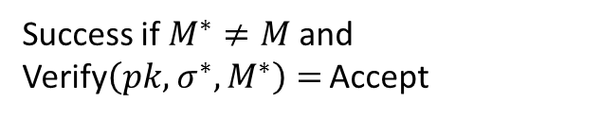
EU-CMA for OTS
$$pk,1^{n}$$
$$sk$$
$$M$$
SIGN
$$(σ,M)$$
$$(σ^{∗},M^{∗})$$
Success if $M^{∗}≠M$and Verify$\left(pk, σ^{∗},M^{∗}\right)=$ Accept

Slide 16
Security
Theorem:
If H is one-way then LD-OTS is one-time eu-cma-secure.

Slide 17


Reduction
Input: $y_{c},k$
Set $H←h_{k}$
Replace random pk_{i,b}
sk_{1,0}
sk_{1,1}
sk_{m,0}
sk_{m,1}
H
H
H
H
H
H
pk_{1,0}
pk_{1,1}
$$y_{c}$$
pk_{m,0}
pk_{m,1}

Slide 18

Reduction
Adv. Message: M = b1,…,bm
If bi = b return fail
else return Sign(M)
Input: $y_{c},k$
Set $H←h_{k}$
Replace random pk_{i,b}
sk_{1,0}
sk_{1,1}
?
sk_{m,0}
sk_{m,1}
H
H
H
H
H
pk_{1,0}
pk_{1,1}
$$y_{c}$$
pk_{m,0}
pk_{m,1}
b1
Mux
b2
Mux
bm
Mux
sk_{1,b1}
sk_{m,bm}

Slide 19



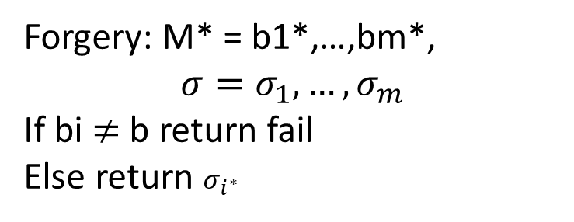
Reduction
Forgery: M* = b1*,…,bm*,
$$σ=σ_{1},…,σ_{m}$$
If bi $≠$ b return fail
Else return $σ_{i^{∗}}$
Input: $y_{c},k$
Set $H←h_{k}$
Choose random pk_{i,b}
?
sk_{1,0}
sk_{1,1}
$$σ_{i^{∗}}$$
$$σ_{i^{∗}}$$
sk_{m,0}
sk_{m,1}
H
H
H
H
H
pk_{1,0}
pk_{1,1}
$$y_{c}$$
pk_{m,0}
pk_{m,1}

Slide 20
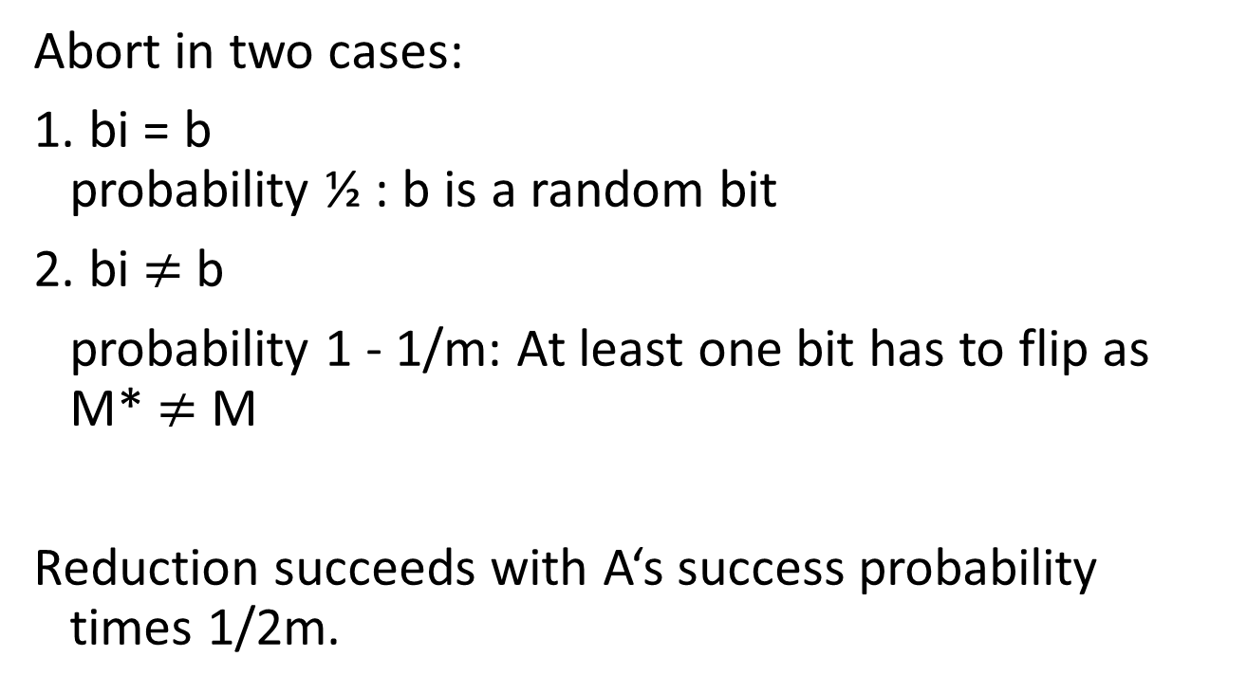
Reduction - Analysis
Abort in two cases:
1. bi = b
probability ½ : b is a random bit
2. bi $≠$ b
probability 1 - 1/m: At least one bit has to flip as M* $≠$ M
Reduction succeeds with A‘s success probability times 1/2m.

Slide 21




Merkle’s Hash-based Signatures
PK
SIG = (i=2, , , , , )
H
OTS
H
H
H
H
H
H
H
H
H
H
H
H
H
H
OTS
OTS
OTS
OTS
OTS
OTS
OTS
OTS
SK

Slide 22
Security
Theorem:
MSS is eu-cma-secure if OTS is a one-time eu-cma secure signature scheme and H is a random element from a family of collision resistant hash functions.

Slide 23
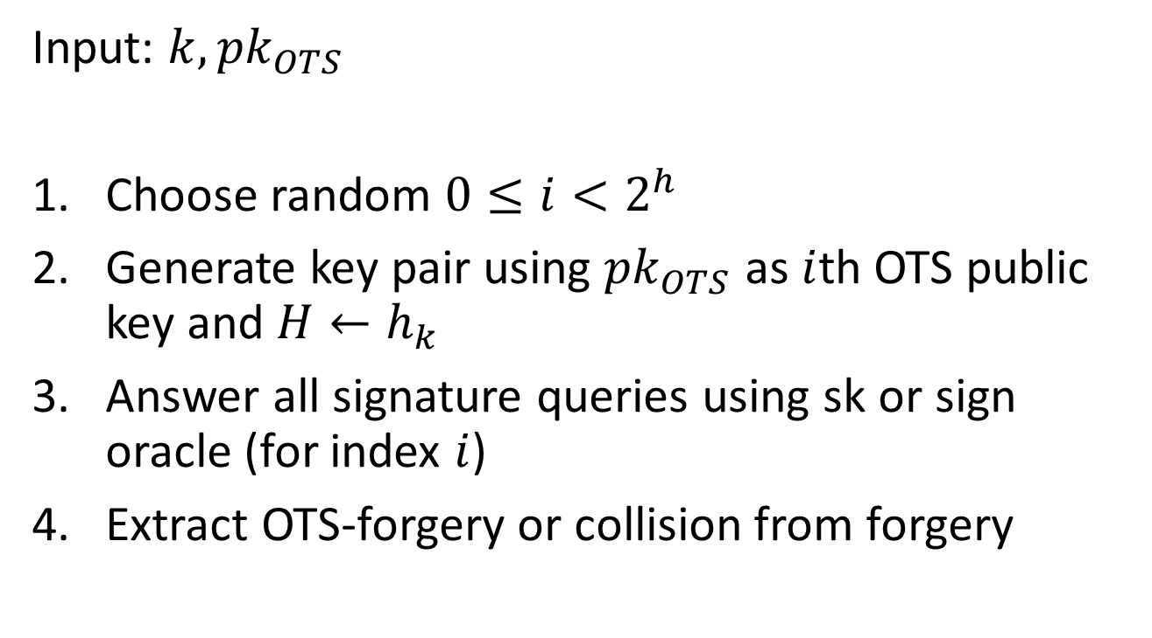
Reduction
Input: $k, {pk}_{OTS}$
Choose random $0≤i<2^{h}$
Generate key pair using ${pk}_{OTS}$ as $i$th OTS public key and $H←h_{k}$
Answer all signature queries using sk or sign oracle (for index $i$)
Extract OTS-forgery or collision from forgery

Slide 24
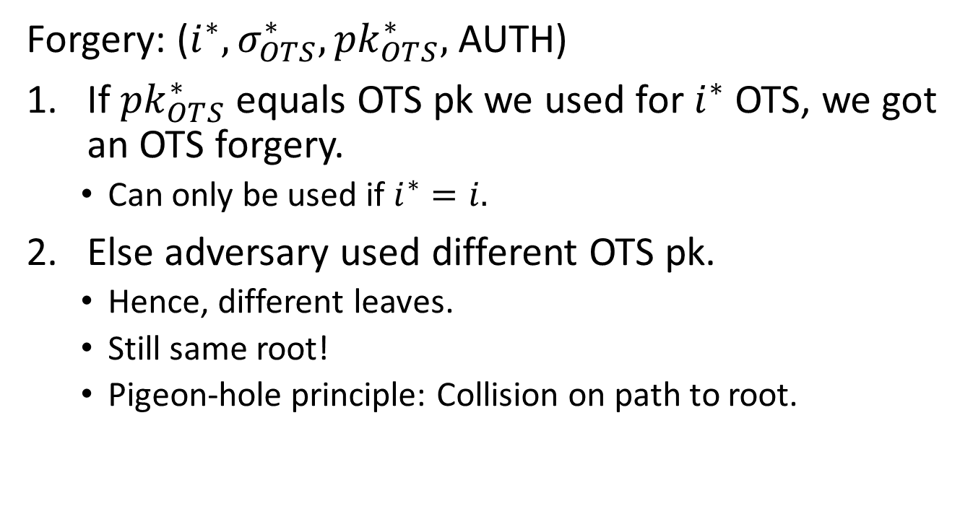
Reduction (Step 4, Extraction)
Forgery: (${i^{∗},σ}_{OTS}^{∗},{pk}_{OTS}^{∗},$AUTH)
If ${pk}_{OTS}^{∗}$ equals OTS pk we used for $i^{∗}$ OTS, we got an OTS forgery.
  Can only be used if $i^{∗}=i.$
Else adversary used different OTS pk.
  Hence, different leaves.
  Still same root!
  Pigeon-hole principle: Collision on path to root.

Slide 25
Winternitz-OTS

Slide 26
Recap LD-OTS [Lam79]
Message M = b1,…,bm, OWF H = n bit
SK
PK
Sig
*
sk_{1,0}
sk_{1,1}
sk_{m,0}
sk_{m,1}
H
H
H
H
H
H
pk_{1,0}
pk_{1,1}
pk_{m,0}
pk_{m,1}
b1
Mux
b2
Mux
bn
Mux
sk_{1,b1}
sk_{m,bm}

Slide 27
LD-OTS in MSS
SIG = (i=2, , , , , )
Verification:
1. Verify
2. Verify authenticity of
We can do better!

Slide 28
Trivial Optimization
Message M = b1,…,bm, OWF H = n bit
*
SK
sk_{1,0}
sk_{1,1}
sk_{m,0}
sk_{m,1}
H
H
H
H
H
H
PK
pk_{1,0}
pk_{1,1}
pk_{m,0}
pk_{m,1}
b1
Mux
Mux
$¬$b1
bm
Mux
Mux
$¬$bm
Sig
sig_{1,0}
sig_{1,1}
sig_{m,0}
sig_{m,1}

Slide 29
Optimized LD-OTS in MSS
X
SIG = (i=2, , , , , )
Verification:
1. Compute from
2. Verify authenticity of
Steps 1 + 2 together verify

Slide 30

Germans love their „Ordnung“!
Message M = b₁,…,b_{m}, OWF H
SK: sk₁,…,sk_{m},sk_{m+1},…,sk_{2m}
PK: H(sk₁),…,H(sk_{m}),H(sk_{m+1}),…,H(sk_{2m})
Encode M: M‘ = M||$¬$M = b₁,…,b_{m},$¬$b₁,…,$¬$b_{m}
(instead of b₁, $¬$b₁,…,b_{m},$¬$b_{m} )
sk_{i} , if b_{i} = 1
Sig: sig_{i} =
H(sk_{i}) , otherwise
Checksum with bad performance!

Slide 31
Optimized LD-OTS
Message M = b₁,…,b_{m}, OWF H
SK: sk₁,…,sk_{m},sk_{m+1},…,sk_{m+log m}
PK: H(sk₁),…,H(sk_{m}),H(sk_{m+1}),…,H(sk_{m+log m})
Encode M: M‘ = b₁,…,b_{m},$¬\sum_{1}^{m}{b_{i}}$
sk_{i} , if b_{i} = 1
Sig: sig_{i} =
H(sk_{i}) , otherwise
IF one b_{i} is flipped from 1 to 0, another b_{j} will flip from 0 to 1

Slide 32



Function chains
Function family:${ H}_{n}≔\left\{h_{k}:{\text{\{0,1\}}}^{n}→{\text{\{0,1\}}}^{n}\right\}$
$$h_{k}\underset{←}{\$}H_{n}$$
Parameter $w$
Chain:
c⁰(x) = x
$$c^{w−1}(x)$$
$c1(x) =h_{k}(x)$

Slide 33

WOTS
Winternitz parameter w, security parameter n, message length m, function family ${ H}_{n}$
Key Generation: Compute $l$, sample $h_{k}$
c⁰(sk₁) = sk₁
pk₁ = c^{w-1}(sk₁)
c¹(sk₁)
c¹(sk_{l} )
pk_{l} = c^{w-1}(sk_{l} )
c⁰(sk_{l} ) = sk_{l}
Notes:
One promissing group of candidates are hash-based signature schemes
They start from an OTS – a signature scheme where a key pair can only be used for one signature.
The central idea – proposed by Merkle - is to authenticate many OTS keypairs using a binary hash tree
These schemes have many advantages over the beforementioned
Quantum computers do not harm their security – the best known quantum attack is Grovers algorithm – allowing exhaustiv search in a set with n elements in time squareroot of n using log n space.
They are provably secure in the standard model
And they can be instantiated using any secure hash function.
On the downside, they produce long signatures.

Slide 34
WOTS Signature generation
M
b₁
b₂
b₃
b₄
…
…
…
…
…
…
…
b_{m‘}
b_{m‘+1}
b_{m‘+2}
…
…
b_{l}
c⁰(sk₁) = sk₁
pk₁ = c^{w-1}(sk₁)
C
σ₁=c^{b1}(sk₁)
Signature:
σ = (σ₁, …, σ_{l} )
pk_{l} = c^{w-1}(sk_{l} )
c⁰(sk_{l} ) = sk_{l}
σ_{l} =c^{bl} (sk_{l} )
Notes:
Well, this work is concerned with the OTS.
There are several OTS schemes. LD, Merkle-OTS which is a specific instance of the W-OTS, the BM-OTS and Biba and HORS.
The most interesting one is the Winternitz OTS as it allows for a time-memory trade-off and even more important
- It is possible to compute the public verification key given a signature. This reduces the signature size of a hash based signature scheme as normaly the public key of the OTS has to be included in a signature of the scheme. Now for WOTS this isn‘t necessary anymore.

Slide 35





WOTS Signature Verification
      Verifier knows: M, w
b₁
b₂
b₃
b₄
…
…
…
…
…
…
…
b_{m‘}
b_{m‘+1}
b_{l 1+2}
…
…
b_{l}
$c^{1}$ (σ₁)
$c^{3}$(σ₁)
pk₁
=?
σ₁
$c^{2}$(σ₁)
$c^{w−1−b_{1}}$ (σ₁)
Signature:
σ = (σ₁, …, σ_{l} )
pk_{l}
=?
σ_{l}
$c^{w−1−b_{l}}$ (σ_{l} )
Notes:
Well, this work is concerned with the OTS.
There are several OTS schemes. LD, Merkle-OTS which is a specific instance of the W-OTS, the BM-OTS and Biba and HORS.
The most interesting one is the Winternitz OTS as it allows for a time-memory trade-off and even more important
- It is possible to compute the public verification key given a signature. This reduces the signature size of a hash based signature scheme as normaly the public key of the OTS has to be included in a signature of the scheme. Now for WOTS this isn‘t necessary anymore.

Slide 36

WOTS Function Chains
For $x∈{\left\{0,1\right\}}^{n}$define $c^{0}\left(x\right)=x$ and
WOTS: $c^{i}\left(x\right)=h_{k}(c^{i−1}\left(x\right))$
WOTS$:${ c}^{i}\left(x\right)=h_{c^{i−1}\left(x\right)}(r)$
WOTS⁺: $c^{i}\left(x\right)=h_{k}(c^{i−1}\left(x\right) ⨁{ r}_{i})$

Slide 37
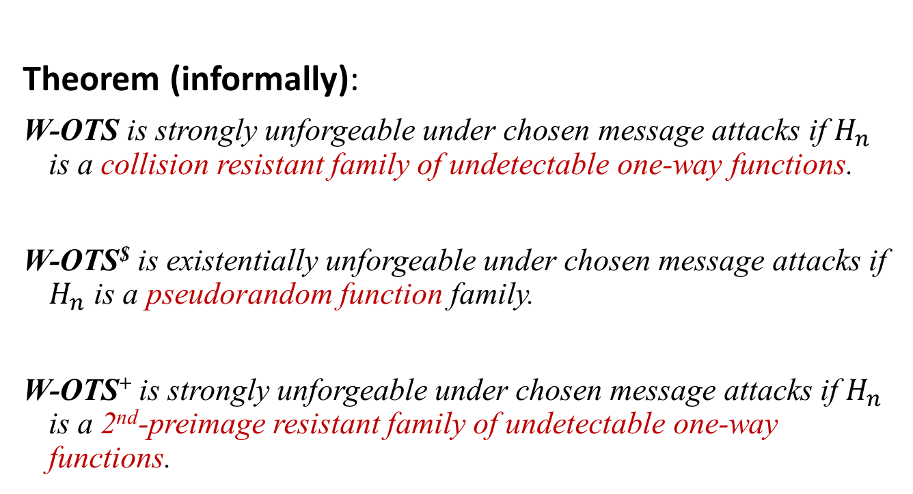
WOTS Security
Theorem (informally):
W-OTS is strongly unforgeable under chosen message attacks if $H_{n}$ is a collision resistant family of undetectable one-way functions.
W-OTS$ is existentially unforgeable under chosen message attacks if $H_{n}$ is a pseudorandom function family.
W-OTS⁺ is strongly unforgeable under chosen message attacks if $H_{n}$ is a 2nd-preimage resistant family of undetectable one-way functions.
Notes:
In our work we showed that we can slightly change the original WOTS construction, such that it uses a function family instead of the hash function family. The resulting scheme is existentially unforgeable under chosen message attacks, if the function family is pseudorandom.
This result has two implications:

Slide 38
WOTS Sizes and Runtimes
 | Lamport-Diffie | WOTS | WOTS$ | WOTS⁺
Public Key Size | 2bm | l 2b ~ 2bm/log w | l b (+b) ~ bm/log w | l b ( +(w-1)b ) ~ bm/log w
Secret Key Size | 2bm | l 2b ~ 2bm/log w | l b ~ bm/log w | l b ~ bm/log w
Signature Size | bm | l 2b ~ 2bm/log w | l b ~ bm/log w | l b ~ bm/log w
Key Generation Time | ~ 2m | l w ~ wm/log w | l w ~wm/log w | l w ~ wm/log w
Security level b, Winternitz parameter w, Message Length m,
l = l (w,m) ~ m / log w

Slide 39
XMSS

Slide 40
XMSS
Tree: Uses bitmasks
Leafs: Use binary tree
with bitmasks
OTS: WOTS⁺
Mesage digest:
Randomized hashing
Collision-resilient
-> signature size halved
b_{i}

Slide 41
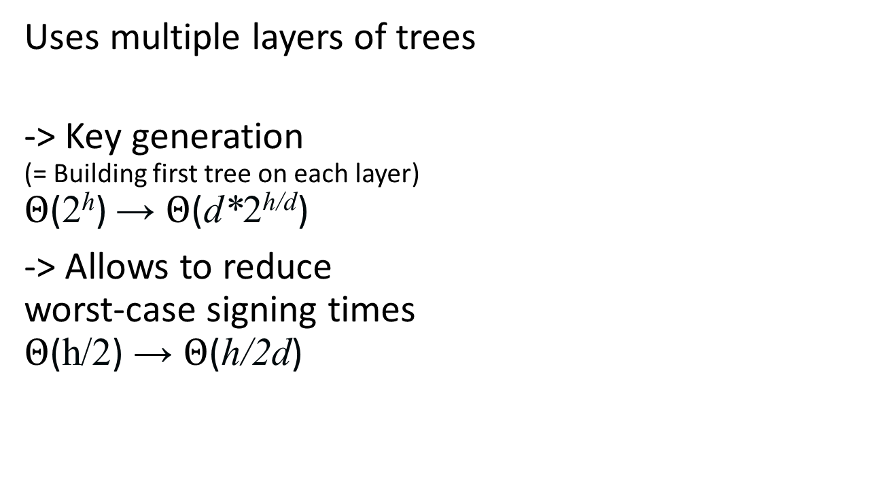
Multi-Tree XMSS
Uses multiple layers of trees
-> Key generation
(= Building first tree on each layer)
$Θ$(2^{h}) → $Θ$(d*2^{h/d})
-> Allows to reduce
worst-case signing times
$Θ$(h/2) → $Θ$(h/2d)

Slide 42
How to Eliminate the State

Slide 43
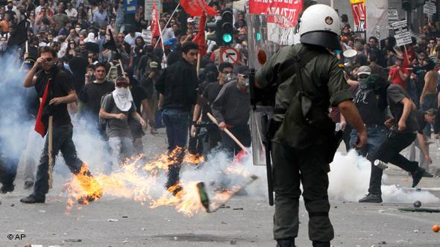
Protest?

Slide 44

Few-Time Signature Schemes

Slide 45
Recap LD-OTS
Message M = b1,…,bn, OWF H = n bit
SK
PK
Sig
*
sk_{1,0}
sk_{1,1}
sk_{n,0}
sk_{n,1}
H
H
H
H
H
H
pk_{1,0}
pk_{1,1}
pk_{n,0}
pk_{n,1}
b1
Mux
b2
Mux
bn
Mux
sk_{1,b1}
sk_{n,bn}

Slide 46
HORS [RR02]
Message M, OWF H, CRHF H’ = n bit
Parameters t=2ª,k, with m = ka (typical a=16, k=32)
SK
PK
*
sk₁
sk₂
sk_{t-1}
sk_{t}
H
H
H
H
H
H
pk₁
pk₁
pk_{t-1}
pk_{t}

Slide 47
HORS mapping function
Message M, OWF H, CRHF H’ = n bit
Parameters t=2ª,k, with m = ka (typical a=16, k=32)
*
M
H’
b₁
b₂
b_{a}
b_{ar}
i₁
i_{k}

Slide 48
HORS
Message M, OWF H, CRHF H’ = n bit
Parameters t=2ª,k, with m = ka (typical a=16, k=32)
*
SK
sk₁
sk₂
sk_{t-1}
sk_{t}
H
H
H
H
H
H
PK
pk₁
pk₁
pk_{t-1}
pk_{t}
H’(M)
b₁
b₂
b_{a}
b_{a+1}
b_{ka-2}
b_{ka-1}
b_{ka}
i₁
Mux
Mux
i_{k}
sk_{i1}
sk_{ik}

Slide 49
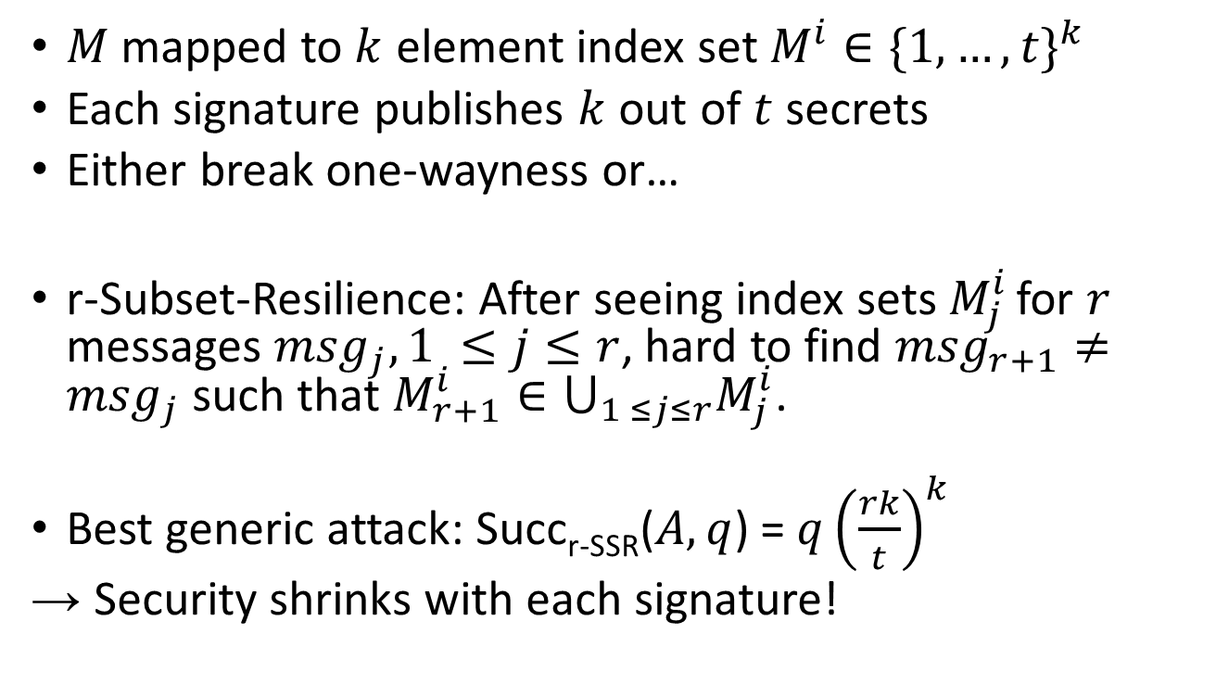
HORS Security
$M$ mapped to $k$ element index set $M^{i}∈{\{1,…,t\}}^{k}$
Each signature publishes $k$ out of $t$ secrets
Either break one-wayness or…
r-Subset-Resilience: After seeing index sets $M_{j}^{i}$ for $r$ messages ${msg}_{j}, 1 ≤j≤r$, hard to find ${msg}_{r+1}≠{msg}_{j}$ such that $M_{r+1}^{i}∈⋃_{1 ≤j≤r}M_{j}^{i}$.
Best generic attack: Succ_{r-SSR}($A,q$) = $q{\left(\frac{rk}{t}\right)}^{k}$
→ Security shrinks with each signature!

Slide 50
HORST
Using HORS with MSS requires adding PK (tn) to MSS signature.
HORST: Merkle Tree on top of HORS-PK
New PK = Root
Publish Authentication Paths for HORS signature values
PK can be computed from Sig
With optimizations: tn → (k(log t − x + 1) + 2^{x})n
  E.g. SPHINCS-256: 2 MB → 16 KB
Use randomized message hash

Slide 51
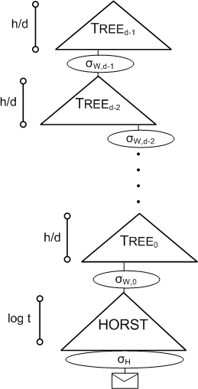
SPHINCS
Stateless Scheme
XMSS^{MT} + HORST
+ (pseudo-)random index
Collision-resilient
Deterministic signing
SPHINCS-256:
  128-bit post-quantum secure
  Hundrest of signatures / sec
  41 kb signature
  1 kb keys

Slide 52

Thank you!
Questions?
For references & further literature see
https://huelsing.wordpress.com/hash-based-signature-schemes/literature/

