Slide 1
An update on
Hash-based Signatures
Andreas Hülsing

Slide 2
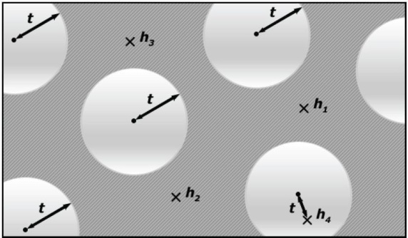

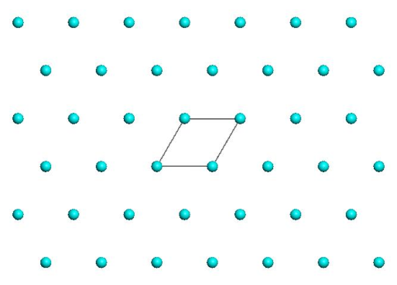
Trapdoor- / Identification Scheme-based (PQ-)Signatures
Lattice, MQ, Coding
Signature and/or key sizes
Runtimes
Secure parameters

Slide 3
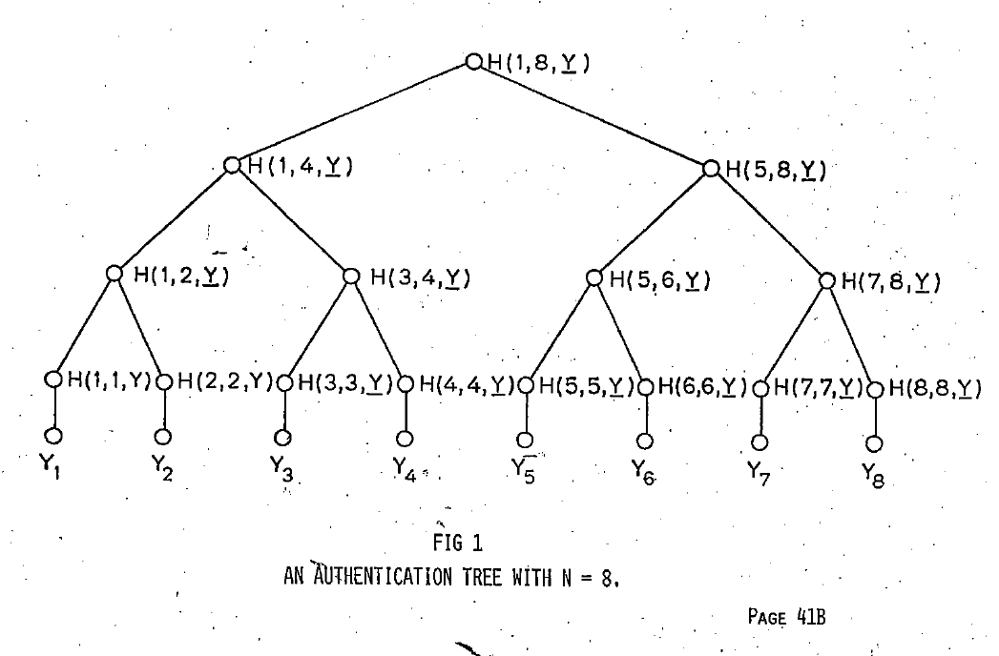
Hash-based Signature Schemes [Mer89]
Post quantum
Only secure hash function
Security well understood
Fast

Slide 4
RSA – DSA – EC-DSA...
Intractability Assumption
Cryptographic
hash function
RSA, DH, SVP, MQ, …
Digital signature scheme

Slide 5

Basic Construction

Slide 6
Lamport-Diffie OTS [Lam79]
Message M = b1,…,bm, OWF H = n bit
SK
PK
Sig
*
sk_{1,0}
sk_{1,1}
sk_{m,0}
sk_{m,1}
H
H
H
H
H
H
pk_{1,0}
pk_{1,1}
pk_{m,0}
pk_{m,1}
b1
Mux
b2
Mux
bm
Mux
sk_{1,b1}
sk_{m,bm}

Slide 7




Merkle’s Hash-based Signatures
PK
SIG = (i=2, , , , , )
H
OTS
H
H
H
H
H
H
H
H
H
H
H
H
H
H
OTS
OTS
OTS
OTS
OTS
OTS
OTS
OTS
SK

Slide 8
Winternitz-OTS

Slide 9



Function chains
Function family:${ H}_{n}≔\left\{h_{k}:{\text{\{0,1\}}}^{n}→{\text{\{0,1\}}}^{n}\right\}$
$$h_{k}\underset{←}{\$}H_{n}$$
Parameter $w$
Chain:
c⁰(x) = x
$$c^{w−1}(x)$$
$c1(x) =h_{k}(x)$

Slide 10

WOTS
Winternitz parameter w, security parameter n, message length m, function family ${ H}_{n}$
Key Generation: Compute $l$, sample $h_{k}$
c⁰(sk₁) = sk₁
pk₁ = c^{w-1}(sk₁)
c¹(sk₁)
c¹(sk_{l} )
pk_{l} = c^{w-1}(sk_{l} )
c⁰(sk_{l} ) = sk_{l}
Notes:
One promissing group of candidates are hash-based signature schemes
They start from an OTS – a signature scheme where a key pair can only be used for one signature.
The central idea – proposed by Merkle - is to authenticate many OTS keypairs using a binary hash tree
These schemes have many advantages over the beforementioned
Quantum computers do not harm their security – the best known quantum attack is Grovers algorithm – allowing exhaustiv search in a set with n elements in time squareroot of n using log n space.
They are provably secure in the standard model
And they can be instantiated using any secure hash function.
On the downside, they produce long signatures.

Slide 11
WOTS Signature generation
M
b₁
b₂
b₃
b₄
…
…
…
…
…
…
…
b_{m‘}
b_{m‘+1}
b_{m‘+2}
…
…
b_{l}
c⁰(sk₁) = sk₁
pk₁ = c^{w-1}(sk₁)
C
σ₁=c^{b1}(sk₁)
Signature:
σ = (σ₁, …, σ_{l} )
pk_{l} = c^{w-1}(sk_{l} )
c⁰(sk_{l} ) = sk_{l}
σ_{l} =c^{bl} (sk_{l} )
Notes:
Well, this work is concerned with the OTS.
There are several OTS schemes. LD, Merkle-OTS which is a specific instance of the W-OTS, the BM-OTS and Biba and HORS.
The most interesting one is the Winternitz OTS as it allows for a time-memory trade-off and even more important
- It is possible to compute the public verification key given a signature. This reduces the signature size of a hash based signature scheme as normaly the public key of the OTS has to be included in a signature of the scheme. Now for WOTS this isn‘t necessary anymore.

Slide 12





WOTS Signature Verification
      Verifier knows: M, w
b₁
b₂
b₃
b₄
…
…
…
…
…
…
…
b_{m‘}
b_{m‘+1}
b_{l 1+2}
…
…
b_{l}
$c^{1}$ (σ₁)
$c^{3}$(σ₁)
pk₁
=?
σ₁
$c^{2}$(σ₁)
$c^{w−1−b_{1}}$ (σ₁)
Signature:
σ = (σ₁, …, σ_{l} )
pk_{l}
=?
σ_{l}
$c^{w−1−b_{l}}$ (σ_{l} )
Notes:
Well, this work is concerned with the OTS.
There are several OTS schemes. LD, Merkle-OTS which is a specific instance of the W-OTS, the BM-OTS and Biba and HORS.
The most interesting one is the Winternitz OTS as it allows for a time-memory trade-off and even more important
- It is possible to compute the public verification key given a signature. This reduces the signature size of a hash based signature scheme as normaly the public key of the OTS has to be included in a signature of the scheme. Now for WOTS this isn‘t necessary anymore.

Slide 13

WOTS Function Chains
For $x∈{\left\{0,1\right\}}^{n}$define $c^{0}\left(x\right)=x$ and
WOTS: $c^{i}\left(x\right)=h_{k}(c^{i−1}\left(x\right))$
WOTS$:${ c}^{i}\left(x\right)=h_{c^{i−1}\left(x\right)}(r)$
WOTS⁺: $c^{i}\left(x\right)=h_{k}(c^{i−1}\left(x\right) ⨁{ r}_{i})$

Slide 14
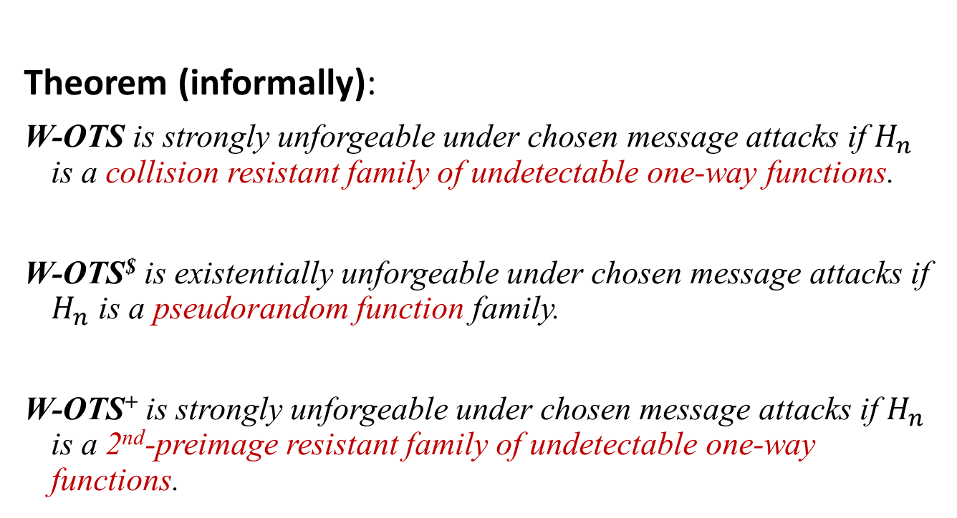
WOTS Security
Theorem (informally):
W-OTS is strongly unforgeable under chosen message attacks if $H_{n}$ is a collision resistant family of undetectable one-way functions.
W-OTS$ is existentially unforgeable under chosen message attacks if $H_{n}$ is a pseudorandom function family.
W-OTS⁺ is strongly unforgeable under chosen message attacks if $H_{n}$ is a 2nd-preimage resistant family of undetectable one-way functions.
Notes:
In our work we showed that we can slightly change the original WOTS construction, such that it uses a function family instead of the hash function family. The resulting scheme is existentially unforgeable under chosen message attacks, if the function family is pseudorandom.
This result has two implications:

Slide 15
Standardizing hash-based signatures.
The case of XMSS

Slide 16
XMSS
Tree: Uses bitmasks
Leafs: Use binary tree
with bitmasks
OTS: WOTS⁺
Mesage digest:
Randomized hashing
Collision-resilient
-> signature size halved
b_{i}

Slide 17
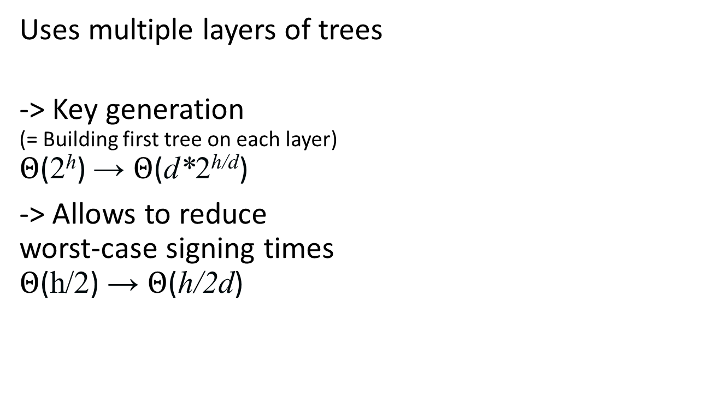
Multi-Tree XMSS
Uses multiple layers of trees
-> Key generation
(= Building first tree on each layer)
$Θ$(2^{h}) → $Θ$(d*2^{h/d})
-> Allows to reduce
worst-case signing times
$Θ$(h/2) → $Θ$(h/2d)

Slide 18
Multi-target attacks
What is the bit security of XMSS using a n = 256 bit hash function?
256 bit?
No!

Slide 19
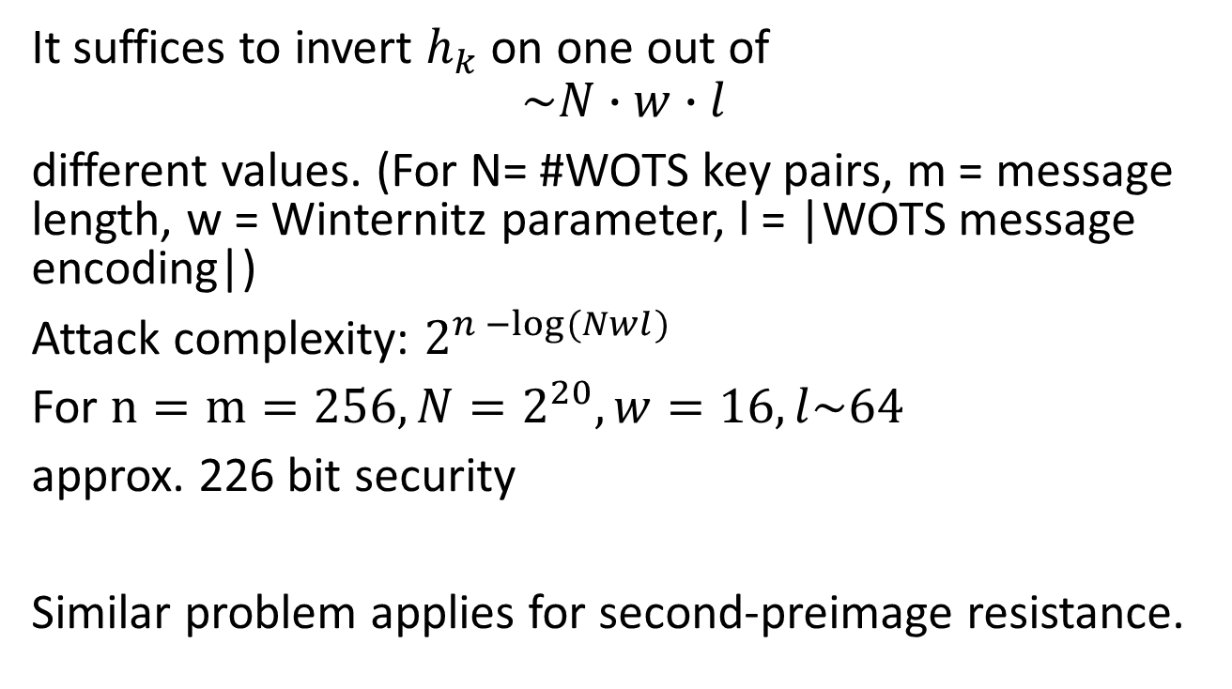
Multi-target attacks
It suffices to invert $h_{k}$ on one out of
$$\sim N∙w∙l$$
different values. (For N= #WOTS key pairs, m = message length, w = Winternitz parameter, l = |WOTS message encoding|)
Attack complexity: $2^{n −log⁡(Nwl)}$
For $n=m=256,N=2^{20}, w=16, l\sim 64$
approx. 226 bit security
Similar problem applies for second-preimage resistance.

Slide 20
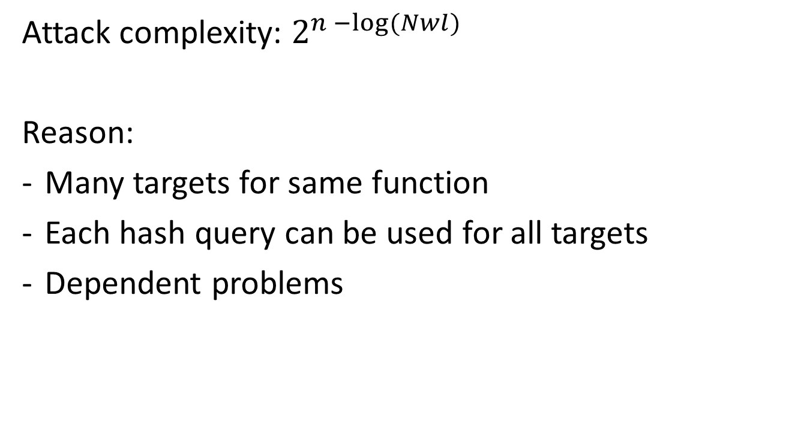
Multi-target attacks
Attack complexity: $2^{n −log⁡(Nwl)}$
Reason:
Many targets for same function
Each hash query can be used for all targets
Dependent problems

Slide 21
Solution?
Use different elements from function family for each hash (and different bitmasks).
Makes problems independent
Each hash query can only be used for one target!

Slide 22
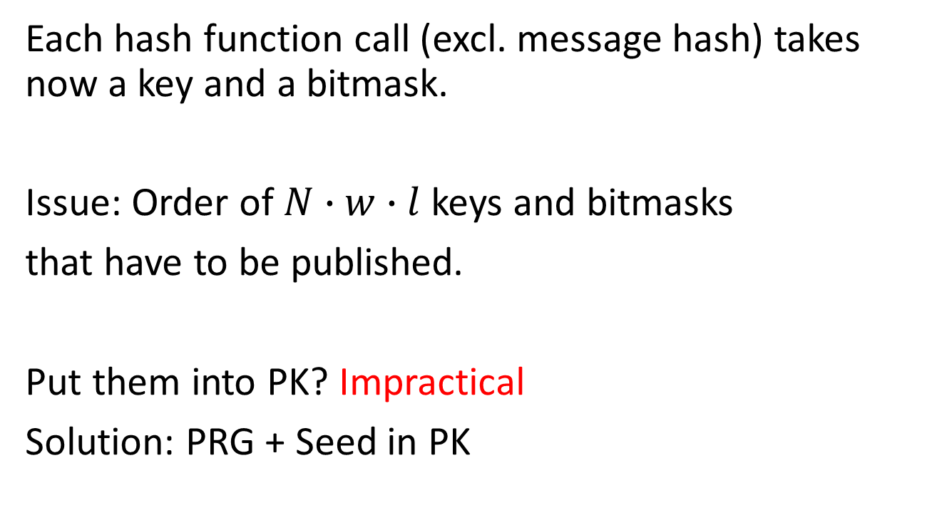
XMSS-Draft since -01
Each hash function call (excl. message hash) takes now a key and a bitmask.
Issue: Order of $N∙w∙l$ keys and bitmasks
that have to be published.
Put them into PK? Impractical
Solution: PRG + Seed in PK

Slide 23
XMSS-Draft since -01
Solution: PRG + Seed in PK
Security:
Not really standard model.
Natural but new assumption („Generating the public values using a PRG, the scheme does not get less secure if seed is published.“),
Or ROM

Slide 24
SPHINCS: practical stateless hash-based signatures
joint work with Daniel J. Bernstein, Daira Hopwood, Tanja Lange, Ruben Niederhagen, Louiza Papachristodoulou, Michael Schneider, Peter Schwabe, Zooko Wilcox O’Hearn

Slide 25
How to Eliminate the State

Slide 26
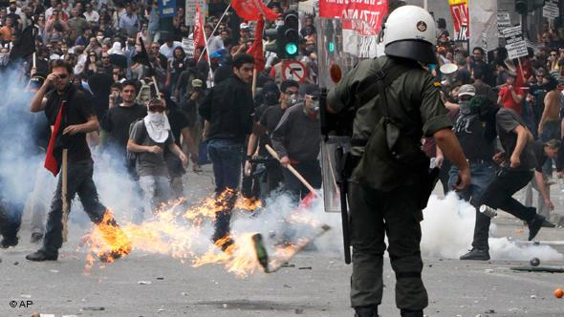
Protest?

Slide 27

Few-Time Signature Schemes

Slide 28
HORS [RR02]
Message M, OWF H, CRHF H’ = n bit
Parameters t=2ª,k, with m = ka (typical a=16, k=32)
SK
PK
*
sk₁
sk₂
sk_{t-1}
sk_{t}
H
H
H
H
H
H
pk₁
pk₁
pk_{t-1}
pk_{t}

Slide 29
HORS mapping function
Message M, OWF H, CRHF H’ = n bit
Parameters t=2ª,k, with m = ka (typical a=16, k=32)
*
M
H’
b₁
b₂
b_{a}
b_{ar}
i₁
i_{k}

Slide 30
HORS
Message M, OWF H, CRHF H’ = n bit
Parameters t=2ª,k, with m = ka (typical a=16, k=32)
*
SK
sk₁
sk₂
sk_{t-1}
sk_{t}
H
H
H
H
H
H
PK
pk₁
pk₁
pk_{t-1}
pk_{t}
H’(M)
b₁
b₂
b_{a}
b_{a+1}
b_{ka-2}
b_{ka-1}
b_{ka}
i₁
Mux
Mux
i_{k}
sk_{i1}
sk_{ik}

Slide 31
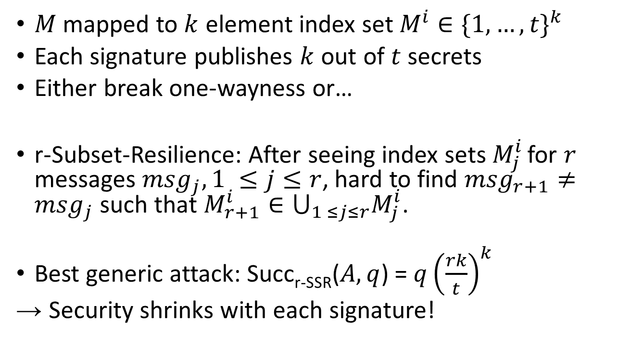
HORS Security
$M$ mapped to $k$ element index set $M^{i}∈{\{1,…,t\}}^{k}$
Each signature publishes $k$ out of $t$ secrets
Either break one-wayness or…
r-Subset-Resilience: After seeing index sets $M_{j}^{i}$ for $r$ messages ${msg}_{j}, 1 ≤j≤r$, hard to find ${msg}_{r+1}≠{msg}_{j}$ such that $M_{r+1}^{i}∈⋃_{1 ≤j≤r}M_{j}^{i}$.
Best generic attack: Succ_{r-SSR}($A,q$) = $q{\left(\frac{rk}{t}\right)}^{k}$
→ Security shrinks with each signature!

Slide 32
HORST
Using HORS with MSS requires adding PK (tn) to MSS signature.
HORST: Merkle Tree on top of HORS-PK
New PK = Root
Publish Authentication Paths for HORS signature values
PK can be computed from Sig
With optimizations: tn → (k(log t − x + 1) + 2^{x})n
  E.g. SPHINCS-256: 2 MB → 16 KB
Use randomized message hash

Slide 33
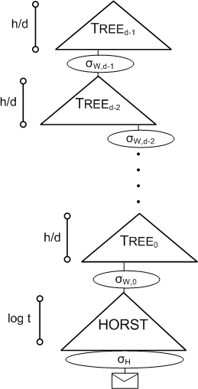
SPHINCS
Stateless Scheme
XMSS^{MT} + HORST
+ (pseudo-)random index
Collision-resilient
Deterministic signing
SPHINCS-256:
  128-bit post-quantum secure
  Hundrest of signatures / sec
  41 kb signature
  1 kb keys

Slide 34

Thank you!
Questions?
For references & further literature see
https://huelsing.wordpress.com/hash-based-signature-schemes/literature/

Slide 35




(Hash) function families
$H_{n}≔\left\{h_{k}:{\text{\{0,1\}}}^{m\left(n\right)}→{\text{\{0,1\}}}^{n}\right\}$
$m(n)≥n$
„efficient“
$${\text{\{0,1\}}}^{n}$$
$$h_{k}$$
$${\text{\{0,1\}}}^{m\left(n\right)}$$

Slide 36
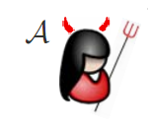



One-wayness
$$H_{n}≔\left\{h_{k}:{\text{\{0,1\}}}^{m\left(n\right)}→{\text{\{0,1\}}}^{n}\right\}$$
$$h_{k}\underset{←}{\$}H_{n}$$
$$x\underset{←}{\$}{\text{\{0,1\}}}^{m\left(n\right)}$$
$$y_{c}←h_{k}\left(x\right)$$
Success if $h_{k}\left(x^{∗}\right)=y_{c}$
$$y_{c},k$$
$$x^{∗}$$

Slide 37

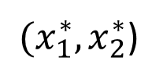

Collision resistance
$$H_{n}≔\left\{h_{k}:{\text{\{0,1\}}}^{m\left(n\right)}→{\text{\{0,1\}}}^{n}\right\}$$
$$h_{k}\underset{←}{\$}H_{n}$$
Success if
$$h_{k}\left(x_{1}^{∗}\right)=h_{k}\left(x_{2}^{∗}\right)$$
$$k$$
${(x}_{1}^{∗},x_{2}^{∗}$)

Slide 38



Second-preimage resistance
$$H_{n}≔\left\{h_{k}:{\text{\{0,1\}}}^{m\left(n\right)}→{\text{\{0,1\}}}^{n}\right\}$$
$$h_{k}\underset{←}{\$}H_{n}$$
$$x_{c}\underset{←}{\$}{\text{\{0,1\}}}^{m\left(n\right)}$$
Success if
$$h_{k}\left(x_{c}\right)=h_{k}\left(x^{∗}\right)$$
$$x_{c},k$$
$$x^{∗}$$

Slide 39

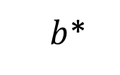

Undetectability
$$H_{n}≔\left\{h_{k}:{\text{\{0,1\}}}^{m\left(n\right)}→{\text{\{0,1\}}}^{n}\right\}$$
$$h_{k}\underset{←}{\$}H_{n}$$
$$b\underset{←}{\$}\{0,1\}$$
If $b=1$
$x\underset{←}{\$}{\text{\{0,1\}}}^{m\left(n\right)}$
$y_{c}←h_{k}(x)$
else
$y_{c}\underset{←}{\$}{\text{\{0,1\}}}^{n}$
$$y_{c},k$$
$b$*

Slide 40






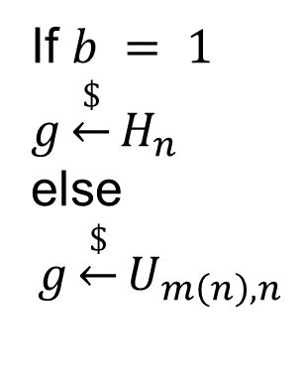
Pseudorandomness
$$H_{n}≔\left\{h_{k}:{\text{\{0,1\}}}^{m\left(n\right)}→{\text{\{0,1\}}}^{n}\right\}$$
$$1^{n}$$
$$b$$
$$x$$
If $b = 1$
$$g\underset{←}{\$}H_{n}$$
else
$$g\underset{←}{\$}U_{m\left(n\right),n}$$
g
$$y = g(x)$$
$b$*

Slide 41
WOTS Sizes and Runtimes
 | Lamport-Diffie | WOTS | WOTS$ | WOTS⁺
Public Key Size | 2bm | l 2b ~ 2bm/log w | l b (+b) ~ bm/log w | l b ( +(w-1)b ) ~ bm/log w
Secret Key Size | 2bm | l 2b ~ 2bm/log w | l b ~ bm/log w | l b ~ bm/log w
Signature Size | bm | l 2b ~ 2bm/log w | l b ~ bm/log w | l b ~ bm/log w
Key Generation Time | ~ 2m | l w ~ wm/log w | l w ~wm/log w | l w ~ wm/log w
Security level b, Winternitz parameter w, Message Length m,
l = l (w,m) ~ m / log w

