Slide 1
Long-term secure authenticity using hash-based signatures
Andreas Hülsing
PLLS 2018
17/09/2018

Slide 2

Requirements for long-term authenticity
Example: Land registry
Lifetime? 100+ years
Known solution:
  Digital Archiving with signature renewal
Requirements:
  Security of signature scheme must„fade out“ rather than „vanish suddenly“
  Can be achieved using double signature
What about quantum computers?
  How many different sigs do we need?

Slide 3
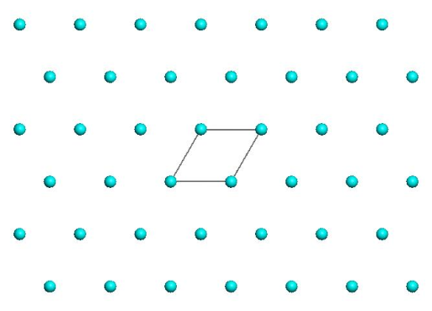
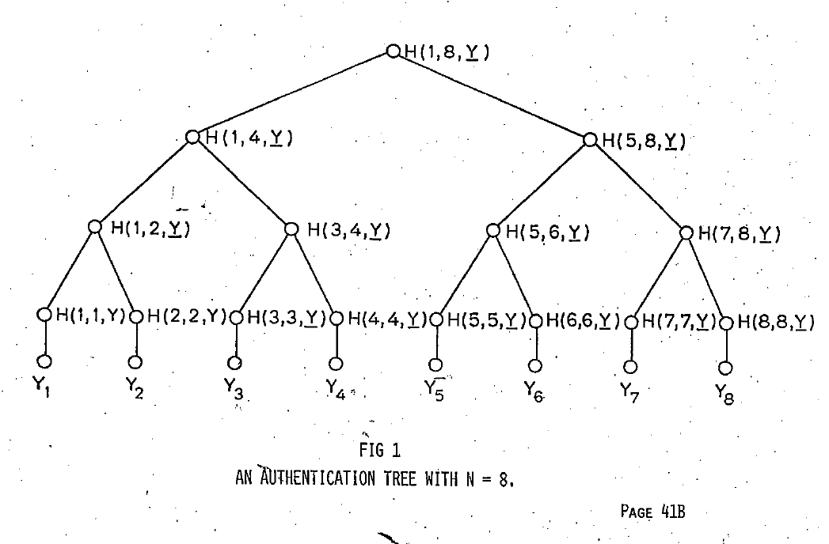
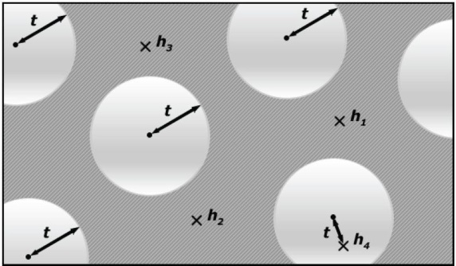
Post-quantum signature schemes
Proposals from all areas of post-quantum cryptography:
Lattice-based: SVP / CVP
Hash-based: CR / SPR / ...
New
Code-based: SD
Multivariate: MQ
Isogenies

Slide 4
Hash-based Signature Schemes [Mer89]
The conservative approach:
Instead of introducing new hardness assumptions...
...reduce the amount of assumptions

Slide 5
RSA – DSA – EC-DSA...
Intractability Assumption
Cryptographic
hash function
RSA, DH, SVP, MQ, …
Digital signature scheme

Slide 6
Hash function families

Slide 7




(Hash) function families
$H_{n}≔\left\{h_{k}:{\text{\{0,1\}}}^{m\left(n\right)}→{\text{\{0,1\}}}^{n}|k∈{\text{\{0,1\}}}^{n}\right\}$
$m(n)≥n$
„efficient“
$${\text{\{0,1\}}}^{n}$$
$$h_{k}$$
$${\text{\{0,1\}}}^{m\left(n\right)}$$

Slide 8
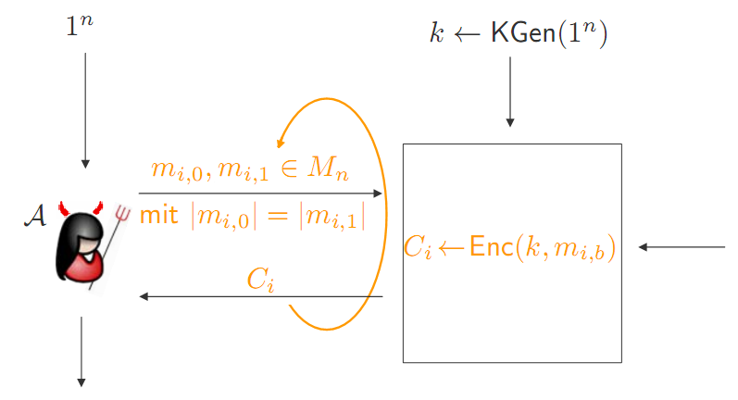



One-wayness
$$H_{n}≔\left\{h_{k}:{\text{\{0,1\}}}^{m\left(n\right)}→{\text{\{0,1\}}}^{n}\right\}$$
$$h_{k}\underset{←}{\$}H_{n}$$
$$x\underset{←}{\$}{\text{\{0,1\}}}^{m\left(n\right)}$$
$$y_{c}←h_{k}\left(x\right)$$
Success if $h_{k}\left(x^{∗}\right)=y_{c}$
$$y_{c},k$$
$$x^{∗}$$

Slide 9

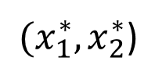

Collision resistance
$$H_{n}≔\left\{h_{k}:{\text{\{0,1\}}}^{m\left(n\right)}→{\text{\{0,1\}}}^{n}\right\}$$
$$h_{k}\underset{←}{\$}H_{n}$$
Success if
$h_{k}\left(x_{1}^{∗}\right)=h_{k}\left(x_{2}^{∗}\right)$ and
$$x_{1}^{∗}≠x_{2}^{∗}$$
$$k$$
${(x}_{1}^{∗},x_{2}^{∗}$)

Slide 10



Second-preimage resistance
$$H_{n}≔\left\{h_{k}:{\text{\{0,1\}}}^{m\left(n\right)}→{\text{\{0,1\}}}^{n}\right\}$$
$$h_{k}\underset{←}{\$}H_{n}$$
$$x_{c}\underset{←}{\$}{\text{\{0,1\}}}^{m\left(n\right)}$$
Success if
$h_{k}\left(x_{c}\right)=h_{k}\left(x^{∗}\right)$ and
$$x_{c}^{}≠x_{}^{∗}$$
$$x_{c},k$$
$$x^{∗}$$

Slide 11
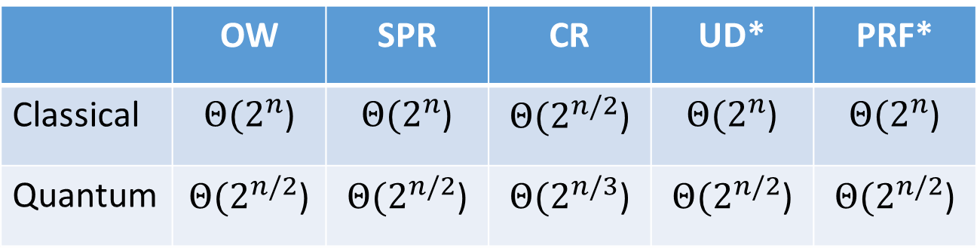
Generic Security
 | OW | SPR | CR | UD* | PRF*
Classical | $Θ(2^{n}$) | $Θ(2^{n}$) | $Θ(2^{n/2}$) | $Θ(2^{n}$) | $Θ(2^{n}$)
Quantum | $Θ(2^{n/2}$) | $Θ(2^{n/2}$) | $Θ(2^{n/3}$) | $Θ(2^{n/2}$) | $Θ(2^{n/2}$)
* conjectured, no proof

Slide 12

Basic Construction

Slide 13
Lamport-Diffie OTS [Lam79]
Message M = b1,…,bm, OWF H = n bit
SK
PK
Sig
*
sk_{1,0}
sk_{1,1}
sk_{m,0}
sk_{m,1}
H
H
H
H
H
H
pk_{1,0}
pk_{1,1}
pk_{m,0}
pk_{m,1}
b1
Mux
b2
Mux
bm
Mux
sk_{1,b1}
sk_{m,bm}

Slide 14
Security
Theorem:
If H is one-way then LD-OTS is one-time eu-cma-secure.

Slide 15




Merkle’s Hash-based Signatures
PK
SIG = (i=2, , , , , )
H
OTS
H
H
H
H
H
H
H
H
H
H
H
H
H
H
OTS
OTS
OTS
OTS
OTS
OTS
OTS
OTS
SK

Slide 16
Security
Theorem:
MSS is eu-cma-secure if OTS is a one-time eu-cma secure signature scheme and H is a random element from a family of collision resistant hash functions.

Slide 17
Winternitz-OTS

Slide 18



Function chains
Function family:${ H}_{n}≔\left\{h_{k}:{\text{\{0,1\}}}^{n}→{\text{\{0,1\}}}^{n}\right\}$
$$h_{k}\underset{←}{\$}H_{n}$$
Parameter $w$
Chain: $c^{i}\left(x\right)=h_{k}\left(c^{i−1}\left(x\right)\right)=h_{k}∘h_{k}∘…∘h_{k}$
i-times
c⁰(x) = x
$$c^{w−1}(x)$$
$c1(x) =h_{k}(x)$

Slide 19

WOTS
Winternitz parameter w, security parameter n, message length m, function family ${ H}_{n}$
Key Generation: Compute $l$, sample $h_{k}$
c⁰(sk₁) = sk₁
pk₁ = c^{w-1}(sk₁)
c¹(sk₁)
c¹(sk_{l} )
pk_{l} = c^{w-1}(sk_{l} )
c⁰(sk_{l} ) = sk_{l}
Notes:
One promissing group of candidates are hash-based signature schemes
They start from an OTS – a signature scheme where a key pair can only be used for one signature.
The central idea – proposed by Merkle - is to authenticate many OTS keypairs using a binary hash tree
These schemes have many advantages over the beforementioned
Quantum computers do not harm their security – the best known quantum attack is Grovers algorithm – allowing exhaustiv search in a set with n elements in time squareroot of n using log n space.
They are provably secure in the standard model
And they can be instantiated using any secure hash function.
On the downside, they produce long signatures.

Slide 20
WOTS Signature generation
M
b₁
b₂
b₃
b₄
…
…
…
…
…
…
…
b_{m‘}
b_{m‘+1}
b_{m‘+2}
…
…
b_{l}
c⁰(sk₁) = sk₁
pk₁ = c^{w-1}(sk₁)
C
σ₁=c^{b1}(sk₁)
Signature:
σ = (σ₁, …, σ_{l} )
pk_{l} = c^{w-1}(sk_{l} )
c⁰(sk_{l} ) = sk_{l}
σ_{l} =c^{bl} (sk_{l} )
Notes:
Well, this work is concerned with the OTS.
There are several OTS schemes. LD, Merkle-OTS which is a specific instance of the W-OTS, the BM-OTS and Biba and HORS.
The most interesting one is the Winternitz OTS as it allows for a time-memory trade-off and even more important
- It is possible to compute the public verification key given a signature. This reduces the signature size of a hash based signature scheme as normaly the public key of the OTS has to be included in a signature of the scheme. Now for WOTS this isn‘t necessary anymore.

Slide 21





WOTS Signature Verification
      Verifier knows: M, w
b₁
b₂
b₃
b₄
…
…
…
…
…
…
…
b_{m‘}
b_{m‘+1}
b_{l 1+2}
…
…
b_{l}
$c^{1}$ (σ₁)
$c^{3}$(σ₁)
pk₁
=?
σ₁
$c^{2}$(σ₁)
$c^{w−1−b_{1}}$ (σ₁)
Signature:
σ = (σ₁, …, σ_{l} )
pk_{l}
=?
σ_{l}
$c^{w−1−b_{l}}$ (σ_{l} )
Notes:
Well, this work is concerned with the OTS.
There are several OTS schemes. LD, Merkle-OTS which is a specific instance of the W-OTS, the BM-OTS and Biba and HORS.
The most interesting one is the Winternitz OTS as it allows for a time-memory trade-off and even more important
- It is possible to compute the public verification key given a signature. This reduces the signature size of a hash based signature scheme as normaly the public key of the OTS has to be included in a signature of the scheme. Now for WOTS this isn‘t necessary anymore.

Slide 22

WOTS Function Chains
For $x∈{\left\{0,1\right\}}^{n}$define $c^{0}\left(x\right)=x$ and
WOTS: $c^{i}\left(x\right)=h_{k}(c^{i−1}\left(x\right))$
WOTS⁺: $c^{i}\left(x\right)=h_{k}(c^{i−1}\left(x\right) ⨁{ r}_{i})$

Slide 23
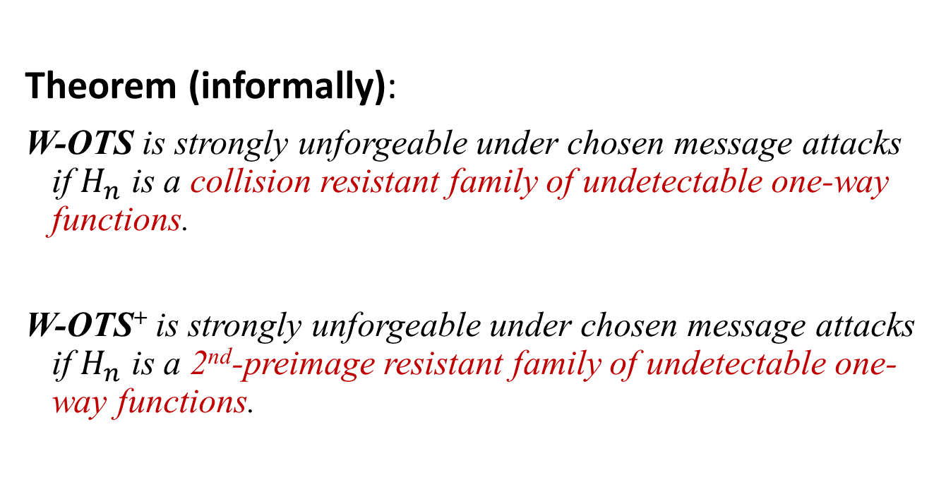
WOTS Security
Theorem (informally):
W-OTS is strongly unforgeable under chosen message attacks if $H_{n}$ is a collision resistant family of undetectable one-way functions.
W-OTS⁺ is strongly unforgeable under chosen message attacks if $H_{n}$ is a 2nd-preimage resistant family of undetectable one-way functions.
Notes:
In our work we showed that we can slightly change the original WOTS construction, such that it uses a function family instead of the hash function family. The resulting scheme is existentially unforgeable under chosen message attacks, if the function family is pseudorandom.
This result has two implications:

Slide 24
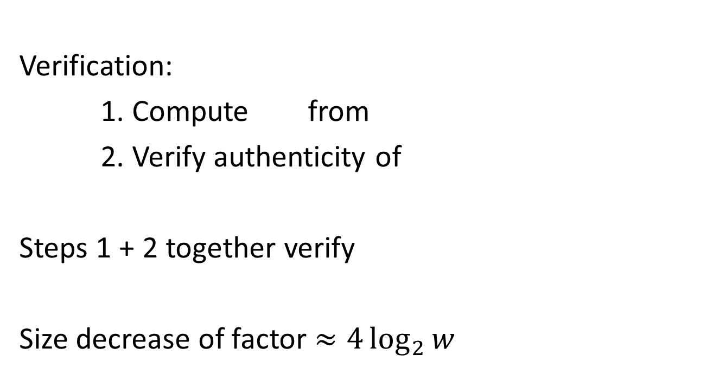
WOTS in MSS
X
SIG = (i=2, , , , , )
Verification:
1. Compute from
2. Verify authenticity of
Steps 1 + 2 together verify
Size decrease of factor $≈4\log_{2}{w}$

Slide 25
XMSS

Slide 26
XMSS
Applies several tricks to achieve collision-resilience
-> signature size halved
Tree: Uses bitmasks
Leafs: Use binary tree
with bitmasks
OTS: WOTS⁺
Mesage digest:
Randomized hashing
b_{i}

Slide 27
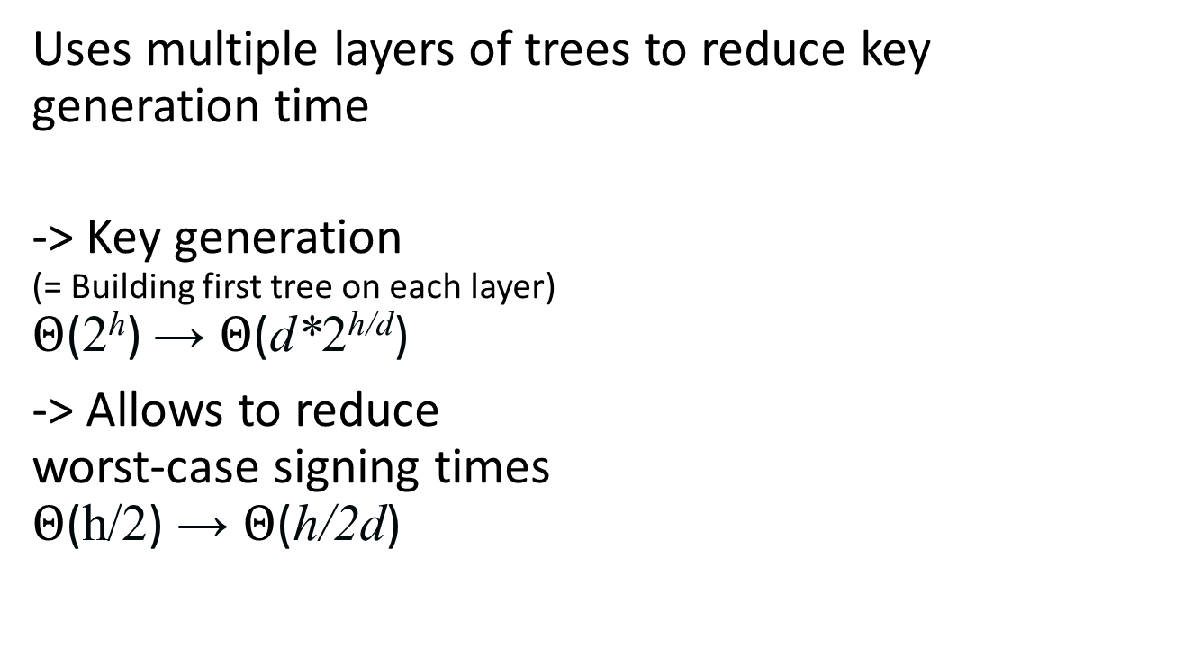
Multi-Tree XMSS
Uses multiple layers of trees to reduce key generation time
-> Key generation
(= Building first tree on each layer)
$Θ$(2^{h}) → $Θ$(d*2^{h/d})
-> Allows to reduce
worst-case signing times
$Θ$(h/2) → $Θ$(h/2d)

Slide 28
Multi-target attack mitigation
Problem: An attack that succeeds when it solves one out of many instances (targets)
  Typical case: Security level drops by log t for t instances
XMSS-T / LMS / SPHINCS+ apply mitigation techniques:
  Attack complexity for t targets becomes same as for 1 target
  Solution: Tweakable hash function
  Idea: Make hash calls independent
  XMSS-T / SPHINCS+ in standard model with an additional assumption (that holds in QROM)
  LMS in (Q)ROM

Slide 29
What if long-term security is needed?

Slide 30
Hash-function properties
stronger / easier to break
Collision-Resistance
Assumption / Attacks
2nd-Preimage-Resistance
One-way
Pseudorandom
weaker /
harder to break

Slide 31
This hardness gap can be used as early warning system!

Slide 32
Attacks on Hash Functions
MD5
Collisions
(theo.)
MD5
Collisions
(practical!)
SHA1
Collisions
(practical!)
SHA1
Collisions
(theo.)
MD5 & SHA-1
No (Second-) Preimage Attacks!
2004
2005
2008
2017

Slide 33
Cheap Redundancy
Hash-Combiner
- Collision-Resistance / 2nd-Preimage-Resistance:
- PRF:
No sudden break
Changes only in hash function
Replaces double signature
Signature size and runtime doubled

Slide 34



Forward Security

Slide 35
Forward Security - cont‘d
pk
classical
sk
pk
forward sec
sk
sk₁
sk₂
sk_{i}
sk_{T}
t_{T}
time
t₁
t₂
t_{i}
Key gen.

Slide 36
XMSS in practice

Slide 37
RFC 8391: XMSS
RFC since May 2018
NIST promised to adopt
Equal to XMSS-T [HRS16] up-to message digest
Function families based on SHA2 or SHAKE
Mandatory: Support for verification with all SHA2-256 parameter sets
Suggested parameters for different szenarios

Slide 38
XMSS / XMSS-T Implementation
C Implementation, using OpenSSL [HRS16]
 | Sign (ms) | Signature (kB) | Public Key (kB) | Secret Key (kB) | Bit Security classical/ quantum | Comment
XMSS | 3.24 | 2.8 | 1.3 | 2.2 | 236 / 118 | h = 20, d = 1,
XMSS-T | 9.48 | 2.8 | 0.064 | 2.2 | 256 / 128 | h = 20, d = 1
XMSS | 3.59 | 8.3 | 1.3 | 14.6 | 196 / 98 | h = 60, d = 3
XMSS-T | 10.54 | 8.3 | 0.064 | 14.6 | 256 / 128 | h = 60, d = 3
Intel(R) Core(TM) i7 CPU @ 3.50GHz
All using SHA2-256, w = 16 and k = 2
Notes:
2013: 80 bit
84 -> 2019
87 -> 2022
157 -> 2113

Slide 39
SPHINCS

Slide 40

About the statefulness
Works great for some settings
However....
... back-up
... multi-threading
... load-balancing

Slide 41
How to Eliminate the State

Slide 42
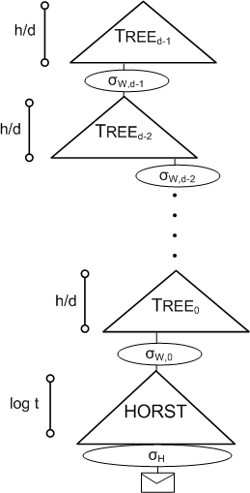
SPHINCS
Stateless Scheme
XMSS^{MT} + HORST
+ (pseudo-)random index
Collision-resilient
Deterministic signing
SPHINCS-256:
  128-bit post-quantum secure
  (at least we thought so)
  Hundreds of signatures / sec
  41 kb signature
  1 kb keys

Slide 43
SPHINCS⁺ (our NIST submission)
Strengthened security gives smaller signatures
Collision- and multi-target attack resilient
Small keys, medium size signatures (lv 3: 17kB)
THE conservative choice
No citable speeds yet

Slide 44
Instantiations
SPHINCS⁺-SHAKE256
SPHINCS⁺-SHA-256
SPHINCS⁺-Haraka

Slide 45
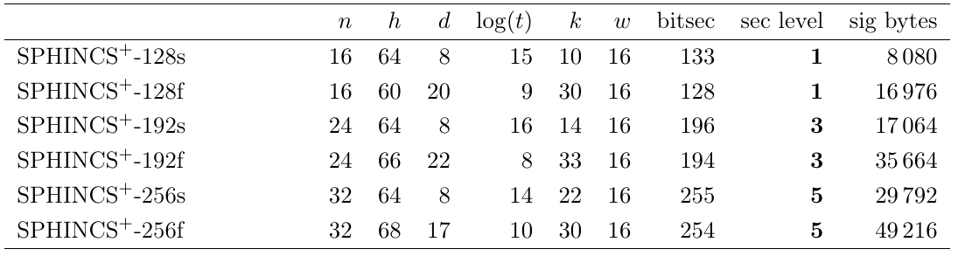
Instantiations (small vs fast)

Slide 46
Conclusion
Practical stateful and stateless solutions
Forward-security only possible for stateful schemes!
Stateful only if you are 100% sure you can handle state
My suggestion: Stateful on dedicated HW (Smartcard, HSM,...)
Everywhere else: In case of doubt use stateless

Slide 47

Thank you!
Questions?
For references, literature & longer lectures see https://huelsing.net

