Slide 1
An attempt to simplify security arguments for hash-based signatures
Andreas Hülsing
Eindhoven University of Technology
Oxford Post-Quantum Cryptography Workshop 2019

Slide 2
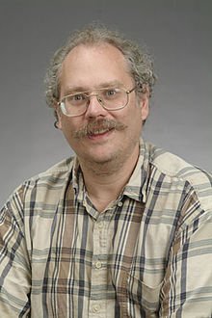
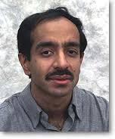
The quantum threat
Shor’s algorithm breaks RSA,
(EC)DSA, (EC)DH,…
Grover’s algorithm asymptotically
reduces complexity of brute-force
search attacks by a square-root
factor.

Slide 3

Why care today
EU launched a one billion Euro project on quantum technologies
Similar range is spent in China
US administration passed a bill on spending $1.275 billion US dollar on quantum computing research
Google, IBM, Microsoft, Alibaba, and others run their own research programs.

Slide 4
It‘s a question of risk assessment

Slide 5
Real world cryptography development
Develop systems
Analyze security
Implement systems
Analyze implementation security
Select best systems and standardize them
Integrate systems into products & protocols
Role out secure products

Slide 6
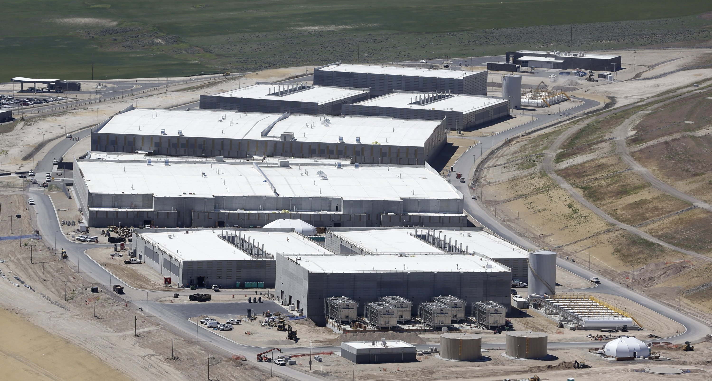


Who would store all encrypted data traffic?
That must be expensive!
$1.5B

Slide 7


Long-lived systems
Development time easily 10+ years
Lifetime easily 10+ years
At least make sure you got a
secure update channel!

Slide 8
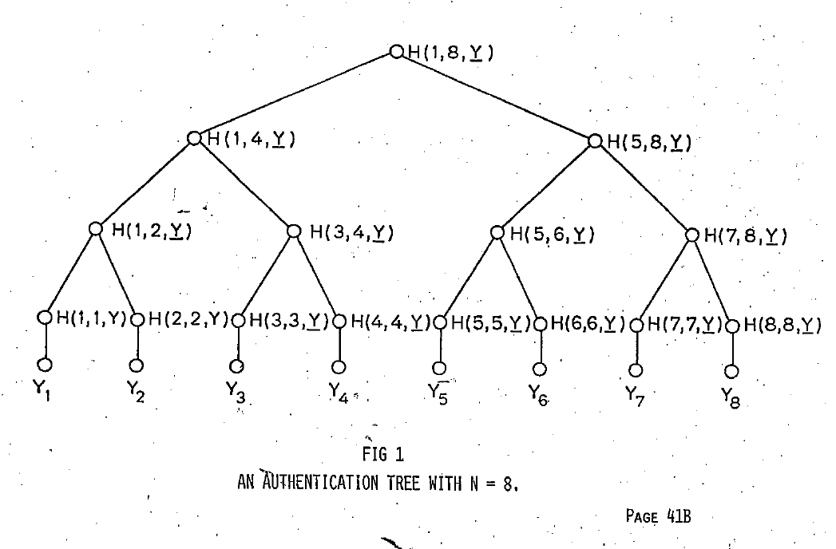
Hash-based signatures
[Lam79,Mer89]
No new hardness assumptions
Provably (post-quantum) secure if
(post-quantum) secure
hash function is used
Basic concept extremely easy
Stateful

Slide 9

Basic construction

Slide 10
Lamport OTS [Lam79]
Message M = b1,…,bm, OWF H = n bit
SK
PK
Sig
*
sk_{1,0}
sk_{1,1}
sk_{m,0}
sk_{m,1}
H
H
H
H
H
H
pk_{1,0}
pk_{1,1}
pk_{m,0}
pk_{m,1}
b1
Mux
b2
Mux
bm
Mux
sk_{1,b1}
sk_{m,bm}

Slide 11




Merkle’s Hash-based Signatures
PK
SIG = (i=2, , , , , )
H
OTS
H
H
H
H
H
H
H
H
H
H
H
H
H
H
OTS
OTS
OTS
OTS
OTS
OTS
OTS
OTS
SK

Slide 12
Winternitz-OTS

Slide 13
Lamport-OTS in MSS
SIG = (i=2, , , , , )
Verification:
1. Verify
2. Verify authenticity of
We can do better!

Slide 14
WOTS in MSS
X
SIG = (i=2, , , , , )
Verification:
1. Compute from
2. Verify authenticity of
Steps 1 + 2 together verify

Slide 15



Function chains
Hash function $h :{\text{\{0,1\}}}^{n}→{\text{\{0,1\}}}^{n}$
Parameter $w$
Chain: $c^{i}\left(x\right)=h\left(c^{i−1}\left(x\right)\right)=h∘h∘…∘h(x)$
i-times
c⁰(x) = x
$$c^{w−1}(x)$$
$c1(x) =h(x)$

Slide 16

WOTS
Winternitz parameter w (usually a power of 2), security parameter n, message length m, hash function $h$
Key Generation: Compute $l$, sample $h_{k}$
c⁰(sk₁) = sk₁
pk₁ = c^{w-1}(sk₁)
c¹(sk₁)
c¹(sk_{l} )
pk_{l} = c^{w-1}(sk_{l} )
c⁰(sk_{l} ) = sk_{l}
Notes:
One promissing group of candidates are hash-based signature schemes
They start from an OTS – a signature scheme where a key pair can only be used for one signature.
The central idea – proposed by Merkle - is to authenticate many OTS keypairs using a binary hash tree
These schemes have many advantages over the beforementioned
Quantum computers do not harm their security – the best known quantum attack is Grovers algorithm – allowing exhaustiv search in a set with n elements in time squareroot of n using log n space.
They are provably secure in the standard model
And they can be instantiated using any secure hash function.
On the downside, they produce long signatures.

Slide 17
WOTS Signature generation
M
b₁
b₂
b₃
b₄
…
…
…
…
…
…
…
b_{m‘}
b_{m‘+1}
b_{m‘+2}
…
…
b_{l}
c⁰(sk₁) = sk₁
pk₁ = c^{w-1}(sk₁)
C
σ₁=c^{b1}(sk₁)
Signature:
σ = (σ₁, …, σ_{l} )
pk_{l} = c^{w-1}(sk_{l} )
c⁰(sk_{l} ) = sk_{l}
σ_{l} =c^{bl} (sk_{l} )
Notes:
Well, this work is concerned with the OTS.
There are several OTS schemes. LD, Merkle-OTS which is a specific instance of the W-OTS, the BM-OTS and Biba and HORS.
The most interesting one is the Winternitz OTS as it allows for a time-memory trade-off and even more important
- It is possible to compute the public verification key given a signature. This reduces the signature size of a hash based signature scheme as normaly the public key of the OTS has to be included in a signature of the scheme. Now for WOTS this isn‘t necessary anymore.

Slide 18





WOTS Signature Verification
      Verifier knows: M, w
b₁
b₂
b₃
b₄
…
…
…
…
…
…
…
b_{m‘}
b_{m‘+1}
b_{l 1+2}
…
…
b_{l}
$c^{1}$ (σ₁)
$c^{3}$(σ₁)
pk₁
=?
σ₁
$c^{2}$(σ₁)
$c^{w−1−b_{1}}$ (σ₁)
Signature:
σ = (σ₁, …, σ_{l} )
pk_{l}
=?
σ_{l}
$c^{w−1−b_{l}}$ (σ_{l} )
Notes:
Well, this work is concerned with the OTS.
There are several OTS schemes. LD, Merkle-OTS which is a specific instance of the W-OTS, the BM-OTS and Biba and HORS.
The most interesting one is the Winternitz OTS as it allows for a time-memory trade-off and even more important
- It is possible to compute the public verification key given a signature. This reduces the signature size of a hash based signature scheme as normaly the public key of the OTS has to be included in a signature of the scheme. Now for WOTS this isn‘t necessary anymore.

Slide 19
Multi-Tree MSS

Slide 20
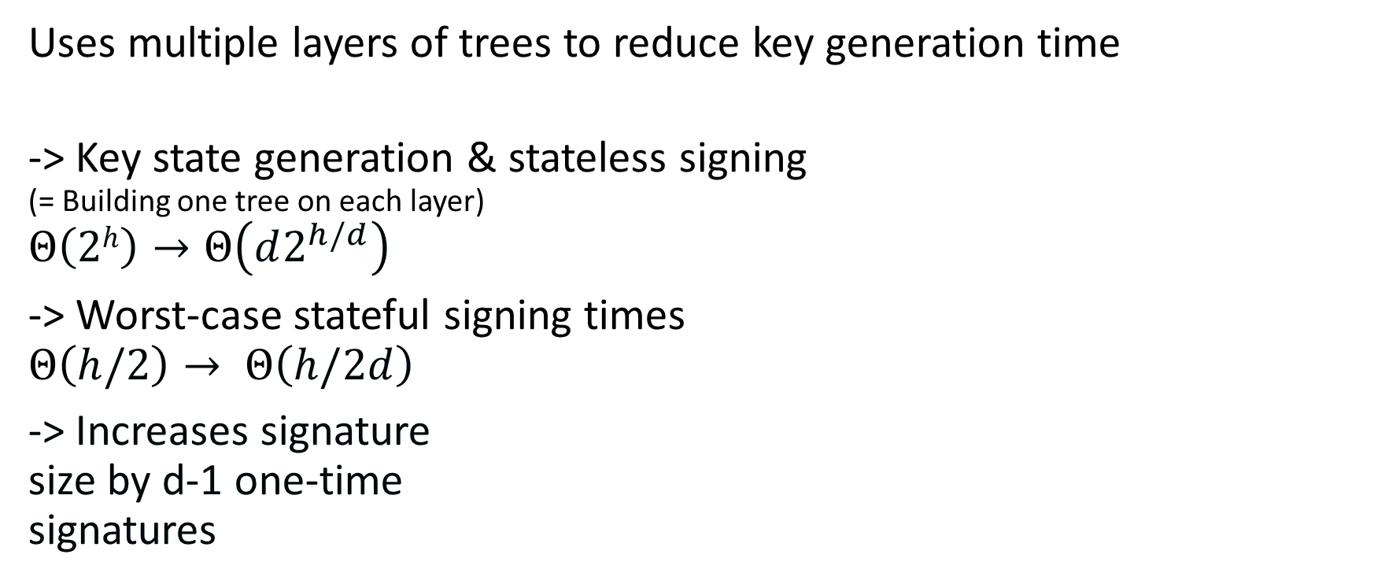
Multi-Tree MSS / Hypertree
Uses multiple layers of trees to reduce key generation time
-> Key state generation & stateless signing
(= Building one tree on each layer)
$$Θ\left(2h\right)→Θ\left(d2^{h/d}\right)$$
-> Worst-case stateful signing times
$$Θ\left(h/2\right)→ Θ\left(h/2d\right)$$
-> Increases signature
size by d-1 one-time
signatures

Slide 21
SPHINCS

Slide 22
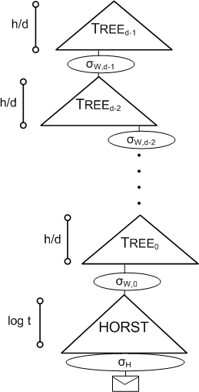
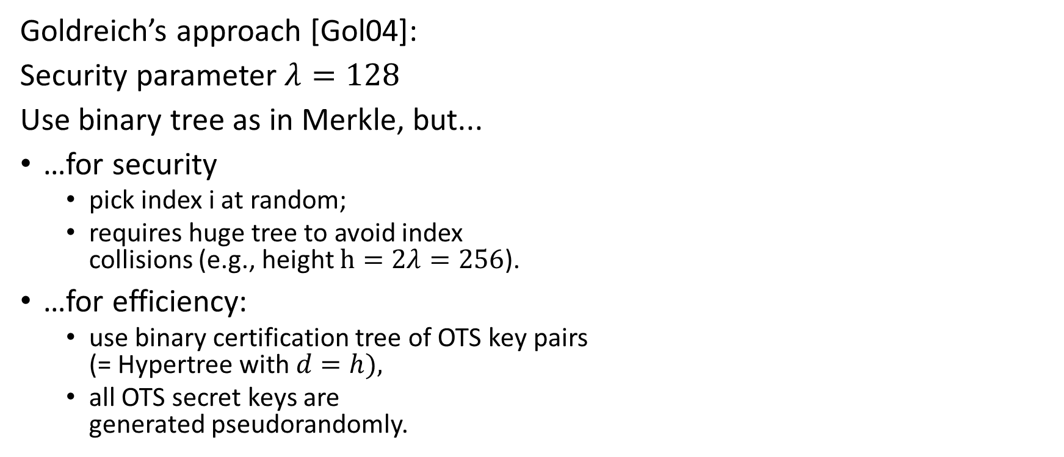
Stateless hash-based signatures [NY89,Gol87,Gol04]
OTS
Goldreich’s approach [Gol04]:
Security parameter $λ=128$
Use binary tree as in Merkle, but...
…for security
  pick index i at random;
  requires huge tree to avoid index
  collisions (e.g., height $h=2λ=256$).
…for efficiency:
  use binary certification tree of OTS key pairs
  (= Hypertree with $d=h),$
  all OTS secret keys are
  generated pseudorandomly.
OTS
OTS
OTS
OTS
OTS
OTS
OTS
OTS

Slide 23
SPHINCS [BHH⁺15]
Select index pseudo-randomly
Use a few-time signature key-pair on
leaves to sign messages
  Few index collisions allowed
  Allows to reduce tree height
Use hypertree: Use d << h.

Slide 24
Security arguments

Slide 25
Requirements
Reductions should lead to
collision-resilience,
multi-target attack protection,
tight security reductions,
and allow for
easy verification, and
maintainability.

Slide 26
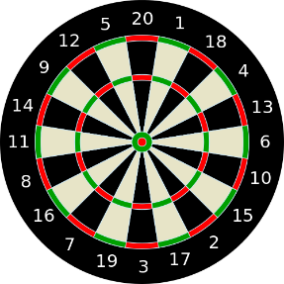
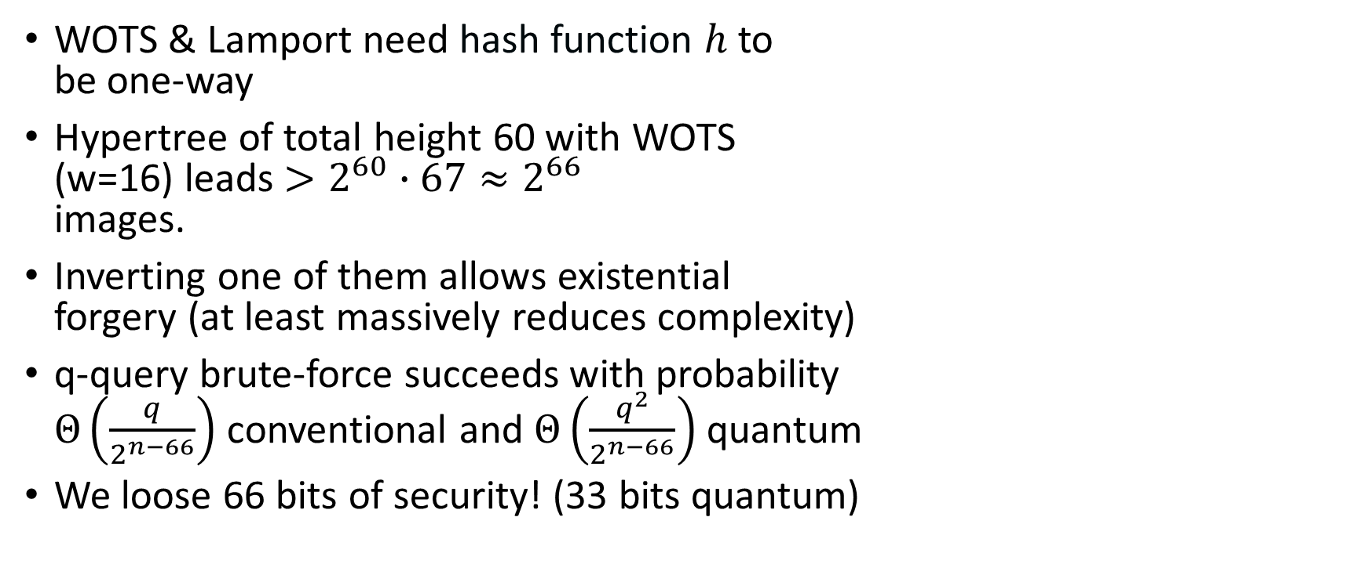
Multi-target attacks
WOTS & Lamport need hash function $h$ to
be one-way
Hypertree of total height 60 with WOTS
(w=16) leads $>2^{60}∙67≈2^{66}$
images.
Inverting one of them allows existential
forgery (at least massively reduces complexity)
q-query brute-force succeeds with probability
$Θ\left(\frac{q}{2^{n−66}}\right)$ conventional and $Θ\left(\frac{q^{2}}{2^{n−66}}\right)$ quantum
We loose 66 bits of security! (33 bits quantum)

Slide 27
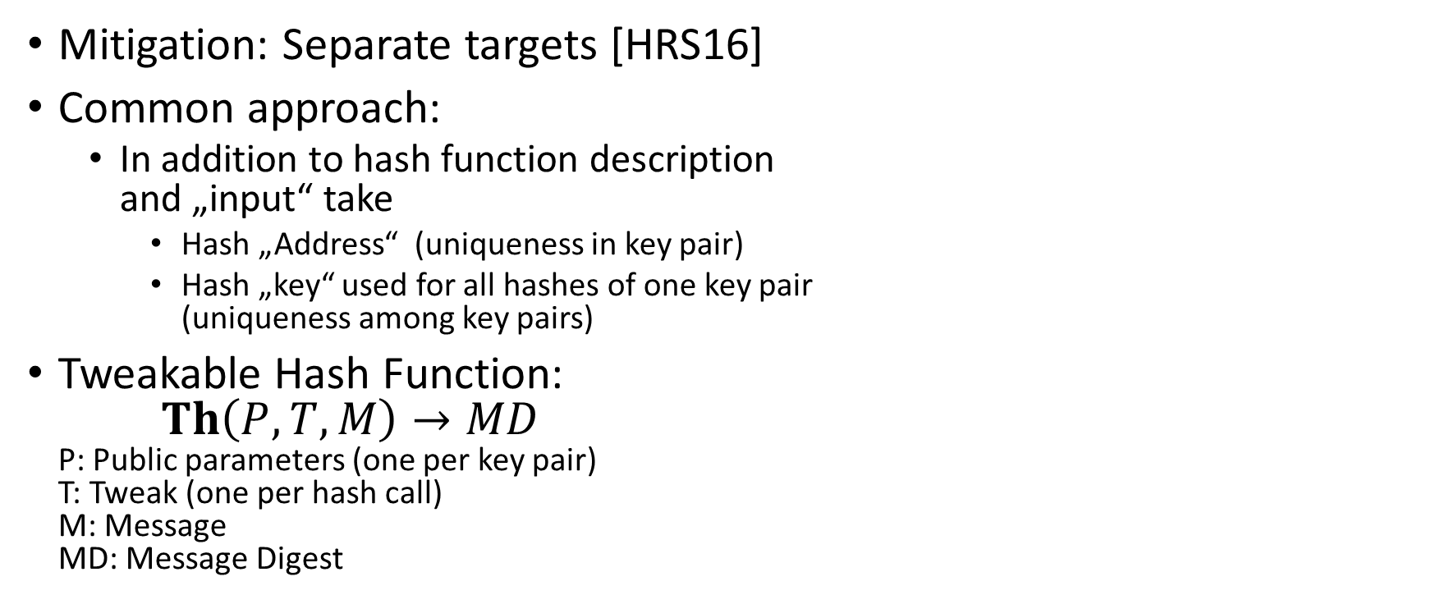
Multi-target attacks: Mitigation
Mitigation: Separate targets [HRS16]
Common approach:
  In addition to hash function description
  and „input“ take
    Hash „Address“ (uniqueness in key pair)
    Hash „key“ used for all hashes of one key pair
    (uniqueness among key pairs)
Tweakable Hash Function:
$Th\left(P, T, M\right)→MD$
P: Public parameters (one per key pair)
T: Tweak (one per hash call)
M: Message
MD: Message Digest

Slide 28
Multi-target attacks: Mitigation
Mitigation: Separate targets [HRS16]
Common approach:
  In addition to hash function description
  and „input“ take
    Hash „Address“ (uniqueness in key pair)
    Hash „key“ used for all hashes of one key pair
    (uniqueness among key pairs)

Slide 29
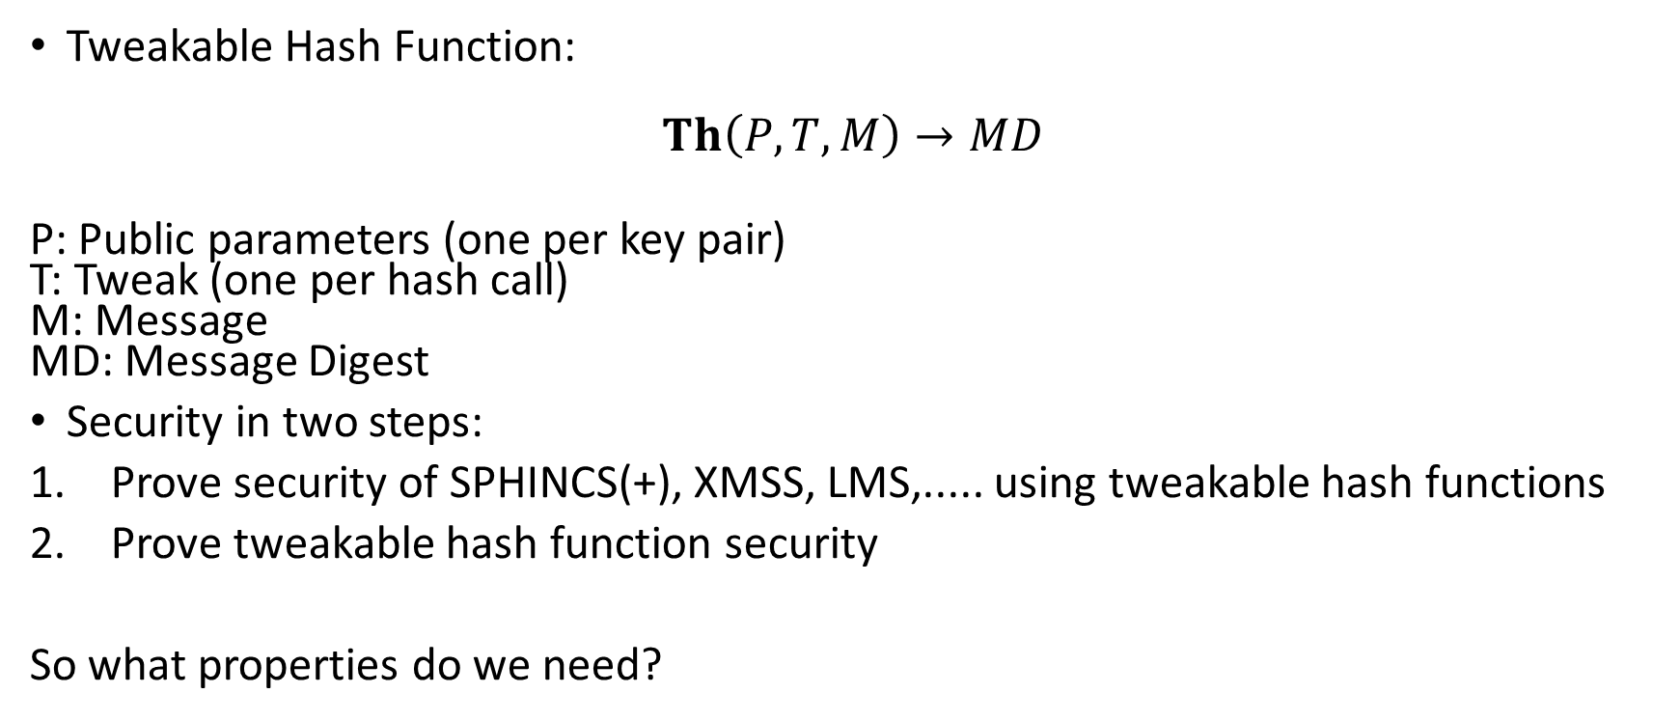
New intermediate abstraction:
Tweakable Hash Function
Tweakable Hash Function:
$$Th\left(P, T, M\right)→MD$$
P: Public parameters (one per key pair)
T: Tweak (one per hash call)
M: Message
MD: Message Digest
Security in two steps:
Prove security of SPHINCS(+), XMSS, LMS,..... using tweakable hash functions
Prove tweakable hash function security
So what properties do we need?

Slide 30
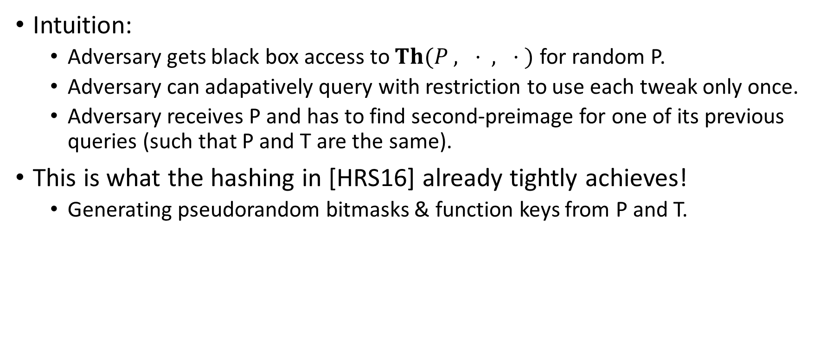
Single-function multi-target collision resistance for distinct tweaks
Intuition:
  Adversary gets black box access to $Th(P , ⋅ , ⋅ )$ for random P.
  Adversary can adapatively query with restriction to use each tweak only once.
  Adversary receives P and has to find second-preimage for one of its previous queries (such that P and T are the same).
This is what the hashing in [HRS16] already tightly achieves!
  Generating pseudorandom bitmasks & function keys from P and T.

Slide 31
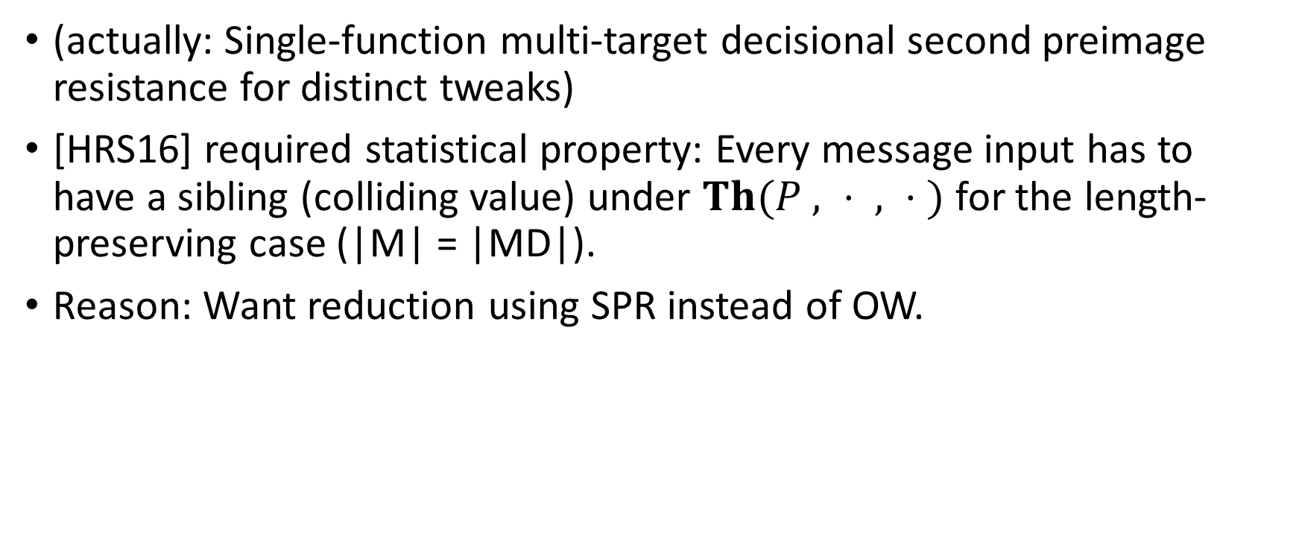
Decisional second-preimage resistance
(actually: Single-function multi-target decisional second preimage resistance for distinct tweaks)
[HRS16] required statistical property: Every message input has to have a sibling (colliding value) under $Th(P , ⋅ , ⋅ )$ for the length-preserving case (|M| = |MD|).
Reason: Want reduction using SPR instead of OW.

Slide 32
WOTS reduction from PRE
(assume adversary that always inverts one of the signature query elements)
b₁
b₂
b₃
b₄
…
…
…
…
…
…
…
b_{m‘}
b_{m‘+1}
b_{m‘+2}
…
…
b_{l}
pk₁ = c^{w-1}(sk₁)
σ₁= target1
Signature:
σ = (σ₁, …, σ_{l} )
pk_{l} = c^{w-1}(sk_{l} )
σ_{l} = target l
Notes:
Well, this work is concerned with the OTS.
There are several OTS schemes. LD, Merkle-OTS which is a specific instance of the W-OTS, the BM-OTS and Biba and HORS.
The most interesting one is the Winternitz OTS as it allows for a time-memory trade-off and even more important
- It is possible to compute the public verification key given a signature. This reduces the signature size of a hash based signature scheme as normaly the public key of the OTS has to be included in a signature of the scheme. Now for WOTS this isn‘t necessary anymore.

Slide 33
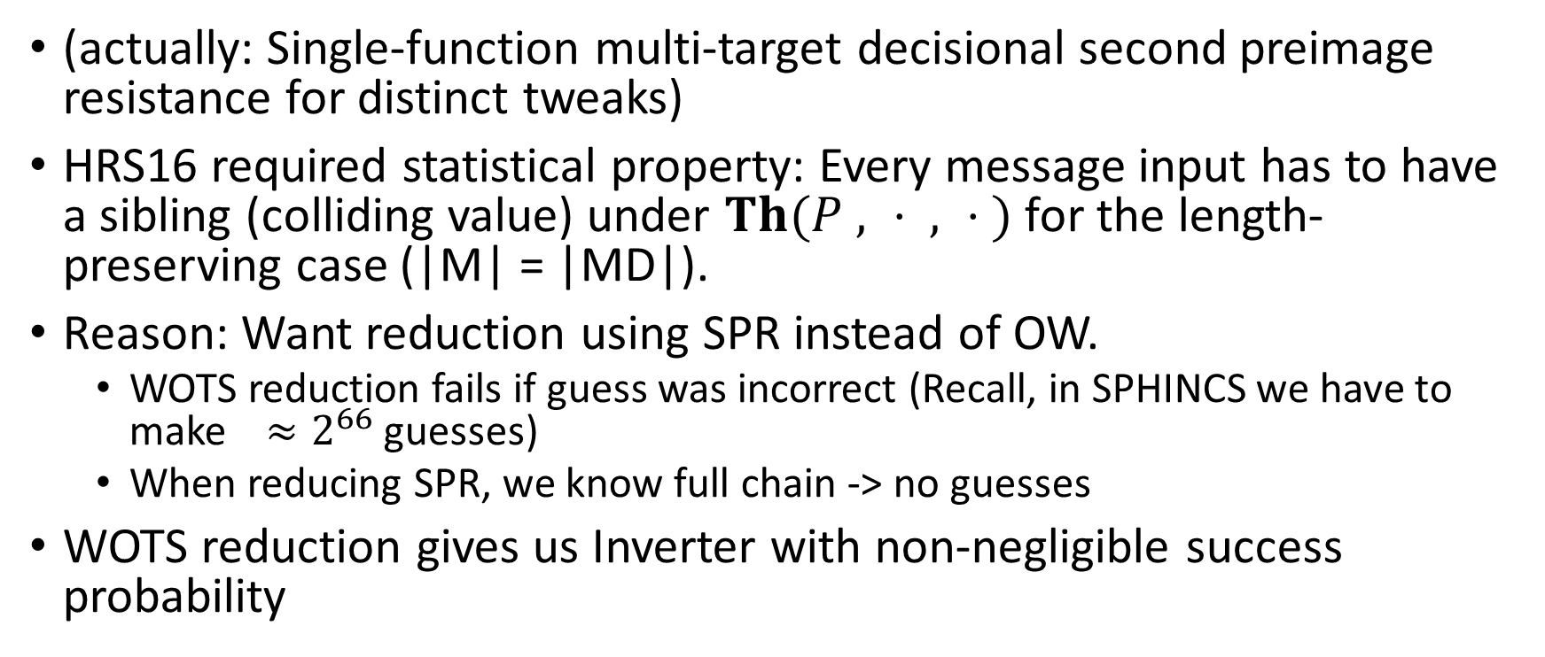
Decisional second-preimage resistance
(actually: Single-function multi-target decisional second preimage resistance for distinct tweaks)
HRS16 required statistical property: Every message input has to have a sibling (colliding value) under $Th(P , ⋅ , ⋅ )$ for the length-preserving case (|M| = |MD|).
Reason: Want reduction using SPR instead of OW.
  WOTS reduction fails if guess was incorrect (Recall, in SPHINCS we have to make $≈2^{66}$ guesses)
  When reducing SPR, we know full chain -> no guesses
WOTS reduction gives us Inverter with non-negligible success probability

Slide 34
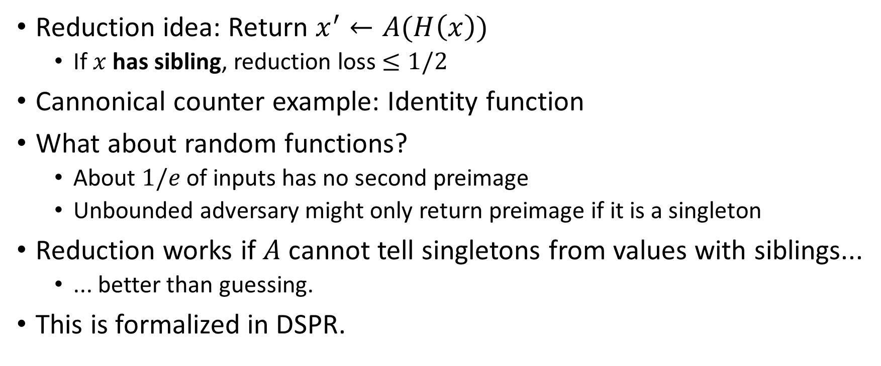
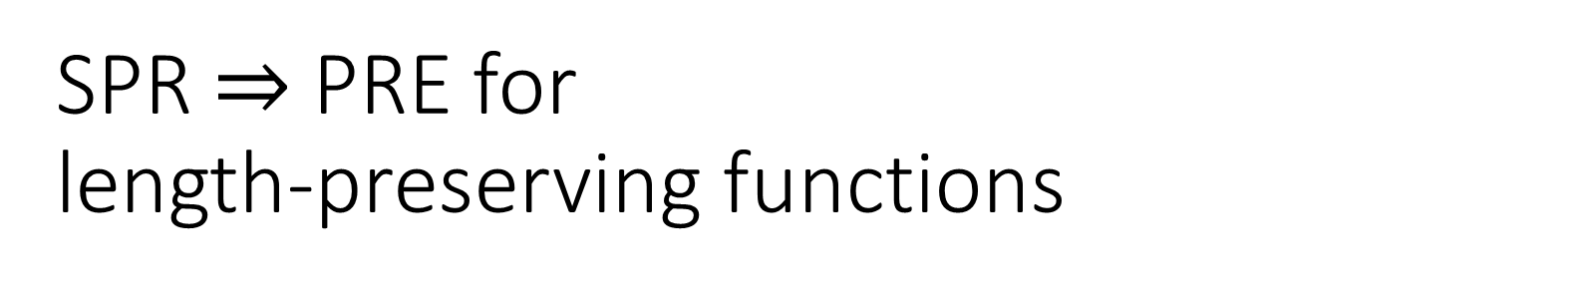
SPR $⇒$ PRE for length-preserving functions
Reduction idea: Return $x^{′}←A(H\left(x\right))$
  If $x$ has sibling, reduction loss $≤1/2$
Cannonical counter example: Identity function
What about random functions?
  About $1/e$ of inputs has no second preimage
  Unbounded adversary might only return preimage if it is a singleton
Reduction works if $A$ cannot tell singletons from values with siblings...
  ... better than guessing.
This is formalized in DSPR.

Slide 35
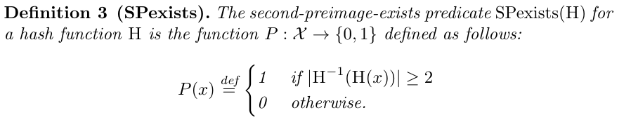
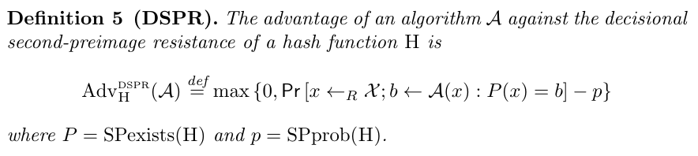
DSPR

Slide 36
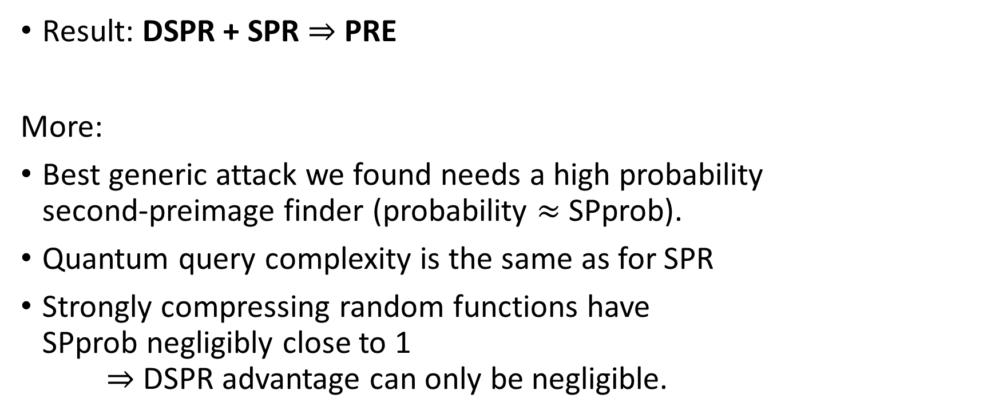
DSPR
Result: DSPR + SPR $⇒$ PRE
More:
Best generic attack we found needs a high probability
second-preimage finder (probability $≈$ SPprob).
Quantum query complexity is the same as for SPR
Strongly compressing random functions have
SPprob negligibly close to 1
$⇒$ DSPR advantage can only be negligible.

Slide 37
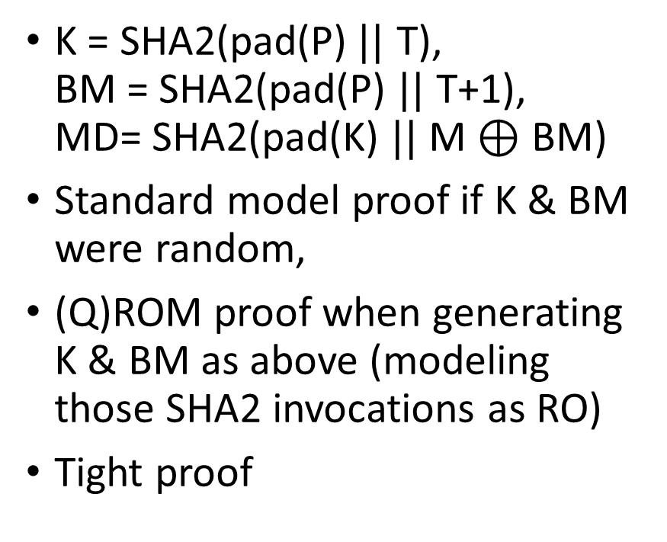

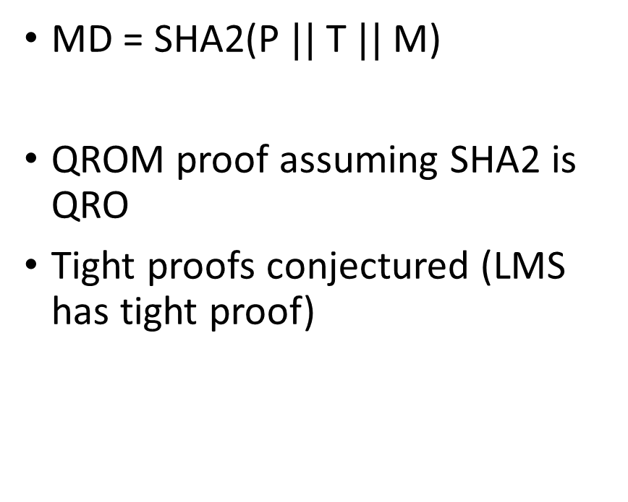

Instantiating the tweakable hash
(for SHA2)
SPHINCS⁺-robust ($≈$XMSS)
SPHINCS⁺- simple ($≈$LMS)
K = SHA2(pad(P)$||$ T),
BM = SHA2(pad(P) $||$ T+1),
MD= SHA2(pad(K) $||$ M$⊕$ BM)
Standard model proof if K & BM were random,
(Q)ROM proof when generating K & BM as above (modeling those SHA2 invocations as RO)
Tight proof
MD = SHA2(P $||$ T $||$ M)
QROM proof assuming SHA2 is QRO
Tight proofs conjectured (LMS has tight proof)

Slide 38
Instantiating the tweakable hash
SPHINCS⁺-simple is factor 3 faster
SPHINCS⁺-simple makes somewhat stronger assumptions about the security properties of the used hash function
More research on direct constructions needed

Slide 39

Thank you!
Questions?
For references, literature & longer lectures see https://huelsing.net

Slide 40
SPHINCS⁺
Joint work with Daniel J. Bernstein, Christoph Dobraunig, Maria Eichlseder, Scott Fluhrer, Stefan-Lukas Gazdag, Panos Kampanakis, Stefan Kölbl, Tanja Lange, Martin M. Lauridsen, Florian Mendel, Ruben Niederhagen, Christian Rechberger, Joost Rijneveld, Peter Schwabe

Slide 41
SPHINCS⁺ (our NIST submission)
Strengthened security gives smaller signatures
Collision- and multi-target attack resilient (XMSS tweakable hash)
Fixed length signatures
Small keys, medium size signatures (lv 3: 17kB)
Sizes can be much smaller if q_sign gets reduced
The conservative choice

Slide 42
FORS (Forest of random subsets)
Parameters t, a = log t, k such that ka = m
...
...
...
...
...

Slide 43
Verifiable index selection
(and optionally non-deterministic randomness)
SPHINCS:
$$(idx||R) =PRF(SK.prf,M)$$
$$md= H_{msg} (R, PK, M)$$
SPHINCS⁺:
$$R = PRF(SK.prf, OptRand, M)$$
$$(md||idx) = H_{msg} (R, PK, M)$$

Slide 44
Verifiable index selection
Improves FORS security
SPHINCS: Attacks can target „weakest“ HORST key pair
SPHINCS⁺: Every hash query also selects FORS key pair
  Leads to notion of interleaved target subset resilience

Slide 45
Instantiations
(after second round tweaks)
SPHINCS⁺-SHAKE256-robust
SPHINCS⁺-SHAKE256-simple
SPHINCS⁺-SHA-256-robust
SPHINCS⁺-SHA-256-simple
SPHINCS⁺-Haraka-robust
SPHINCS⁺-Haraka-simple
NEW!
NEW!
NEW!

Slide 46
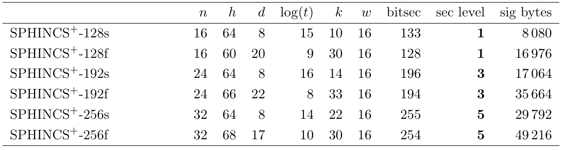
Instantiations (small vs fast)

Slide 47
Comparison to SPHINCS-128 at same security level
 | Signing median cycles | Verifying median cycles | Signature bytes
SPHINCS⁺ (n = 24, h = 55, d = 11, b = 8, k = 30, w = 16) | 67 017 940 | 1 911 684 | 21 288
SPHINCS⁺ (n = 24, h = 51, d = 17, b = 9, k = 30, w = 16) | 40 117 282 | 2 724 094 | 29 256
SPHINCS-128 (n=32, h=60, d=12, t=2^16, k=32, w = 16) | 51 636 372 | 1 451 004 | 41 000

Slide 48
Hash-based Signatures in NIST „Competition“
SPHINCS⁺
  FORS as few-time signature
  XMSS-T tweakable hash
Gravity-SPHINCS (R.I.P.)
  PORS as few-time signature
  Requires collision-resistance -> no tweakable hash
(PICNIC)

