Slide 1
Hash-based Signatures
Andreas Hülsing

Slide 2
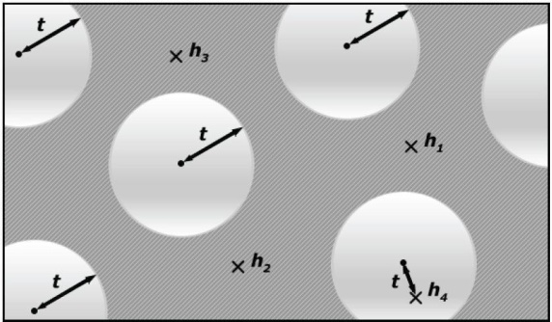

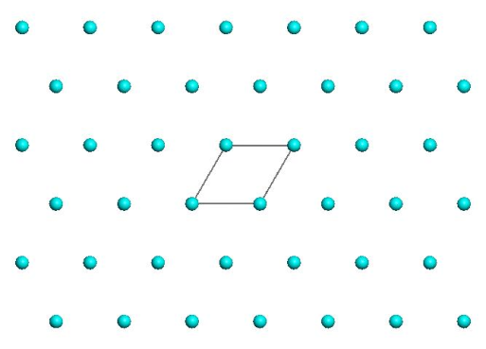
Post-Quantum Signatures
Lattice, MQ, Coding
Signature and/or key sizes
Runtimes
Secure parameters

Slide 3
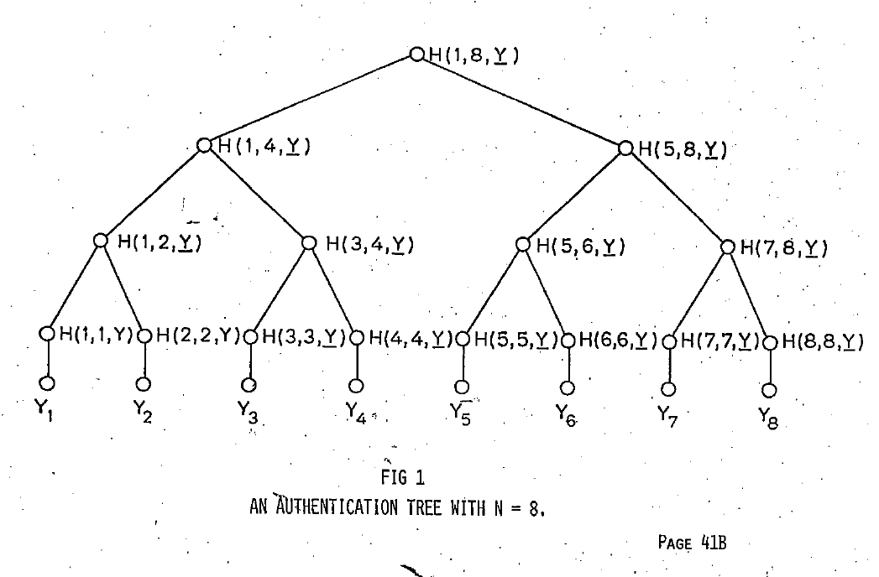
Hash-based Signature Schemes [Mer89]
Post quantum
Only secure hash function
Security well understood
Fast

Slide 4
RSA – DSA – EC-DSA...
Intractability Assumption
Cryptographic
hash function
RSA, DH, SVP, MQ, …
Digital signature scheme

Slide 5
Hash function families

Slide 6




(Hash) function families
$H_{n}≔\left\{h_{k}:{\text{\{0,1\}}}^{m\left(n\right)}→{\text{\{0,1\}}}^{n}\right\}$
$m(n)≥n$
„efficient“
$${\text{\{0,1\}}}^{n}$$
$$h_{k}$$
$${\text{\{0,1\}}}^{m\left(n\right)}$$

Slide 7
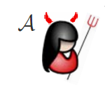



One-wayness
$$H_{n}≔\left\{h_{k}:{\text{\{0,1\}}}^{m\left(n\right)}→{\text{\{0,1\}}}^{n}\right\}$$
$$h_{k}\underset{←}{\$}H_{n}$$
$$x\underset{←}{\$}{\text{\{0,1\}}}^{m\left(n\right)}$$
$$y_{c}←h_{k}\left(x\right)$$
Success if $h_{k}\left(x^{∗}\right)=y_{c}$
$$y_{c},k$$
$$x^{∗}$$

Slide 8

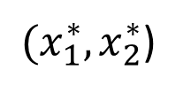

Collision resistance
$$H_{n}≔\left\{h_{k}:{\text{\{0,1\}}}^{m\left(n\right)}→{\text{\{0,1\}}}^{n}\right\}$$
$$h_{k}\underset{←}{\$}H_{n}$$
Success if
$h_{k}\left(x_{1}^{∗}\right)=h_{k}\left(x_{2}^{∗}\right)$ and
$$x_{1}^{∗}≠x_{2}^{∗}$$
$$k$$
${(x}_{1}^{∗},x_{2}^{∗}$)

Slide 9



Second-preimage resistance
$$H_{n}≔\left\{h_{k}:{\text{\{0,1\}}}^{m\left(n\right)}→{\text{\{0,1\}}}^{n}\right\}$$
$$h_{k}\underset{←}{\$}H_{n}$$
$$x_{c}\underset{←}{\$}{\text{\{0,1\}}}^{m\left(n\right)}$$
Success if
$h_{k}\left(x_{c}\right)=h_{k}\left(x^{∗}\right)$ and
$$x_{c}^{}≠x_{}^{∗}$$
$$x_{c},k$$
$$x^{∗}$$

Slide 10

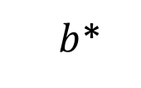

Undetectability
$$H_{n}≔\left\{h_{k}:{\text{\{0,1\}}}^{m\left(n\right)}→{\text{\{0,1\}}}^{n}\right\}$$
$$h_{k}\underset{←}{\$}H_{n}$$
$$b\underset{←}{\$}\{0,1\}$$
If $b=1$
$x\underset{←}{\$}{\text{\{0,1\}}}^{m\left(n\right)}$
$y_{c}←h_{k}(x)$
else
$y_{c}\underset{←}{\$}{\text{\{0,1\}}}^{n}$
$$y_{c},k$$
$b$*

Slide 11






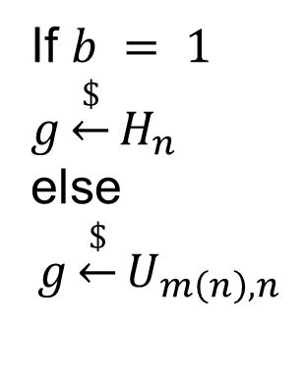
Pseudorandomness
$$H_{n}≔\left\{h_{k}:{\text{\{0,1\}}}^{m\left(n\right)}→{\text{\{0,1\}}}^{n}\right\}$$
$$1^{n}$$
$$b$$
$$x$$
If $b = 1$
$$g\underset{←}{\$}H_{n}$$
else
$$g\underset{←}{\$}U_{m\left(n\right),n}$$
g
$$y = g(x)$$
$b$*

Slide 12
Generic security
„Black Box“ security (best we can do without looking at internals)
  For hash functions: Security of random function family
(Often) expressed in #queries (query complexity)
Hash functions not meeting generic security considered insecure

Slide 13
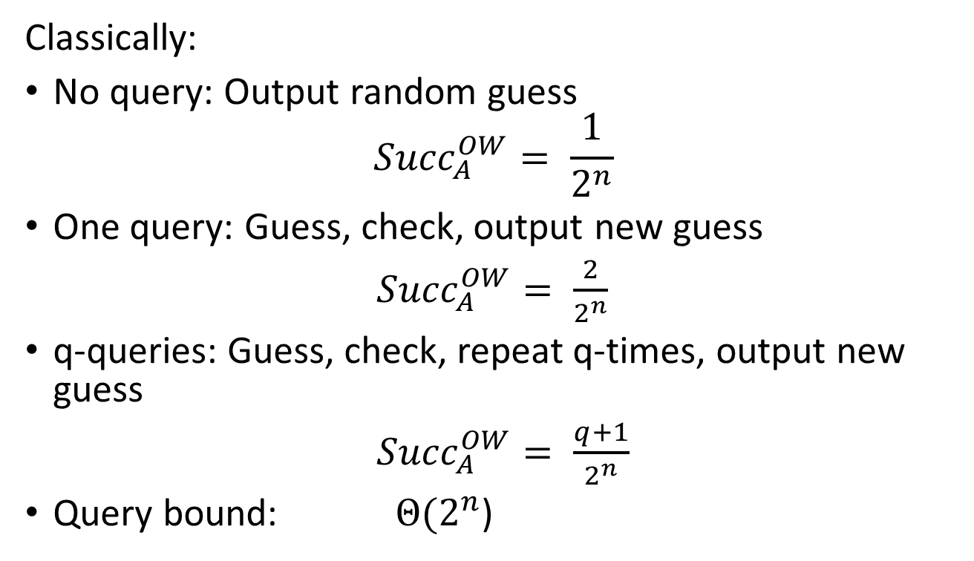
Generic Security - OWF
Classically:
No query: Output random guess
$${Succ}_{A}^{OW}= \frac{1}{2^{n}}$$
One query: Guess, check, output new guess
${Succ}_{A}^{OW}= \frac{2}{2^{n}}$
q-queries: Guess, check, repeat q-times, output new guess
${Succ}_{A}^{OW}= \frac{q+1}{2^{n}}$
Query bound: $Θ(2^{n}$)

Slide 14
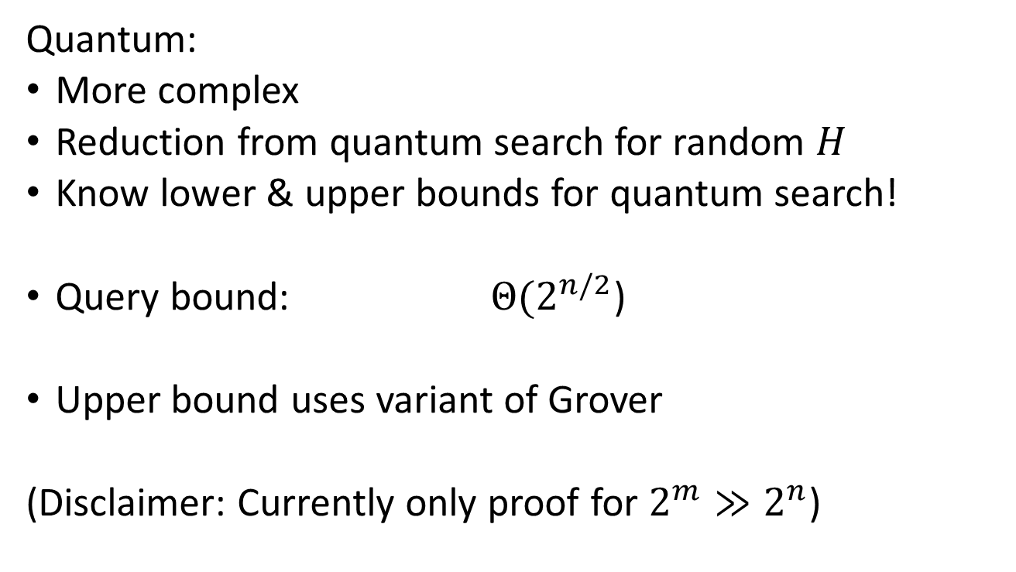
Generic Security - OWF
Quantum:
More complex
Reduction from quantum search for random $H$
Know lower & upper bounds for quantum search!
Query bound: $Θ(2^{n/2}$)
Upper bound uses variant of Grover
(Disclaimer: Currently only proof for ${2^{m}≫2}^{n}$)

Slide 15
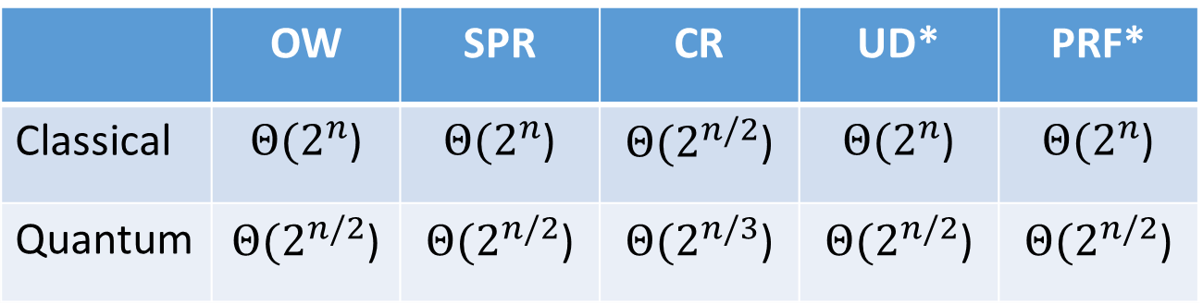
Generic Security
 | OW | SPR | CR | UD* | PRF*
Classical | $Θ(2^{n}$) | $Θ(2^{n}$) | $Θ(2^{n/2}$) | $Θ(2^{n}$) | $Θ(2^{n}$)
Quantum | $Θ(2^{n/2}$) | $Θ(2^{n/2}$) | $Θ(2^{n/3}$) | $Θ(2^{n/2}$) | $Θ(2^{n/2}$)
* conjectured, no proof

Slide 16
Hash-function properties
stronger / easier to break
Collision-Resistance
Assumption / Attacks
2nd-Preimage-Resistance
One-way
Pseudorandom
weaker /
harder to break

Slide 17
Attacks on Hash Functions
MD5
Collisions
(theo.)
MD5
Collisions
(practical!)
SHA-1
Collisions
(theo.)
MD5 & SHA-1
No (Second-) Preimage Attacks!
2004
2005
2008
2015

Slide 18

Basic Construction

Slide 19
Lamport-Diffie OTS [Lam79]
Message M = b1,…,bm, OWF H = n bit
SK
PK
Sig
*
sk_{1,0}
sk_{1,1}
sk_{m,0}
sk_{m,1}
H
H
H
H
H
H
pk_{1,0}
pk_{1,1}
pk_{m,0}
pk_{m,1}
b1
Mux
b2
Mux
bm
Mux
sk_{1,b1}
sk_{m,bm}

Slide 20





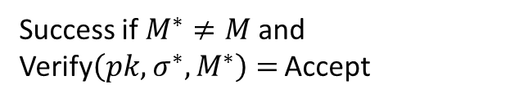
EU-CMA for OTS
$$pk,1^{n}$$
$$sk$$
$$M$$
SIGN
$$(σ,M)$$
$$(σ^{∗},M^{∗})$$
Success if $M^{∗}≠M$and Verify$\left(pk, σ^{∗},M^{∗}\right)=$ Accept

Slide 21
Security
Theorem:
If H is one-way then LD-OTS is one-time eu-cma-secure.

Slide 22


Reduction
Input: $y_{c},k$
Set $H←h_{k}$
Replace random pk_{i,b}
sk_{1,0}
sk_{1,1}
sk_{m,0}
sk_{m,1}
H
H
H
H
H
H
pk_{1,0}
pk_{1,1}
$$y_{c}$$
pk_{m,0}
pk_{m,1}

Slide 23

Reduction
Adv. Message: M = b1,…,bm
If bi = b return fail
else return Sign(M)
Input: $y_{c},k$
Set $H←h_{k}$
Replace random pk_{i,b}
sk_{1,0}
sk_{1,1}
?
sk_{m,0}
sk_{m,1}
H
H
H
H
H
pk_{1,0}
pk_{1,1}
$$y_{c}$$
pk_{m,0}
pk_{m,1}
b1
Mux
b2
Mux
bm
Mux
sk_{1,b1}
sk_{m,bm}

Slide 24



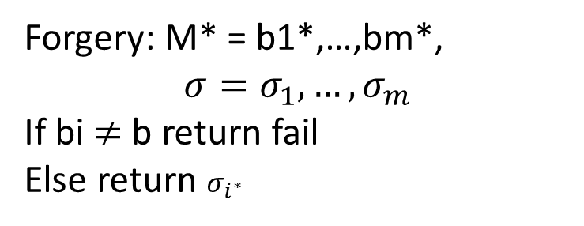
Reduction
Forgery: M* = b1*,…,bm*,
$$σ=σ_{1},…,σ_{m}$$
If bi $≠$ b return fail
Else return $σ_{i^{∗}}$
Input: $y_{c},k$
Set $H←h_{k}$
Choose random pk_{i,b}
?
sk_{1,0}
sk_{1,1}
$$σ_{i^{∗}}$$
$$σ_{i^{∗}}$$
sk_{m,0}
sk_{m,1}
H
H
H
H
H
pk_{1,0}
pk_{1,1}
$$y_{c}$$
pk_{m,0}
pk_{m,1}

Slide 25
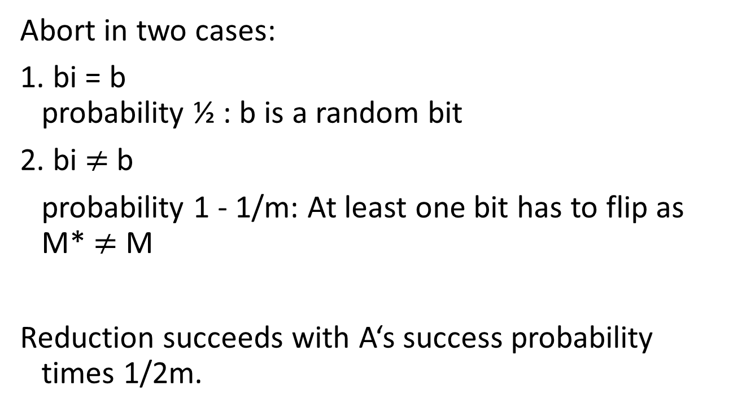
Reduction - Analysis
Abort in two cases:
1. bi = b
probability ½ : b is a random bit
2. bi $≠$ b
probability 1 - 1/m: At least one bit has to flip as M* $≠$ M
Reduction succeeds with A‘s success probability times 1/2m.

Slide 26




Merkle’s Hash-based Signatures
PK
SIG = (i=2, , , , , )
H
OTS
H
H
H
H
H
H
H
H
H
H
H
H
H
H
OTS
OTS
OTS
OTS
OTS
OTS
OTS
OTS
SK

Slide 27
Security
Theorem:
MSS is eu-cma-secure if OTS is a one-time eu-cma secure signature scheme and H is a random element from a family of collision resistant hash functions.

Slide 28
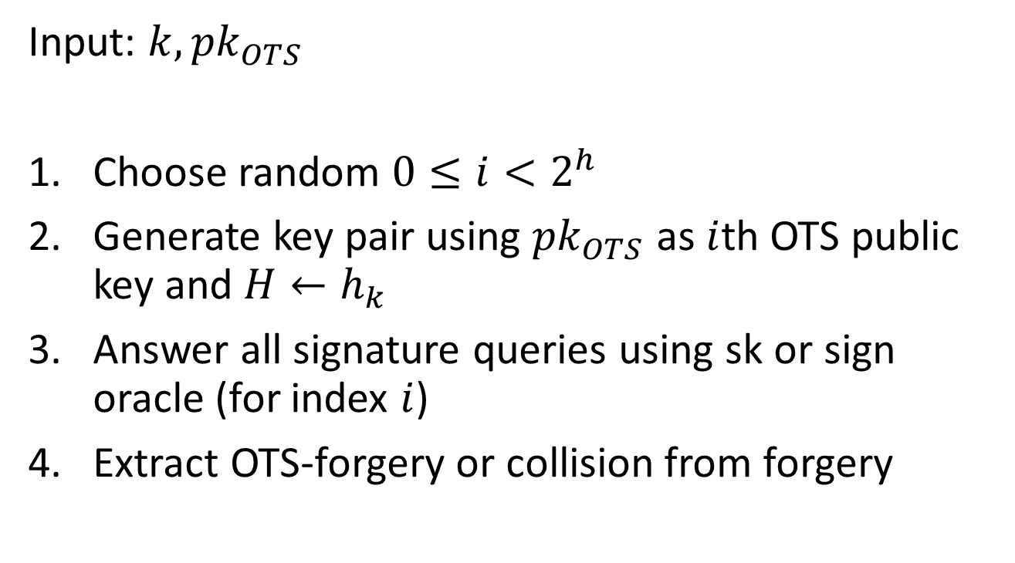
Reduction
Input: $k, {pk}_{OTS}$
Choose random $0≤i<2^{h}$
Generate key pair using ${pk}_{OTS}$ as $i$th OTS public key and $H←h_{k}$
Answer all signature queries using sk or sign oracle (for index $i$)
Extract OTS-forgery or collision from forgery

Slide 29
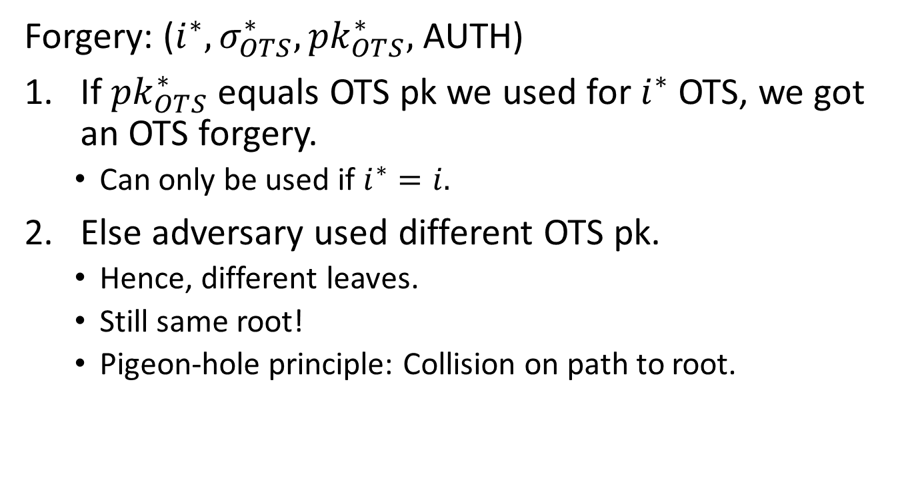
Reduction (Step 4, Extraction)
Forgery: (${i^{∗},σ}_{OTS}^{∗},{pk}_{OTS}^{∗},$AUTH)
If ${pk}_{OTS}^{∗}$ equals OTS pk we used for $i^{∗}$ OTS, we got an OTS forgery.
  Can only be used if $i^{∗}=i.$
Else adversary used different OTS pk.
  Hence, different leaves.
  Still same root!
  Pigeon-hole principle: Collision on path to root.

Slide 30
Winternitz-OTS

Slide 31
Recap LD-OTS [Lam79]
Message M = b1,…,bm, OWF H = n bit
SK
PK
Sig
*
sk_{1,0}
sk_{1,1}
sk_{m,0}
sk_{m,1}
H
H
H
H
H
H
pk_{1,0}
pk_{1,1}
pk_{m,0}
pk_{m,1}
b1
Mux
b2
Mux
bn
Mux
sk_{1,b1}
sk_{m,bm}

Slide 32
LD-OTS in MSS
SIG = (i=2, , , , , )
Verification:
1. Verify
2. Verify authenticity of
We can do better!

Slide 33
Trivial Optimization
Message M = b1,…,bm, OWF H = n bit
*
SK
sk_{1,0}
sk_{1,1}
sk_{m,0}
sk_{m,1}
H
H
H
H
H
H
PK
pk_{1,0}
pk_{1,1}
pk_{m,0}
pk_{m,1}
b1
Mux
Mux
$¬$b1
bm
Mux
Mux
$¬$bm
Sig
sig_{1,0}
sig_{1,1}
sig_{m,0}
sig_{m,1}

Slide 34
Optimized LD-OTS in MSS
X
SIG = (i=2, , , , , )
Verification:
1. Compute from
2. Verify authenticity of
Steps 1 + 2 together verify

Slide 35

Germans love their „Ordnung“!
Message M = b₁,…,b_{m}, OWF H
SK: sk₁,…,sk_{m},sk_{m+1},…,sk_{2m}
PK: H(sk₁),…,H(sk_{m}),H(sk_{m+1}),…,H(sk_{2m})
Encode M: M‘ = M||$¬$M = b₁,…,b_{m},$¬$b₁,…,$¬$b_{m}
(instead of b₁, $¬$b₁,…,b_{m},$¬$b_{m} )
sk_{i} , if b_{i} = 1
Sig: sig_{i} =
H(sk_{i}) , otherwise
Checksum with bad performance!

Slide 36

Optimized LD-OTS
Message M = b₁,…,b_{m}, OWF H
SK: sk₁,…,sk_{m},sk_{m+1},…,sk_{m+1+log m}
PK: H(sk₁),…,H(sk_{m}),H(sk_{m+1}),…,H(sk_{m+1+log m})
Encode M: M‘ = b₁,…,b_{m},$¬\sum_{1}^{m}{b_{i}}$
sk_{i} , if b_{i} = 1
Sig: sig_{i} =
H(sk_{i}) , otherwise
IF one b_{i} is flipped from 1 to 0, another b_{j} will flip from 0 to 1

Slide 37



Function chains
Function family:${ H}_{n}≔\left\{h_{k}:{\text{\{0,1\}}}^{n}→{\text{\{0,1\}}}^{n}\right\}$
$$h_{k}\underset{←}{\$}H_{n}$$
Parameter $w$
Chain:
c⁰(x) = x
$$c^{w−1}(x)$$
$c1(x) =h_{k}(x)$

Slide 38

WOTS
Winternitz parameter w, security parameter n, message length m, function family ${ H}_{n}$
Key Generation: Compute $l$, sample $h_{k}$
c⁰(sk₁) = sk₁
pk₁ = c^{w-1}(sk₁)
c¹(sk₁)
c¹(sk_{l} )
pk_{l} = c^{w-1}(sk_{l} )
c⁰(sk_{l} ) = sk_{l}
Notes:
One promissing group of candidates are hash-based signature schemes
They start from an OTS – a signature scheme where a key pair can only be used for one signature.
The central idea – proposed by Merkle - is to authenticate many OTS keypairs using a binary hash tree
These schemes have many advantages over the beforementioned
Quantum computers do not harm their security – the best known quantum attack is Grovers algorithm – allowing exhaustiv search in a set with n elements in time squareroot of n using log n space.
They are provably secure in the standard model
And they can be instantiated using any secure hash function.
On the downside, they produce long signatures.

Slide 39
WOTS Signature generation
M
b₁
b₂
b₃
b₄
…
…
…
…
…
…
…
b_{m‘}
b_{m‘+1}
b_{m‘+2}
…
…
b_{l}
c⁰(sk₁) = sk₁
pk₁ = c^{w-1}(sk₁)
C
σ₁=c^{b1}(sk₁)
Signature:
σ = (σ₁, …, σ_{l} )
pk_{l} = c^{w-1}(sk_{l} )
c⁰(sk_{l} ) = sk_{l}
σ_{l} =c^{bl} (sk_{l} )
Notes:
Well, this work is concerned with the OTS.
There are several OTS schemes. LD, Merkle-OTS which is a specific instance of the W-OTS, the BM-OTS and Biba and HORS.
The most interesting one is the Winternitz OTS as it allows for a time-memory trade-off and even more important
- It is possible to compute the public verification key given a signature. This reduces the signature size of a hash based signature scheme as normaly the public key of the OTS has to be included in a signature of the scheme. Now for WOTS this isn‘t necessary anymore.

Slide 40





WOTS Signature Verification
      Verifier knows: M, w
b₁
b₂
b₃
b₄
…
…
…
…
…
…
…
b_{m‘}
b_{m‘+1}
b_{l 1+2}
…
…
b_{l}
$c^{1}$ (σ₁)
$c^{3}$(σ₁)
pk₁
=?
σ₁
$c^{2}$(σ₁)
$c^{w−1−b_{1}}$ (σ₁)
Signature:
σ = (σ₁, …, σ_{l} )
pk_{l}
=?
σ_{l}
$c^{w−1−b_{l}}$ (σ_{l} )
Notes:
Well, this work is concerned with the OTS.
There are several OTS schemes. LD, Merkle-OTS which is a specific instance of the W-OTS, the BM-OTS and Biba and HORS.
The most interesting one is the Winternitz OTS as it allows for a time-memory trade-off and even more important
- It is possible to compute the public verification key given a signature. This reduces the signature size of a hash based signature scheme as normaly the public key of the OTS has to be included in a signature of the scheme. Now for WOTS this isn‘t necessary anymore.

Slide 41

WOTS Function Chains
For $x∈{\left\{0,1\right\}}^{n}$define $c^{0}\left(x\right)=x$ and
WOTS: $c^{i}\left(x\right)=h_{k}(c^{i−1}\left(x\right))$
WOTS$:${ c}^{i}\left(x\right)=h_{c^{i−1}\left(x\right)}(r)$
WOTS⁺: $c^{i}\left(x\right)=h_{k}(c^{i−1}\left(x\right) ⨁{ r}_{i})$

Slide 42
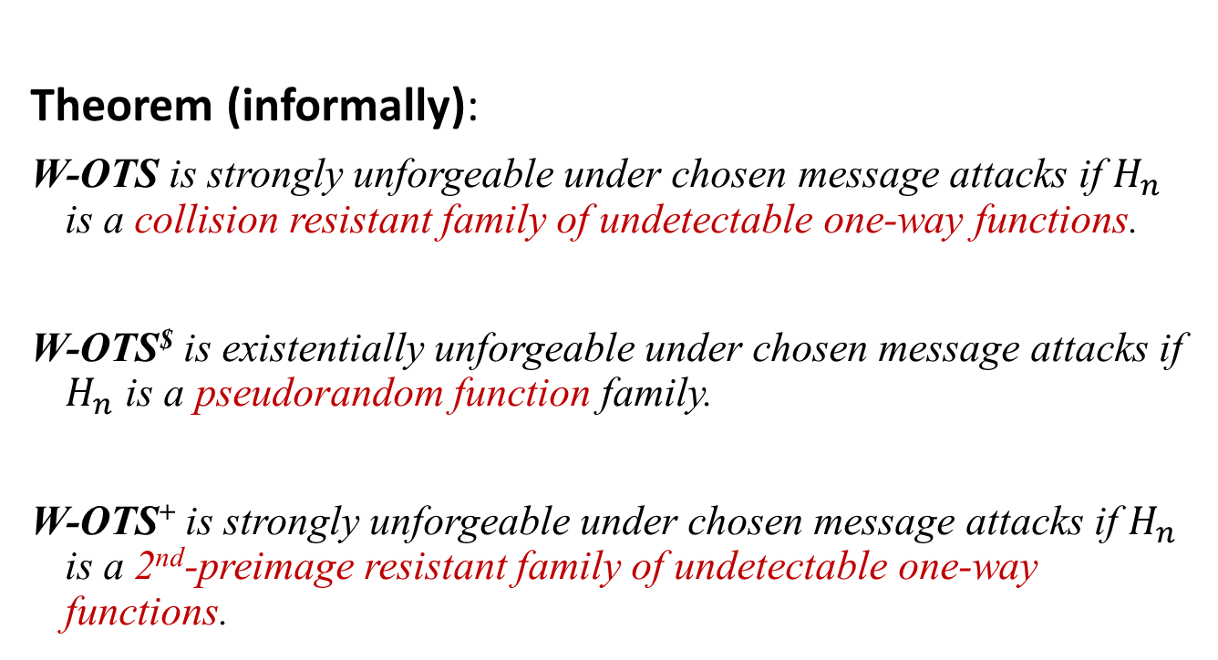
WOTS Security
Theorem (informally):
W-OTS is strongly unforgeable under chosen message attacks if $H_{n}$ is a collision resistant family of undetectable one-way functions.
W-OTS$ is existentially unforgeable under chosen message attacks if $H_{n}$ is a pseudorandom function family.
W-OTS⁺ is strongly unforgeable under chosen message attacks if $H_{n}$ is a 2nd-preimage resistant family of undetectable one-way functions.
Notes:
In our work we showed that we can slightly change the original WOTS construction, such that it uses a function family instead of the hash function family. The resulting scheme is existentially unforgeable under chosen message attacks, if the function family is pseudorandom.
This result has two implications:

Slide 43
WOTS Sizes and Runtimes
 | Lamport-Diffie | WOTS | WOTS$ | WOTS⁺
Public Key Size | 2bm | l 2b ~ 2bm/log w | l b (+b) ~ bm/log w | l b ( +(w-1)b ) ~ bm/log w
Secret Key Size | 2bm | l 2b ~ 2bm/log w | l b ~ bm/log w | l b ~ bm/log w
Signature Size | bm | l 2b ~ 2bm/log w | l b ~ bm/log w | l b ~ bm/log w
Key Generation Time | ~ 2m | l w ~ wm/log w | l w ~wm/log w | l w ~ wm/log w
Security level b, Winternitz parameter w, Message Length m,
l = l (w,m) ~ m / log w

Slide 44
XMSS

Slide 45
XMSS
Tree: Uses bitmasks
Leafs: Use binary tree
with bitmasks
OTS: WOTS⁺
Mesage digest:
Randomized hashing
Collision-resilient
-> signature size halved
b_{i}

Slide 46
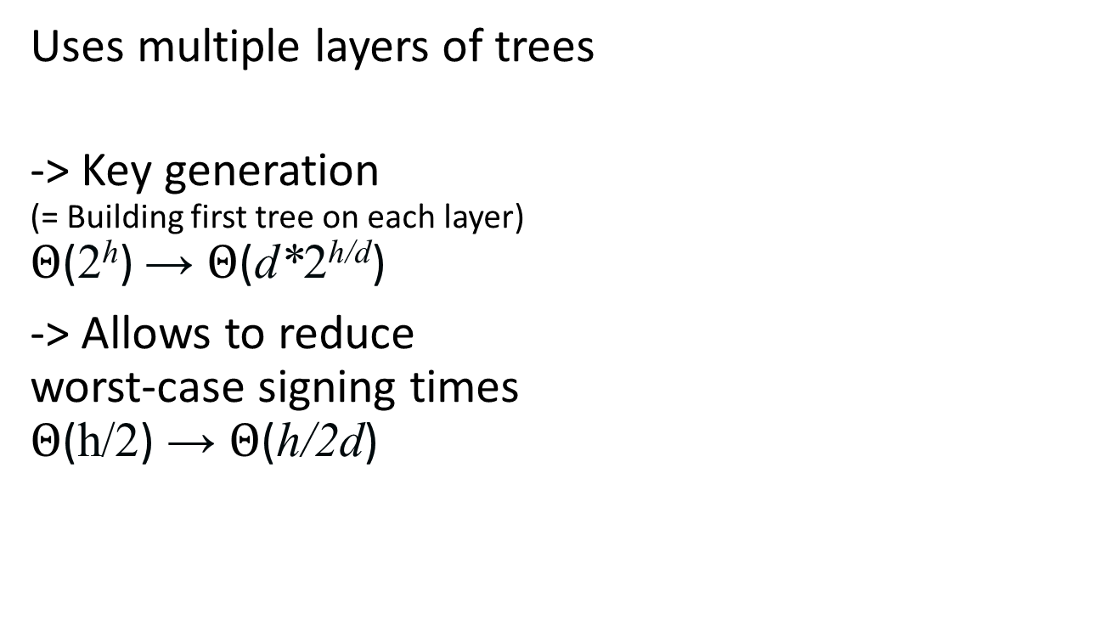
Multi-Tree XMSS
Uses multiple layers of trees
-> Key generation
(= Building first tree on each layer)
$Θ$(2^{h}) → $Θ$(d*2^{h/d})
-> Allows to reduce
worst-case signing times
$Θ$(h/2) → $Θ$(h/2d)

Slide 47
Authentication path computation

Slide 48
TreeHash
(Mer89)

Slide 49
TreeHash
TreeHash(v,i): Computes node on level v with leftmost descendant L_{i}
Public Key Generation: Run TreeHash(h,0)
L₀ L₁ L₂ L_{3 . . .} L₇
=
v = h = 3
v = 2
h
v = 1
v = 0

Slide 50
TreeHash
TreeHash(v,i)
1: Init Stack, N1, N2
2: For j = i to i+2^{v}-1 do
3: N1 = LeafCalc(j)
4: While N1.level() == Stack.top().level() do
5: N2 = Stack.pop()
6: N1 = ComputeParent( N2, N1 )
7: Stack.push(N1)
8: Return Stack.pop()

Slide 51
TreeHash
TreeHash(v,i)
L_{i} Li+1 . . . L_{i+2v-1}

Slide 52
Efficiency?
Key generation: Every node has to be computed once.
cost = 2^{h} leaves + 2^{h}-1 nodes
=> optimal
Signature: One node on each level 0 <= v < h.
cost 2^{h}-1 leaves + 2^{h}-1-h nodes.
Many nodes are computed many times!
(e.g. those on level v=h-1 are computed 2^{h-1} times)
-> Not optimal if state allowed

Slide 53
The BDS Algorithm
[BDS08]

Slide 54
Motivation
(for all Tree Traversal Algorithms)
No Storage:
Signature: Compute one node on each level 0 <= v < h.
Costs: 2^{h}-1 leaf + 2^{h}-1-h node computations.
Example: XMSS with SHA2-256 and h = 20 -> approx. 15min
Store whole tree: 2^{h}n bits.
Example: h=20, n=256; storage: 2²⁸bits = 32MB
Idea: Look for time-memory trade-off!

Slide 55
Use a State

Slide 56
Authentication Paths

Slide 57
Observation 1
Same node in authentication path is recomputed many times!
Node on level v is recomputed for 2^{v} successive paths.
Idea: Keep authentication path in state.
-> Only have to update “new” nodes.
Result
Storage: h nodes
Time: ~ h leaf + h node computations (average)
But: Worst case still 2^{h}-1 leaf + 2^{h}-1-h node computations!
-> Keep in mind. To be solved.

Slide 58
Observation 2
When new left node in authentication path is needed, its children have been part of previous authentication paths.

Slide 59
Computing Left Nodes
v = 2
i

Slide 60
Result
Storing nodes
all left nodes can be computed with one node computation / node

Slide 61
Observation 3
Right child nodes on high levels are most costly.
Computing node on level v requires
2^{v} leaf and 2^{v}-1 node computations.
Idea: Store right nodes on top k levels during key generation.
Result
Storage: 2^{k}-2 n bit nodes
Time: ~ h-k leaf + h-k node computations (average)
Still: Worst case 2^{h-k}-1 leaf + 2^{h-k}-1-(h-k) node computations!

Slide 62
Distribute Computation

Slide 63
Intuition
Observation:
For every second signature only one leaf computation
Average runtime: ~ h-k leaf + h-k node computations
Idea: Distribute computation to achieve average runtime in worst case.
Focus on distributing computation of leaves

Slide 64
TreeHash with Updates
TreeHash.init(v,i)
1: Init Stack, N1, N2, j=i, j_max = i+2^{v}-1
2: Exit
TreeHash.update()
1: If j <= j_max
2: N1 = LeafCalc(j)
3: While N1.level() == Stack.top().level() do
5: N2 = Stack.pop()
6: N1 = ComputeParent( N2, N1 )
7: Stack.push(N1)
8: Set j = j+1
9: Exit
One leaf per update

Slide 65
Distribute Computation
Concept
Run one TreeHash instance per level 0 <= v < h-k
Start computation of next right node on level v when current node becomes part of authentication path.
Use scheduling strategy to guarantee that nodes are finished in time.
Distribute (h-k)/2 updates per signature among all running TreeHash instances

Slide 66
Distribute Computation
Worst Case Runtime
Before:
2^{h-k}-1 leaf and 2^{h-k}-1-(h-k) node computations.
With distributed computation:
(h-k)/2 + 1 leaf and 3(h-k-1)/2 + 1 node computations.
Add. Storage
Single stack of size h-k nodes for all TreeHash instances.
+ One node per TreeHash instance.
= 2(h-k) nodes

Slide 67
BDS Performance
Storage:
n bit nodes
Runtime:
(h−k)/2+1 leaf and
3(h−k−1)/2+1 node computations.

Slide 68
XMSS in practice

Slide 69
XMSS Implementation
C Implementation, using OpenSSL [BDH2011]
 | Sign (ms) | Verify (ms) | Signature (bit) | Public Key (bit) | Secret Key (byte) | Bit Security | Comment
XMSS-SHA-2 | 35.60 | 1.98 | 16,672 | 13,600 | 3,364 | 157 | h = 20, w = 64,
XMSS-AES-NI | 0.52 | 0.07 | 19,616 | 7,328 | 1,684 | 84 | h = 20, w = 4
XMSS-AES | 1.06 | 0.11 | 19,616 | 7,328 | 1,684 | 84 | h = 20, w = 4
RSA 2048 | 3.08 | 0.09 | ≤ 2,048 | ≤ 4,096 | ≤ 512 | 87
Intel(R) Core(TM) i5-2520M CPU @ 2.50GHz with Intel AES-NI
Notes:
2013: 80 bit
84 -> 2019
87 -> 2022
157 -> 2113

Slide 70
XMSS Internet-Draft
(draft-irtf-cfrg-xmss-hash-based-signatures)
Protecting against multi-target attacks / tight security
  n-bit hash => n bit security
Small public key (2n bit)
  At the cost of ROM for proving PK compression secure
Function families based on SHA2
Equal to XMSS-T [HRS16] up-to message digest

Slide 71
XMSS / XMSS-T Implementation
C Implementation, using OpenSSL [HRS16]
 | Sign (ms) | Signature (kB) | Public Key (kB) | Secret Key (kB) | Bit Security classical/ quantum | Comment
XMSS | 3.24 | 2.8 | 1.3 | 2.2 | 236 / 118 | h = 20, d = 1,
XMSS-T | 9.48 | 2.8 | 0.064 | 2.2 | 256 / 128 | h = 20, d = 1
XMSS | 3.59 | 8.3 | 1.3 | 14.6 | 196 / 98 | h = 60, d = 3
XMSS-T | 10.54 | 8.3 | 0.064 | 14.6 | 256 / 128 | h = 60, d = 3
Intel(R) Core(TM) i7 CPU @ 3.50GHz
XMSS-T uses message digest from Internet-Draft
All using SHA2-256, w = 16 and k = 2
Notes:
2013: 80 bit
84 -> 2019
87 -> 2022
157 -> 2113

Slide 72
Open research topics
1. Message compression which
  is collision-resilient,
  provdies tight provable security,
  especially resists multi-target attacks (=> no eTCR)
  => Has applications outside hash-based crypto!
2. Quantum query complexity for further properties
  E.g. PRF, UD, aSec, ...
3. Quantum security of existing hash function constructions.
  E.g. can classical attacks be improved (e.g. differential cryptanalysis)

Slide 73
SPHINCS

Slide 74
About the statefulness
Works great for some settings
However....
... back-up
... multi-threading
... load-balancing

Slide 75
How to Eliminate the State

Slide 76
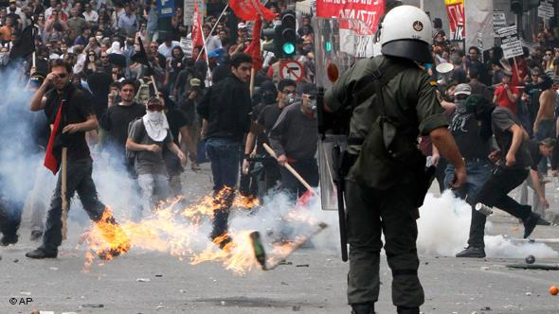
Protest?

Slide 77

Few-Time Signature Schemes

Slide 78
Recap LD-OTS
Message M = b1,…,bn, OWF H = n bit
SK
PK
Sig
*
sk_{1,0}
sk_{1,1}
sk_{n,0}
sk_{n,1}
H
H
H
H
H
H
pk_{1,0}
pk_{1,1}
pk_{n,0}
pk_{n,1}
b1
Mux
b2
Mux
bn
Mux
sk_{1,b1}
sk_{n,bn}

Slide 79
HORS [RR02]
Message M, OWF H, CRHF H’ = n bit
Parameters t=2ª,k, with m = ka (typical a=16, k=32)
SK
PK
*
sk₁
sk₂
sk_{t-1}
sk_{t}
H
H
H
H
H
H
pk₁
pk₁
pk_{t-1}
pk_{t}

Slide 80
HORS mapping function
Message M, OWF H, CRHF H’ = n bit
Parameters t=2ª,k, with m = ka (typical a=16, k=32)
*
M
H’
b₁
b₂
b_{a}
b_{ar}
i₁
i_{k}

Slide 81
HORS
Message M, OWF H, CRHF H’ = n bit
Parameters t=2ª,k, with m = ka (typical a=16, k=32)
*
SK
sk₁
sk₂
sk_{t-1}
sk_{t}
H
H
H
H
H
H
PK
pk₁
pk₁
pk_{t-1}
pk_{t}
H’(M)
b₁
b₂
b_{a}
b_{a+1}
b_{ka-2}
b_{ka-1}
b_{ka}
i₁
Mux
Mux
i_{k}
sk_{i1}
sk_{ik}

Slide 82
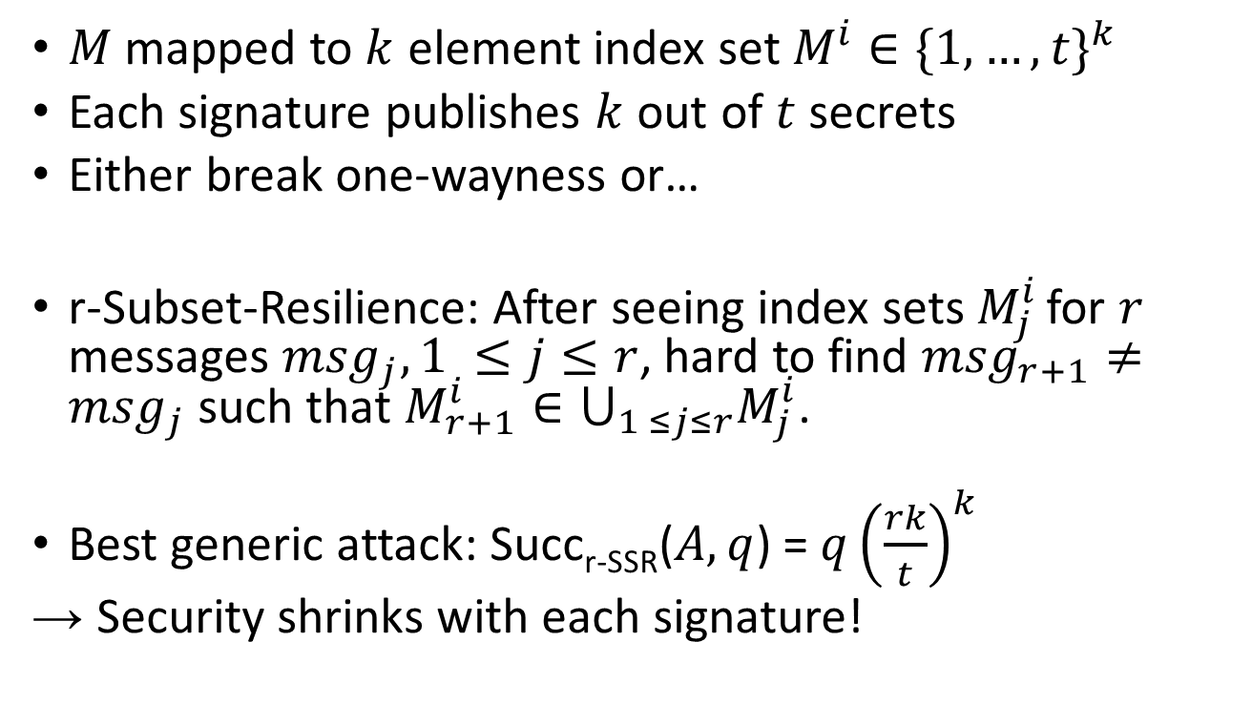
HORS Security
$M$ mapped to $k$ element index set $M^{i}∈{\{1,…,t\}}^{k}$
Each signature publishes $k$ out of $t$ secrets
Either break one-wayness or…
r-Subset-Resilience: After seeing index sets $M_{j}^{i}$ for $r$ messages ${msg}_{j}, 1 ≤j≤r$, hard to find ${msg}_{r+1}≠{msg}_{j}$ such that $M_{r+1}^{i}∈⋃_{1 ≤j≤r}M_{j}^{i}$.
Best generic attack: Succ_{r-SSR}($A,q$) = $q{\left(\frac{rk}{t}\right)}^{k}$
→ Security shrinks with each signature!

Slide 83
HORST
Using HORS with MSS requires adding PK (tn) to MSS signature.
HORST: Merkle Tree on top of HORS-PK
New PK = Root
Publish Authentication Paths for HORS signature values
PK can be computed from Sig
With optimizations: tn → (k(log t − x + 1) + 2^{x})n
  E.g. SPHINCS-256: 2 MB → 16 KB
Use randomized message hash

Slide 84
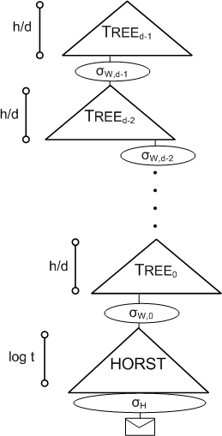
SPHINCS
Stateless Scheme
XMSS^{MT} + HORST
+ (pseudo-)random index
Collision-resilient
Deterministic signing
SPHINCS-256:
  128-bit post-quantum secure
  Hundrest of signatures / sec
  41 kb signature
  1 kb keys

Slide 85
Open research topics II
More efficient few-time signatures
Different constructions?
... ?

Slide 86

Thank you!
Questions?
For references & further literature see
https://huelsing.wordpress.com/hash-based-signature-schemes/literature/

