Slide 1
SPHINCS⁺
Jean-Philippe Aumasson, Daniel J. Bernstein, Ward Beullens, Christoph Dobraunig, Maria Eichlseder, Scott Fluhrer, Stefan-Lukas Gazdag, Andreas Hülsing, Panos Kampanakis, Stefan Kölbl, Tanja Lange, Martin M. Lauridsen, Florian Mendel, Ruben Niederhagen, Christian Rechberger, Joost Rijneveld, Peter Schwabe, Bas Westerbaan

Slide 2
Hash-based signatures (Merkle ´89)
Boring crypto:
Dates back to beginning of public key cryptography
No fancy new mathematical assumption: Only requires a secure hash function („minimal security assumptions“)
Stateful schemes already in standardization

Slide 3
Hash-based signatures (Merkle ´89)
Boring crypto:
Dates back to beginning of public key cryptography
No fancy new mathematical assumption: Only requires a secure hash function („minimal security assumptions“)
Stateful schemes already in standardization

Slide 4
SPHINCS (Eurocrypt 2015)
Joint work with Daniel J. Bernstein, Daira Hopwood, Tanja Lange, Ruben Niederhagen, Louiza Papachristodoulou, Michael Schneider, Peter Schwabe, and Zooko Wilcox-O’Hearn

Slide 5
Stateless hash-based signatures [NY89,Gol87,Gol04]
OTS
Goldreich’s approach [Gol04]:
Security parameter $λ=128$
Use binary tree as in Merkle, but...
…for security
pick index i at random;
requires huge tree to avoid index collisions (e.g., height $h=2λ=256$).
…for efficiency:
use binary certification tree of OTS key pairs (= Hypertree with $d=h),$
all OTS secret keys are generated pseudorandomly.
OTS
OTS
OTS
OTS
OTS
OTS
OTS
OTS

Slide 6
SPHINCS [BHH⁺15]
Select index pseudorandomly
Use a few-time signature key-pair on leaves to sign messages
Few index collisions allowed
Allows to reduce tree height
Use hypertree: Use d << h.

Slide 7
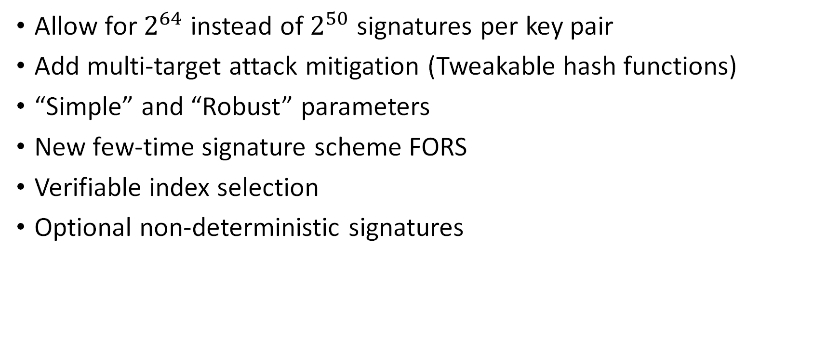
SPHINCS⁺ vs SPHINCS
Allow for $2^{64}$ instead of $2^{50}$ signatures per key pair
Add multi-target attack mitigation (Tweakable hash functions)
“Simple” and “Robust” parameters
New few-time signature scheme FORS
Verifiable index selection
Optional non-deterministic signatures

Slide 8
SPHINCS⁺ in 3rd Round
Joint work with Jean-Philippe Aumasson, Daniel J. Bernstein, Ward Beullens, Christoph Dobraunig, Maria Eichlseder, Scott Fluhrer, Stefan-Lukas Gazdag, Panos Kampanakis, Stefan Kölbl, Tanja Lange, Martin M. Lauridsen, Florian Mendel, Ruben Niederhagen, Christian Rechberger, Joost Rijneveld, Peter Schwabe, Bas Westerbaan

Slide 9
3rd Round changes
Two new team members: Ward Beullens, Bas Westerbaan
New parameter sets (more efficient at same security)
(Discussed hierarchical PRG & constant sum WOTS but discarded both)

Slide 10
New parameter sets
Search criteria:
Improvement in optimized metric (fast / small)
No significant penalty in other metric
No worse verification speed
No change to security assumptions / strength
No increased complexity
-> We only changed h, d, log(t) & k

Slide 11
New parameter sets

Slide 12
New parameter sets

Slide 13
New parameter sets
 | sign | verify | sig | sec
128s | ± 0 | - 8 % | - 2.77 % | ± 0
128f | - 24 % | + 10 % | + 0.66 % | ± 0
192s | - 20 % | - 10 % | - 4.92 % | -3 bit (still 193 > 192)
192f | ± 0 | ± 0 | ± 0 | ± 0
256s | ± 0 | ± 0 | ± 0 | ± 0
256f | - 13 % | ± 0 | + 1.30 % | +1 bit
Changes in speed are averaged over robust / simple & SHA2, SHAKE & Haraka parameter sets. For more details see our change log and the latest specification.

Slide 14
After round three updates

Slide 15
H_msg with SHA-256 #1
Feb 11: Mail by Morgan Stern “In particular, in SPHINCS+-SHA-256 there is an issue with the definition of the H_msg function so that the security of the signature presently relies on the multi-target second pre-image resistance of the SHA-256 hash function.”
$$H_msg(R, PK.seed, PK.root, M) = \text{MGF}\text{1−}\text{SHA}\text{−256}(\text{SHA}\text{−256}(R||PK.seed||PK.root||M), m).$$
MGF1-SHA-256
SHA-256
$$R||…||M$$

Slide 16
H_msg with SHA2-256 #1
The multi-target second preimage attack loses about 64 bit in security
Security down to 192 bits (for all SHA-256 parameters)
Violates L5
Fix: Switch to SHA2-512 for H_msg (& H_PRF) at L5.
MGF1-SHA-256
SHA-256
$$R||…||M$$

Slide 17
H_msg with SHA2-256 #2
Feb 16: Mail by John Kelsey
“I believe there’s also a long-message second preimage attack that applies here. (Ray Perlner pointed this out in a discussion.)”
Fix: $$\text{H}\text{_}\text{msg} := \text{MGF}\text{1−}\text{SHA}\text{−}\text{X}(R || PK.seed || \text{SHA}\text{−}\text{X}(R || PK.seed || PK.root || M ), m)$$ (where X is 256 for L1 & L3, and 512 for L5)

Slide 18
H_msg with SHA2-256 #2
Fix: $$\text{H}\text{_}\text{msg} := \text{MGF}\text{1−}\text{SHA}\text{−}\text{X}(R || PK.seed || \text{SHA}\text{−}\text{X}(R || PK.seed || PK.root || M ), m)$$ (where X is 256 for L1 & L3, and 512 for L5)
Attack:
Ask for q signatures on long messages (2^k message blocks)
Find expandable messages (takes time $\sim O(2^{n/2})$)
Find collision between expandable message and a message block in long message (takes times $O(2^{n−k−\log{q}−1}))$
Expand expandable message sufficiently

Slide 19
H_msg with SHA2-256 #2
Attack before fix takes time $O(2^{n/2}+2^{n−k−\log{q}−1})$
Max values are $q=2^{64},k=55⇒$We lose 119 bit security.
Recall: Honest user signs!
Assume compression function call takes $2^{−22}$seconds ($≈200ns$).
Attack takes $2^{64}⋅ 2^{55}= 2^{119}$compression function calls.
That is $2^{97}$sec = $2^{72}$years.
Still $2^{52}$years if key continuously used on 1 million machines!

Slide 20
Conclusion
Possible synergies with standardizing stateful hash-based signatures
The most conservative submission in the competition.

Slide 21
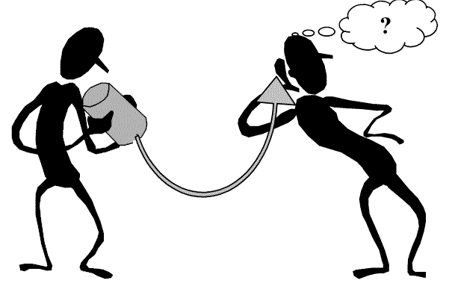
Thank you!
Questions?

