Slide 1
SPHINCS⁺ ^{Lessons learned}
Andreas Hülsing,
Eindhoven University of Technology
RWPQC 2023

Slide 2
Take-away #1: It's a team effort!
Jean-Philippe Aumasson, Daniel J. Bernstein, Ward Beullens,
Christoph Dobraunig, Maria Eichlseder, Scott Fluhrer,
Stefan-Lukas Gazdag, Andreas Hülsing, Panos Kampanakis,
Stefan Kölbl, Mike Kudinov, Tanja Lange, Martin M. Lauridsen,
Florian Mendel, Ruben Niederhagen, Christian Rechberger,
Joost Rijneveld, Peter Schwabe, Bas Westerbaan
-------------
19 People!

Slide 3
Hash-based signatures (Merkle ´89)
Boring crypto:
Dates back to beginning of public key cryptography
No fancy new mathematical assumption: Only requires a secure hash function („minimal security assumptions“)
Stateful schemes are first PQ-signatures standardized (LMS & XMSS)

Slide 4
Signatures & Hash Functions
H

Slide 5
One-time signatures (Lamport’76)

Slide 6
SPHINCS (Eurocrypt 2015)
Joint work with Daniel J. Bernstein, Daira Hopwood, Tanja Lange, Ruben Niederhagen, Louiza Papachristodoulou, Michael Schneider, Peter Schwabe, and Zooko Wilcox-O’Hearn

Slide 7
SPHINCS(+) Design Criteria
Stateless
Practical performance
Conservative security
Collision resilience
n-bit hash == n-bit classical security (n/2-bit quantum security)

Slide 8
How to go stateless (from an OTS)
Security parameter k
Generate 2^{2k} OTS key pairs
Authenticate all OTS public keys
Sign message with random OTS
Sig is OTS sig + authentication information
PK_{OTS}
PK_{OTS}
PK_{OTS}
PK_{OTS}
PK_{OTS}
PK_{OTS}
PK_{OTS}
PK_{OTS}
PK_{OTS}
PK_{OTS}
PK_{OTS}
PK_{OTS}
PK_{OTS}
PK_{OTS}
PK_{OTS}
PK_{OTS}
PK_{OTS}
PK_{OTS}
PK_{OTS}
PK_{OTS}
PK_{OTS}
PK_{OTS}
PK_{OTS}
PK_{OTS}
PK_{OTS}
PK_{OTS}
PK_{OTS}
PK_{OTS}
PK_{OTS}
PK_{OTS}
PK_{OTS}
PK_{OTS}
PK_{OTS}
PK_{OTS}
PK_{OTS}
PK_{OTS}
PK_{OTS}
PK_{OTS}
PK_{OTS}
PK_{OTS}
PK_{OTS}
PK_{OTS}
PK_{OTS}
PK_{OTS}
PK_{OTS}
PK_{OTS}
PK_{OTS}
PK_{OTS}
PK_{OTS}
PK_{OTS}
PK_{OTS}
PK_{OTS}
PK_{OTS}
PK_{OTS}
PK_{OTS}
PK_{OTS}
PK
PK_{OTS}
PK_{OTS}
PK_{OTS}
PK_{OTS}
PK_{OTS}
H
PK_{OTS}
PK_{OTS}
PK_{OTS}
PK_{OTS}
PK_{OTS}
PK_{OTS}
PK_{OTS}
PK_{OTS}
PK_{OTS}
PK_{OTS}
PK_{OTS}
PK_{OTS}
PK_{OTS}
PK_{OTS}
PK_{OTS}
PK_{OTS}
PK_{OTS}
PK_{OTS}
PK_{OTS}
PK_{OTS}
PK_{OTS}
PK_{OTS}
PK_{OTS}
PK_{OTS}
PK_{OTS}
PK_{OTS}
PK_{OTS}
PK_{OTS}
PK_{OTS}

Slide 9
Merkle Tree [Merkle’79]
PK
H
H
H
H
H
H
H
PK_{OTS}
PK_{OTS}
PK_{OTS}
PK_{OTS}
PK_{OTS}
PK_{OTS}
PK_{OTS}
PK_{OTS}

Slide 10
Certification Tree [Merkle’87] (for 2-time signature)
= Certification (Signature on PK)
PK
PK
PK
PK
PK
PK
PK
PK
PK
PK
PK
PK
PK
PK
PK
PK

Slide 11
Stateless hash-based signatures [NY89,Gol87,Gol04]
OTS
Goldreich's approach [Gol04]:
Security parameter k = 128
Use binary certification tree with OTS
Key pairs are generated pseudorandomly
Requires huge tree to avoid collisions (height 256)
Ok speed but HUGE signatures
OTS
OTS
OTS
OTS
OTS
OTS
OTS
OTS

Slide 12
SPHINCS [BHH⁺15]
Select index (pseudo-)randomly
Mix both methods: Use a certification tree of Merkle trees
Use a few-time signature key-pair on leaves to sign messages
Few index collisions allowed
Allows to reduce tree height (± 64)

Slide 13
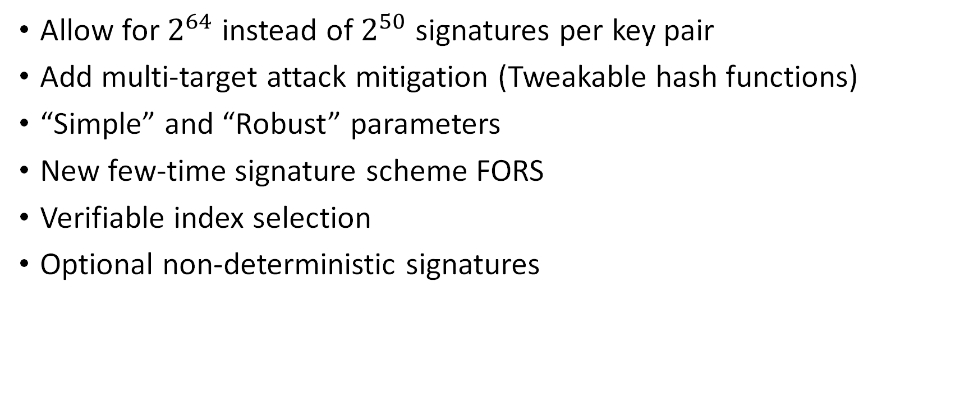
SPHINCS⁺ vs SPHINCS
Allow for $2^{64}$ instead of $2^{50}$ signatures per key pair
Add multi-target attack mitigation (Tweakable hash functions)
“Simple” and “Robust” parameters
New few-time signature scheme FORS
Verifiable index selection
Optional non-deterministic signatures

Slide 14
Sizes

Slide 15
Speed (on single core of 3Ghz CPU)
 | Sign | Verify | |sig|
SPHINCS+ -SHA2-128s-simple | ~ 214 ms | ~ 0.28 ms | 7856 byte
SPHINCS+ -SHA2-128f-simple | ~ 11 ms | ~ 0.72 ms | 17088 byte
SPHINCS+ -SHA2-192s-simple | ~ 415 ms | ~0.48 ms | 16224 byte
SPHINCS+ -SHA2-192f-simple | ~ 18 ms | ~ 1.17 ms | 35664 byte

Slide 16
Take-away #2: Avoid splits between implementation and proofs
Avoid "scheme implemented ≠ scheme analyzed"
Positive example: Tweakable hash functions

Slide 17
Take-away #3: Proofs are tough! (To write AND to read)
Most conservative scheme? (Tight) proof was wrong!
Fixed [Hülsing, Kudinov. "Recovering the tight security proof of SPHINCS+.", Asiacrypt 2022. https://eprint.iacr.org/2022/346.pdf]
New proof step verified in EasyCrypt. [Barbosa, Dupressoir, Grégoire, Hülsing, Meijers, Strub. "Machine-Checked Security for XMSS as in RFC 8391 and SPHINCS+". https://eprint.iacr.org/2023/408.pdf]

Slide 18
Take-away #4: Proofs stop at some level! (And SHA2 is a bad RO)
Morgan Stern and John Kelsey: MGF1-SHA2-256 does not give you level V security
Sydney Anotonov: SHA2-256 does not achieve perfect multi-target mitigation
Reason?
Inner state collisions too easy to find. -> SHA2 is not a good random oracle!

Slide 19
Take-away #5: You are never done
There are always new ideas / insights!
See SPHINCS+C
After (lacking) feedback, we suggest to not implement SPHINCS+C
We encourage NIST to standardize a low #sig version (in a different SP – maybe the one for stateful schemes?)
Next important topic: Do we allow pre-hashing? If so, how? (see discussions e.g. in CFRG)

Slide 20
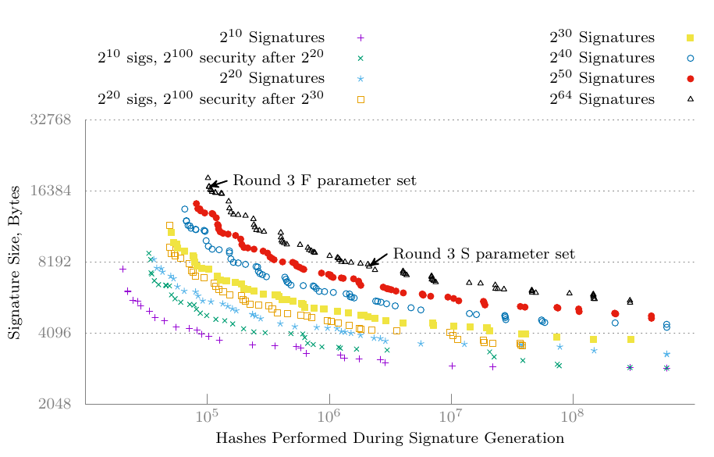
Lower q_{sign}? [Kölbel, "A note on SPHINCS+ parameter sets". https://eprint.iacr.org/2022/1725]
"NIST asks for public feedback on a version of SPHINCS+ with a lower number of maximum signatures."

Slide 21
Conclusion
The most conservative selected signature scheme.
No size & speed records, but for many applications... (e.g., code-signing, email & document signatures, etc.)
… size is negligible compared to data, and
… runtime is not that critical
… (long-term) security is of utmost importance
Possible synergies with stateful hash-based signatures

Slide 22
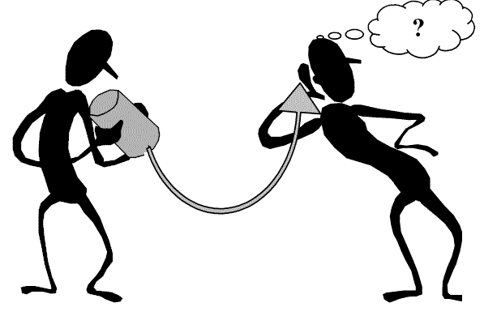
Thank you!
Questions?

