Slide 1
Machine-checking post-quantum cryptography
Andreas Hülsing Applied & Provable Security Group Eindhoven University of Technology

Slide 2
How do you ensure that a cryptographic scheme is hard to break?

Slide 3
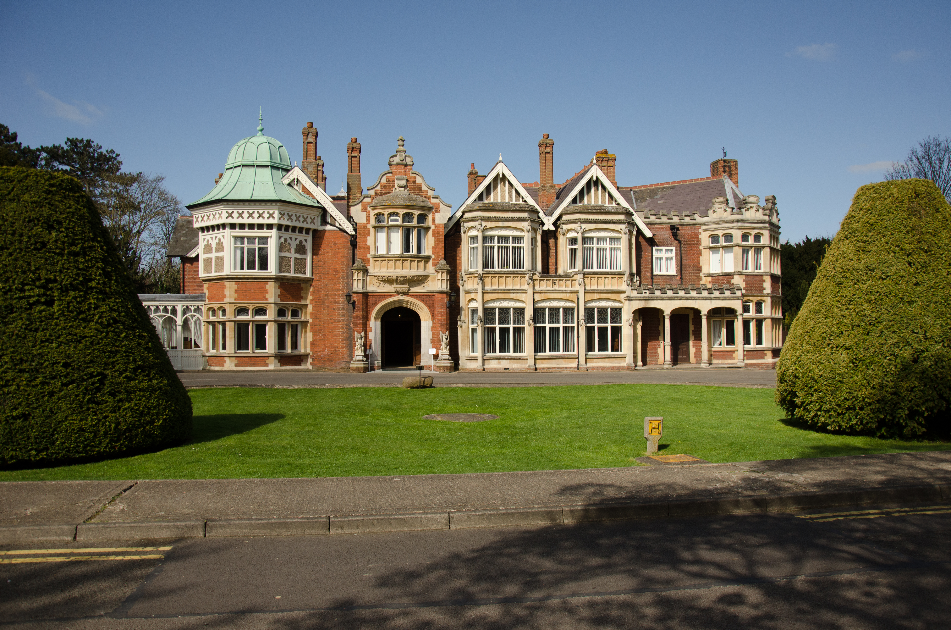
Traditional Answer: Cryptanalysis
Have many smart people try to break it.
Does not scale!
NIST: 64 candidates
NIST signature on-ramp: 40 candidates
KpqC: 16 candidates
China, Russia, …
Who is supposed to cryptanalyze all of these?
What about protocols?
"Bletchley Park House home of the World War Two Codebreakers," by Outwivcamera is licensed under CC BY-SA 4.0.

Slide 4
The Role of Security Proofs in Cryptography
Scheme
Proof
Cryptanalysis
Hard Problem

Slide 5
The Role of Security Proofs in Cryptography
Scheme
Proof
Scheme
Proof
Scheme
Proof
Scheme
Proof
Scheme
Proof
Scheme 6
Proof 6
Cryptanalysis
Hard Problem

Slide 6
The Role of Security Proofs in Cryptography
Protocol
Proof
Scheme
Proof
Scheme
Proof
Scheme
Proof
Scheme
Proof
Scheme
Proof
Scheme 6
Proof 6
Hard Problem
Cryptanalysis

Slide 7
Beautiful idea, but who checks the proofs?
The reviewers?
Review load per reviewer at top tier IACR: 16+ papers, 30 pages main body, often 50+ pages with appendix
The community?
eprint 2023:
1703 papers, of which 512 tagged protocols, 264 tagged PKC (ignoring foundations, applications,…)
2919 IACR members in 2023

Slide 8
Does that work?
Bugs in proofs / proof is wrong.
XMSS & SPHINCS+:
Kudinov, Kiktenko, and Fedorov 2020: Bug in proof of tight security bound for SPHINCS+.
Dilithium (and many other schemes):
Flaw in the HVZK proof step for Fiat-Shamir with aborts. [Barbosa, Barthe, Doczkal, Don, Fehr, Grégoire, Huang, Hülsing, Lee, and Wu. Fixing and Mechanizing the Security Proof of Fiat-Shamir with Aborts and Dilithium. CRYPTO 2023.]
All these are fixed now!

Slide 9
Does that work?
Bugs in instantiation / proof does not apply:
XMSS & SPHINCS+:
Peickert 2018: Tight-security proof does not apply to instantiations.
Antonov 2022: SHA256 instantiation of SPHINCS+ does not achieve full conjectured security on required security properties.
Kyber:
FO-transform used by Kyber is not the one with a security proof
Kyber round 1: Proof does not apply when using key compression
All these are fixed now!

Slide 10
Proof failure modes (Taken from Peter Schwabe)
Proof is wrong
Theorem is correct
Theorem is also wrong
Scheme is still (possibly) secure
Scheme is efficiently broken
Proof doesn’t apply to the scheme
Proof correct, but theorem “insufficient”
Example: attack hides in non-tightness
Proof (and possibly theorem) too vague
Theorem and proof correct, but not very useful
“A is secure if A is secure”

Slide 11
How to solve this?

Slide 12
Formosa Crypto
Effort to formally verify crypto
Goal: verified PQC ready for deployment
Three main projects:
EasyCrypt proof assistant
Jasmin programming language
Libjade (PQ-)crypto library
Core community of ≈ 30–40 people
Discussion forum with >180 people

Slide 13
The toolchain
EasyCrypt
Jasmin
EasyCrypt Spec
EasyCrypt Model
Jasmin Compiler
Jasmin Code
Extracts
EasyCrypt Equivalence Proof
Certified compilation
EasyCrypt Security Proof
assembly

Slide 14
Results (Security proofs)
Barbosa, Barthe, Fan, Grégoire, Hung, Katz, Strub, Wu, and Zhou. EasyPQC: Verifying Post-Quantum Cryptography. ACM CCS 2021
Hülsing, Meijers, and Strub. Formal Verification of Saber’s Public-Key Encryption Scheme in EasyCrypt. CRYPTO 2022
Barbosa, Barthe, Doczkal, Don, Fehr, Grégoire, Huang, Hülsing, Lee, and Wu. Fixing and Mechanizing the Security Proof of Fiat-Shamir with Aborts and Dilithium. CRYPTO 2023
Barbosa, Dupressoir, Grégoire, Hülsing, Meijers, and Strub. Machine-Checked Security for XMSS as in RFC 8391 and SPHINCS+. CRYPTO 2023
EasyCrypt
EasyCrypt Spec
EasyCrypt Model
EasyCrypt Equivalence Proof
EasyCrypt Security Proof

Slide 15
Impact
Proof is wrong
Theorem is correct
Theorem is also wrong
Scheme is still (possibly) secure
Scheme is efficiently broken
Proof doesn’t apply to the scheme
Proof correct, but theorem “insufficient”
Example: attack hides in non-tightness
Proof (and possibly theorem) too vague
Theorem and proof correct, but not very useful
“A is secure if A is secure”

Slide 16
Results
Almeida, Barbosa, Barthe, Grégoire, Laporte, Léchenet, Oliveira, Pacheco, Quaresma, Schwabe, Séré, Strub. Formally verifying Kyber Part I: Implementation Correctness. TCHES, 2023
EasyCrypt
EasyCrypt Spec
EasyCrypt Model
EasyCrypt Equivalence Proof
EasyCrypt Security Proof

Slide 17
Impact
Proof is wrong
Theorem is correct
Theorem is also wrong
Scheme is still (possibly) secure
Scheme is efficiently broken
Proof doesn’t apply to the scheme
Proof correct, but theorem “insufficient”
Example: attack hides in non-tightness
Proof (and possibly theorem) too vague
Theorem and proof correct, but not very useful
“A is secure if A is secure”

Slide 18
Impact
Proof is wrong
Theorem is correct
Theorem is also wrong
Scheme is still (possibly) secure
Scheme is efficiently broken
Proof doesn’t apply to the scheme
Proof correct, but theorem “insufficient”
Example: attack hides in non-tightness
Proof (and possibly theorem) too vague
Theorem and proof correct, but not very useful
“A is secure if A is secure”

Slide 19
What I did not talk about
Implementation security (Jasmin part)
Side-Channel Attack Resistance
Speculative Execution Attack Mitigation
Memory Safety
…
See CHES 2023 invited talk by Peter Schwabe https://youtu.be/7uIabAwB92M?si=gdGWEwXlz9XGZUhm&t=944
Other tools
Barbosa, Barthe, Bhargavan, Blanchet, Cremers, Liao, Parno. SoK: Computer-Aided Cryptography. S&P '21 https://eprint.iacr.org/2019/1393

Slide 20
Why does NIST not require machine-checked proofs for the signature round?
Results are great but
Full workflow for Kyber took more than 3 years of many, many people! (Still not fully published!)
Tools are "Expert Tools"
New proofs often need help of tool developer
Little automation
Little integration with higher level tools (e.g., for protocols)

Slide 21
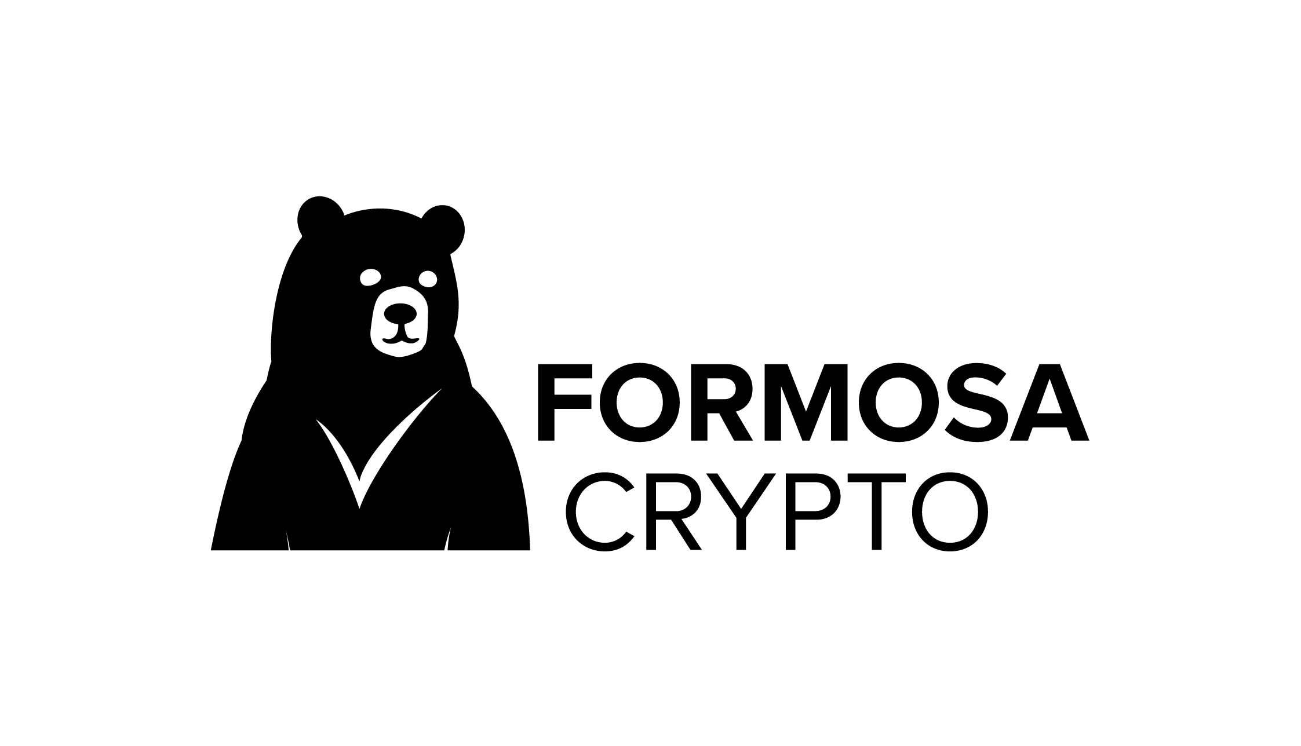
Summary
We have the tools, we can achieve great results
Verifying proofs is still research
Usability still needs improvement
There are many different tools for different use-cases
We are working on a fully verified PQC library!
Join the Formosa project (https://formosa-crypto.org/)

