Slide 1
SDitH in the QROM
Carlos Aguilar-Melchor, Andreas Hülsing, David Joseph, Christian Majenz, Eyal Ronen, and Dongze Yue
Mathematics and Computer Science

Slide 2
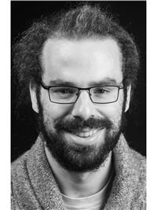
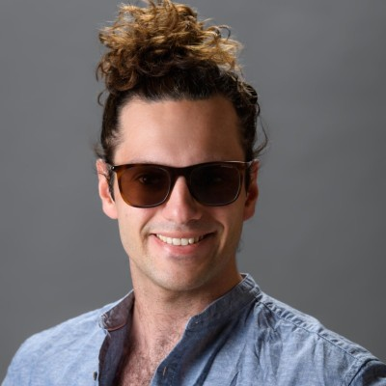
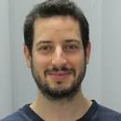
Joint work with
Christian Majenz
Carlos Aguilar Melchor
David Joseph
Dongzhe Yue
Eyal Ronen
SDitH in the QROM

Slide 3
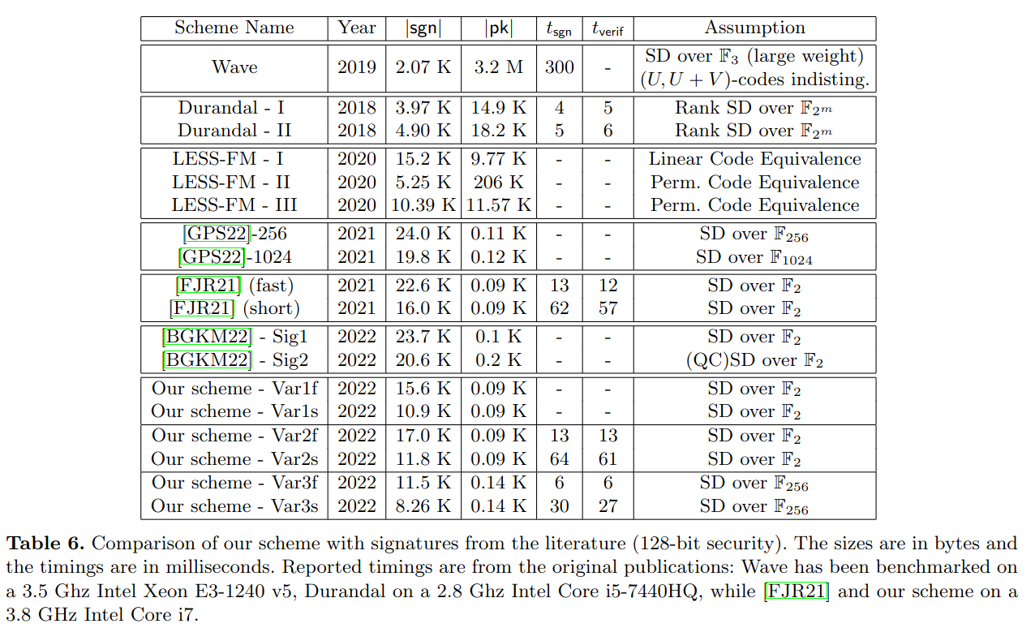
Syndrome Decoding in the Head (FJR22)
Code-based signature scheme
Using MPC in the Head (MPCitH)
Source: Thibauld Feneuil, Antoine Joux, and Matthieu Rivain. Syndrome Decoding in the Head: Shorter Signatures from Zero-Knowledge Proofs. Crypto'22

Slide 4
Identification schemes (3-round, public coin)
Prover P
Verifier V
w
c
z

Slide 5
Identification schemes (5-round, public coin)
Prover P
Verifier V
w
c
z
c
z

Slide 6
Security Properties
(special) soundness: There exists an efficient extractor E that given two transcripts with same w but different c, extracts sk.
Honest verifier zero-knowledge (HVZK): There exists an efficient simulator S that, given only the public key, outputs transcripts which are indistinguishable from transcripts of honest protocol runs

Slide 7
Identification schemes (3-round, public coin)
Prover P
Verifier V
w
c
z

Slide 8
MPCitH for PQ-identification (Y. Ishai, E. Kushilevitz, R. Ostrovsky, and A. Sahai. “Zero-knowledge from secure multiparty computation”. STOC'07)
Given OWF F: X -> Y
Create identification scheme IDS that proves knowledge of x such that
F(x) = y
for given y in zero-knowledge.
sk = x, pk = y
Used for (at least) 9 of 40 new NIST signature proposals.

Slide 9
MPCitH
KeyGen:
Sample x, set y = F(x)

Slide 10
MPCitH
Commit:
Secret share x:
Sample random tapes:
Commit to shares & rand:
Run MPC protocol such that
Output

Slide 11
MPCitH
Response:
Open all commitments except com_{c} and output openings.

Slide 12
MPCitH
Verify:
Check
Verify
Return true if none of the above failed.

Slide 13
MPCitH Security
HVZK: Secrecy of inputs in MPC
Soundness: Cut & Choose - catch a cheating prover with probability 1- (1 / #parties)
Special soundness: Two valid openings for same commitments but
different challenge reveal all secret shares (and as it opens all parties, none of them can have cheated without getting caught)

Slide 14
SDitH (FJR'22)
Apply MPCitH to Syndrome Decoding problem

Slide 15
SDitH (FJR'22)
Apply MPCitH to Syndrome Decoding problem
Advantage: Linear function.

Slide 16
SDitH (FJR'22)
Apply MPCitH to Syndrome Decoding problem
Advantage: Linear function.
Disadvantage: Weight check.

Slide 17
SDitH – Weight check
Uses "Polynomial zero-test"
Uses polys Q, P, and public F as well as polynomial S derived from x such that
T = SQ – PF = 0 if wt(x)
Checking this is done by evaluating T at random points.
Needs multiplication which needs one more round of interaction!

Slide 18
SDitH Identification scheme (5-round, public coin)
Prover P
Verifier V
w
c
z
c
z

Slide 19
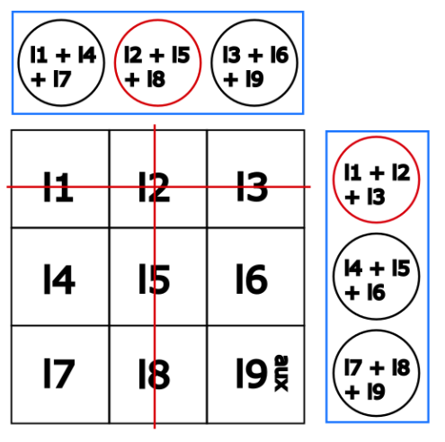
Tweaks
Use TreePRG for random x_{i} and r_{i}. (Log size opening)
Hypercube:
Carlos Aguilar-Melchor, Nicolas Gama, James Howe, Andreas Hülsing, David Joseph, and Dongze Yue
The Return of the SDitH. EUROCRYPT, 2023

Slide 20
Signature Scheme
Fiat-Shamir transform
S.KeyGen = IDS.KeyGen
S.Sign(sk,m) = P.COMMIT + P.RESPONSE₁ + P.RESPONSE₂ with c₁ = H(w[, m]), c₂ = H(c₁,z₁,m)
S.Verify = V.verify with c₁ = H(w[, m]), c₂ = H(c₁,z₁,m)

Slide 21
How to prove security?
IDS: Done in [FJR'22]
Signature against classical adversaries (ROM): Done in [FJR'22]
Signature against quantum adversaries (QROM): ?

Slide 22
How to prove security?
IDS: Done in [FJR'22]
Signature against classical adversaries (ROM): Done in [FJR'22]
Signature against quantum adversaries (QROM): ?
Generic results on (5-round) FS have a horrible tightness loss
Amazing (pretty) tight result for commit & open IDS J. Don, S. Fehr, C. Majenz, and C. Schaffner. Efficient NIZKs and Signatures from Commit-and-Open Protocols in the QROM. Crypto'22 But: only for 3-round IDS

Slide 23
Wait, FJR'22 showed 2-special soundness.

Slide 24
We showed something about 2-special sound 5-round IDS in the MQDSS paper...

Slide 25
Observation
We can apply a "cheap FS transform" to the first challenge.
Replace challenge by hash of commitment
Security argument based on hard search problem
Cheap? No extraction needed. Just information theoretic arguments (as everything is in the (Q)ROM).

Slide 26
Proof strategy
Reduce to 3-rounds
Prove HVZK in QROM -> standard
Prove Soundness in QROM -> see below
Apply known results:
A. B. Grilo, K. Hövelmanns, A. Hülsing, and Christian Majenz. Tight adaptive reprogramming in the QROM. Asiacrypt'21 UF-NMA + HVZK ==QROM==> UF-CMA
J. Don, S. Fehr, C. Majenz, and C. Schaffner. Efficient NIZKs and Signatures from Commit-and-Open Protocols in the QROM. Crypto'22 Sp. Sound. ==QROM==> UF-NMA

Slide 27
Computational version of special soundness

Slide 28
Proven bound

Slide 29
Proven bound

Slide 30
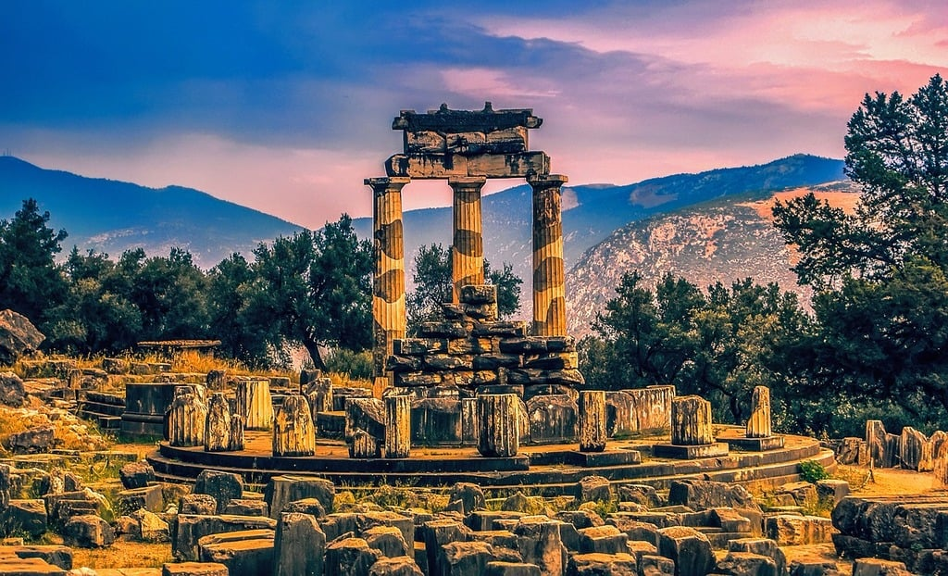
QROM+ - Phase 1
Compressed oracle [Zhandry'18]

Slide 31
QROM+ - Phase 2
Compressed oracle [Zhandry'18]

Slide 32
Why do we need a QROM+?
We build algorithm R for oracle search problem
R runs A against soundness of IDS
A solves search problems (reflected in queries)
A's QROM queries cannot be seen by R

Slide 33
Why is this unproblematic?
Search problems are not easier in QROM+!
R as a whole (including A) has the knowledge
It's as if R is oblivious
Measurement does not give any new information

Slide 34
UF-NMA

Slide 35
UF-CMA

Slide 36
UF-CMA

Slide 37
Results

Slide 38
Conclusion
Security proof for SDitH and H-SDitH against quantum adversaries
Bound is tight up to constants if multi-target mitigation is used
Allows for online-offline signatures with very short online phase
Techniques may apply to similar schemes
(eprint) PoW can be used to optimize parameters
https://eprint.iacr.org/2023/756.pdf

Slide 39
Backup

Slide 40
PoW (increase cost of RO query)

