Slide 1
Signatures from identification, MPCitH, and more
Andreas Hülsing Eindhoven University of Technology & SandboxAQ

Slide 2
PQ Signatures
Signatures vs KEM: Should be easier … it isn't...
Approaches:
Hash & Sign
Full Domain Hash (FDH) with Trapdoor OWP: RSA-PSS, MAYO, UOV,...
FDH with Preimage-sampleable TDF: Falcon
Hash-based signatures
Signatures from identification:
Fiat-Shamir (FS): (EC)DSA, Schnorr, …
FS with aborts: Dilithium
FS + MPC in the Head (MPCitH): Picnic, Biscuit, MIRA, MiRitH, MQOM, PERK, RYDE, SDitH, AIMer, ...

Slide 3
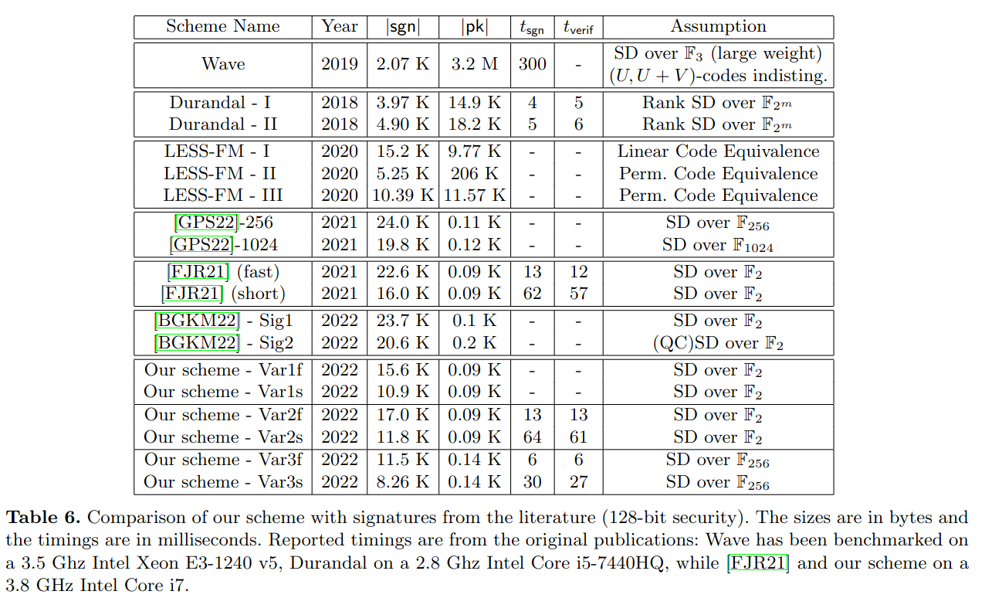
Syndrome Decoding in the Head (FJR22)
Code-based signature scheme using MPCitH
Beats all previous code-based signatures
Uses unstructured SD problem!
Source: Thibauld Feneuil, Antoine Joux, and Matthieu Rivain. "Syndrome Decoding in the Head: Shorter Signatures from Zero-Knowledge Proofs". Crypto'22

Slide 4
Outline
OWF
MPC
P₁([x]₁)
x = [x]₁ + [x]₂ + … + [x]_{N}
x
F
y
P₅([x]₅)
P₂([x]₂)
C([x]₁, [x]₂, …, [x]_{N}) = F(x)
P₄([x]₄)
P₃([x]₃)
MPC in the Head
DSig
IDS
Prover P (sk)
Verifier V (pk)
Fiat-Shamir
w <- Commit(sk)
w
SK
PK
/
c
c <-_{R} CSpace
Sign
Vrfy
z <- Response(sk,w,c)
z
b <- Verify(pk,w,c,z)

Slide 5
Outline
OWF
MPC
P₁([x]₁)
x = [x]₁ + [x]₂ + … + [x]_{N}
x
F
y
P₅([x]₅)
P₂([x]₂)
C([x]₁, [x]₂, …, [x]_{N}) = F(x)
P₄([x]₄)
P₃([x]₃)
MPC in the Head
DSig
IDS
Prover P (sk)
Verifier V (pk)
Fiat-Shamir
w <- Commit(sk)
w
SK
PK
/
c
c <-_{R} CSpace
Sign
Vrfy
z <- Response(sk,w,c)
z
b <- Verify(pk,w,c,z)

Slide 6
OWF
AES (FEAST)
LowMC (Picnic)
AIM (AIMer)
Polynomial arithmetic & evaluation (SDitH)
MQ equation system (Biscuit)
Low multiplicative depth is an advantage!
OWF
x
F
y

Slide 7
(secure) Multi-Party Computation
MPC
P₁([x]₁)
P₅([x]₅)
P₂([x]₂)
P₄([x]₄)
P₃([x]₃)

Slide 8
MPC
Allows N parties P₁, … ,P_{N} with inputs x₁, … , x_{N} to jointly compute a function F(x₁, … , x_{N}) = y such that
all parties learn the outcome y
but nothing beyond that
MPC
P₁([x]₁)
P₅([x]₅)
P₂([x]₂)
P₄([x]₄)
P₃([x]₃)

Slide 9
Example: Price negotiations
Buyer & Seller compute if they can agree on price X
Logical AND of "willingness"
If you do not agree, you do not learn the other party's decision!
Prevents pushing up / down to limit of other party

Slide 10
MPC
Allows N parties P₁, … ,P_{N} with inputs x₁, … , x_{N} to jointly compute a function F(x₁, … , x_{N}) = y such that
all parties learn the outcome y
but nothing beyond that
We additionally need:
Correctness: If all parties are honest, the result is correct
N-1 private: If N-1 parties collaborate, they can still not learn anything about the input of the last party beyond what can be derived from F(x₁, … , x_{N}) = y
Broadcast communication: All messages are broadcasted

Slide 11
(additive) Secret Sharing Scheme (SSS)
Split x = [x]₁ + [x]₂ + … + [x]_{N} with secret shares [x]_{i} in F_{q}
Given all but one share x is information theoretically hidden!

Slide 12
MPC for additive SSS
Split x = [x]₁ + [x]₂ + … + [x]_{N} with secret shares [x]_{i} in F_{q}
Party i holds share [x]_{i} of value x.
Operations:
Adding shared values ([x] + [y]): Parties locally add shares Σ([x]_{i}+[y]_{i}) = Σ[x]_{i}+ Σ[y]_{i} = x+y
Adding constant ([x] + c): P1 computes [x]₁ + c, all others do nothing [x]₁ + c + [x]₂ + … + [x]_{N} = Σ[x]_{i} + c = x + c
Multiplication by constant ([x] · c): All parties locally compute [x]_{i} · c [x]₁ · c + [x]₂ · c + … + [x]_{N} · c = ([x]₁ + [x]₂ + … + [x]_{N}) · c = x · c

Slide 13
MPC for additive SSS
Split x = [x]₁ + [x]₂ + … + [x]_{N} with secret shares [x]_{i} in F_{q}
Party i holds share [x]_{i} of value x.
Operations:
Adding shared values ([x] + [y]): Parties locally add shares Σ([x]_{i}+[y]_{i}) = Σ[x]_{i}+ Σ[y]_{i} = x+y
Adding constant ([x] + c): P1 computes [x]₁ + c, all others do nothing [x]₁ + c + [x]₂ + … + [x]_{N} = Σ[x]_{i} + c = x + c
Multiplication by constant ([x] · c): All parties locally compute [x]_{i} · c [x]₁ · c + [x]₂ · c + … + [x]_{N} · c = ([x]₁ + [x]₂ + … + [x]_{N}) · c = x · c
Multiplication of shared values?

Slide 14
Share multiplication
Conventional:
(Katz, Kolesnikov, Wang. "Improved non-interactive zero knowledge with applications to post-quantum signatures". CCS 2018)
All parties know one share of both inputs
After protocol, all parties know a share of the output
Modern:
(Lindell, Nof. "A framework for constructing fast MPC over arithmetic circuits with malicious adversaries and an honest-majority". CCS 2017)
(Baum, Nof. "Concretely-Efficient Zero-Knowledge Arguments for Arithmetic Circuits and Their Application to Lattice-Based Cryptography". PKC 2020)
All parties know a share of both inputs and the output
Protocol proves that output is a sharing of product of input

Slide 15
Verifying multiplication
Parties need random triple [a], [b], [c], with ab = c, to verify [x], [y], [z], with xy = z
Take random element e in F_{q}
Parties locally set [α] = e[x] + [a] and [β] = [y] + [b]
Parties broadcast [α] and [β] shares to open α and β
Parties locally set [v] = e[z] − [c] + α · [b] + β · [a] − α · β (note that last summand is only subtracted by P₁)
Parties broadcast [v] shares to open v and accept if v = 0.

Slide 16
Verifying multiplication – Correctness
v = e · z − c + α · b + β · a − α · β
= e · xy − ab + (e · x + a)b + (y + b)a − (e · x + a)(y + b)
= exy – ab + exb + ab + ya + ba − exy − exb − ay – ab = 0

Slide 17
Verifying multiplication – Soundness
v = e · z − c + α · b + β · a − α · β
= e · xy − ab + (e · x + a)b + (y + b)a − (e · x + a)(y + b)
= exy – ab + exb + ab + ya + ba − exy − exb − ay – ab = 0

Slide 18
Verifying multiplication – Soundness
Let z = xy + d_{z} and c = ab + d_{c}
v = e · z − c + α · b + β · a − α · β
= e · xy + ed_{z} − ab − d_{c} + (e · x + a)b + (y + b)a − (e · x + a)(y + b)
= 0 + ed_{z} − d_{c}

Slide 19
Verifying multiplication – Soundness
Claim: If d_{z} ≠ 0 or d_{c} ≠ 0 then v = 0 with probability at most 1 / |F_{q}|
Proof: Recall v = ed_{z} − d_{c}
Case d_{z} = 0 & d_{c} ≠ 0:
v = ed_{z} − d_{c} = - d_{c} ≠ 0

Slide 20
Verifying multiplication – Soundness
Claim: If d_{z} ≠ 0 or d_{c} ≠ 0 then v = 0 with probability at most 1 / |F_{q}|
Proof: Recall v = ed_{z} − d_{c}
Case d_{z} = 0 & d_{c} ≠ 0:
v = ed_{z} − d_{c} = - d_{c} ≠ 0
Case d_{z} ≠ 0 & d_{c} ≠ 0:
v = 0 <=> d_{c} = ed_{z} <=> dcd_{z}⁻¹= e (prob 1 / |F_{q}|)

Slide 21
Verifying multiplication – Soundness
Claim: If d_{z} ≠ 0 or d_{c} ≠ 0 then v = 0 with probability at most 1 / |F_{q}|
Proof: Recall v = ed_{z} − d_{c}
Case d_{z} = 0 & d_{c} ≠ 0:
v = ed_{z} − d_{c} = - d_{c} ≠ 0
Case d_{z} ≠ 0 & d_{c} ≠ 0:
v = 0 <=> d_{c} = ed_{z} <=> dcd_{z}⁻¹= e (prob 1 / |F_{q}|)
Case d_{z} ≠ 0 & d_{c} = 0:
v = ed_{z} − d_{c} = edz => v = 0 iff e = 0 (prob 1 / |F_{q}|)

Slide 22
Function to circuit - Examples
Evaluating shared polynomial [P] = Σ [p_{i}] x^{i} at public point r:
Locally: [P](r) = Σ [p_{i}] r^{i} = [y]
No interaction
Single secret shared value as outcome
Evaluating product of shared polynomials [P], [S] at public point r:
Requires knowledge of result [z]
Locally: [P](r) = Σ [p_{i}] r^{i} = [y], [S](r) = Σ [s_{i}] r^{i} = [x]
Run verify for [x]·[y] = [z]
Single broadcast interaction + final opening

Slide 23
Function to circuit: SDitH (FJR'22)
Turn Syndrome Decoding function into MPC

Slide 24
Function to circuit: SDitH (FJR'22)
Turn Syndrome Decoding function into MPC
Advantage: Linear function.

Slide 25
Function to circuit: SDitH (FJR'22)
Turn Syndrome Decoding function into MPC
Advantage: Linear function.
Disadvantage: Weight check.

Slide 26
SDitH – Implicit Equation Check
Use H in standard form: H = (H' | I_{m-k})
Can write x = (x_{A} | x_{B}) with y = H'x_{A} + x_{B}
Define sk = x_{A}
Compute x via x_{B} = y – H'x_{A}
=> guarantees x fulfills y = Hx

Slide 27
SDitH – Weight check
Compute x from x_{A}, H, and y
Derive a polynomial S from x
Generate polys Q, P, and public F such that
SQ – PF = 0 if wt(x)
Select t random points r_{i} and verify that
S(r_{i})Q(r_{i}) = PF(r_{i}) for 0 < i ≤ t.

Slide 28
SDitH – MPC circuit
Compute [x] from [x_{A}], H, and y (only linear ops)
Derive share of polynomial [S] from [x] (only linear ops)
Generate secret shared polys [Q], [P], and public F such that
[S][Q] – [P]F = 0 if wt(x)
Get t random points r_{i}, t random masks e_{i}, and run verification for
[S](r_{i})[Q](r_{i}) = [P]F(r_{i}) using e_{i}
for 0 < i ≤ t.

Slide 29
Identification Schemes
IDS
Prover P (sk)
Verifier V (pk)
w <- Commit(sk)
w
c
c <-_{R} CSpace
z <- Response(sk,w,c)
z
b <- Verify(pk,w,c,z)

Slide 30
Identification Schemes (IDS) / Zero-knowledge proofs (ZKP)
Invented by Shafi Goldwasser, Silvio Micali and Charles Rackoff in 1985
Interactive proof systems
Prove knowledge of a secret without revealing any information about the secret
[For people that like classifications: The IDS we discuss are actually Honest-Verifier Zero-Knowledge Arguments of Knowledge]

Slide 31
Identification schemes (3-round, public coin)
Prover P (sk)
Verifier V (pk)
w <- Commit(sk)
w
c
c <-_{R} CSpace
z <- Response(sk,w,c)
z
b <- Verify(pk,w,c,z)
Also called a "Sigma Protocol"

Slide 32
The case of Sudoku
A: I have a nice Sudoku for you
B: You are sure this is solvable?
A: Sure!
B: Prove it!
A: Ok...
5 3 4 6 7 8 9 1 2
6 7 2 1 9 5 3 4 8
1 9 8 3 4 2 5 6 7
8 5 9 7 6 1 4 2 3
4 2 6 8 5 3 7 9 1
7 1 3 9 2 4 8 5 6
9 6 1 5 3 7 2 8 4
2 8 7 4 1 9 6 3 5
3 4 5 2 8 6 1 7 9

Slide 33
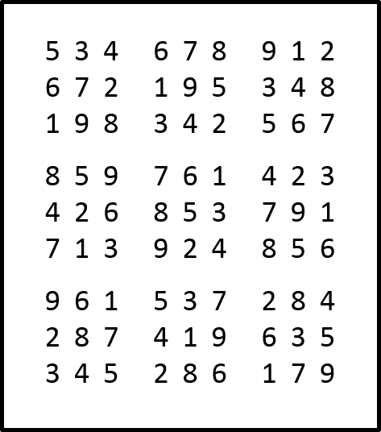
The case of Sudoku
So how can Alice prove that a solution exists without making the Sudoku easier (a.k.a. leaking information)?

Slide 34
The case of Sudoku
Apply random permutation to solution:
1 | 2 | 3 | 4 | 5 | 6 | 7 | 8 | 9
3 | 2 | 7 | 1 | 6 | 9 | 4 | 5 | 8
5 3 4 6 7 8 9 1 2
6 7 2 1 9 5 3 4 8
1 9 8 3 4 2 5 6 7
8 5 9 7 6 1 4 2 3
4 2 6 8 5 3 7 9 1
7 1 3 9 2 4 8 5 6
9 6 1 5 3 7 2 8 4
2 8 7 4 1 9 6 3 5
3 4 5 2 8 6 1 7 9
6 7 1 9 4 5 8 3 2
9 4 2 3 8 6 7 1 5
3 8 5 7 1 2 6 9 4
5 6 8 4 9 3 1 2 7
1 2 9 5 6 7 4 8 3
4 3 7 8 2 1 5 6 9
8 9 3 6 7 4 2 5 1
2 5 4 1 3 8 9 7 6
7 1 6 2 5 9 3 4 8

Slide 35
The case of Sudoku
Prepare scratch card:
6 7 1 9 4 5 8 3 2
9 4 2 3 8 6 7 1 5
3 8 5 7 1 2 6 9 4
5 6 8 4 9 3 1 2 7
1 2 9 5 6 7 4 8 3
4 3 7 8 2 1 5 6 9
8 9 3 6 7 4 2 5 1
2 5 4 1 3 8 9 7 6
7 1 6 2 5 9 3 4 8

Slide 36
The case of Sudoku
Show scratch card to Bob and allow him to ask Alice to do one out of the following:
Scratch off a row
Scratch off a column
Scratch off a square
Scratch off original Sudoku
6 7 1 9 4 5 8 3 2
9 4 2 3 8 6 7 1 5
3 8 5 7 1 2 6 9 4
5 6 8 4 9 3 1 2 7
1 2 9 5 6 7 4 8 3
4 3 7 8 2 1 5 6 9
8 9 3 6 7 4 2 5 1
2 5 4 1 3 8 9 7 6
7 1 6 2 5 9 3 4 8

Slide 37
The case of Sudoku
What does Bob gain? (Soundness)
If scratching reveals inconsistency: Alice cheated!
If scratching reveals consistent values: Alice might have cheated... But Bob gains some confidence in Alice knowing a solution.

Slide 38
The case of Sudoku
Bob choose from 28 possible “challenges“
If Alice is cheating she gets caught with prob. $≥\frac{1}{28}$
Cheating Alice has chance of $≤\frac{27}{28}$ to succeed
Repeating protocol $n$ times means Alice’s cheating probability goes down to ${\left(\frac{27}{28}\right)}^{n}≈{\left(\frac{1}{2}\right)}^{0.05n}$
When $n = 2500$, Alice caught with $0.99$ probability.

Slide 39
The case of Sudoku
(Honest-Verifier) Zero-knowledge:
We want to show that (honest) Bob does not learn anything about the secret (i.e., the Sudoku solution)
We will prove: Everything he learns, he could have generated himself.
Can be proved showing that Bob (without knowing the secret) could have generated valid protocol transcripts that are indistinguishable from those obtained by communicating with Alice.
?

Slide 40
The case of Sudoku
Proving zero-knowledge:
Trick: When Bob generates transcripts, he can first select the challenge, then produce the scratch card!
For challenge row, column, or square: Just put random permutation of 1...9.
For challenge original Sudoku: Just put random permutation of the used numbers.
$⟹$ Follows exactly same distribution as what Alice would have put there!

Slide 41
The case of Sudoku - Implications
Yato 2003: „Solvability of n x n Sudoku is NP-complete“
We can use this proof for any other problem in NP
Just transform problem instance into Sudoku instance and run ZKP for that instance.

Slide 42
Identification schemes (3-round, public coin)
Prover P (sk)
Verifier V (pk)
w <- Commit(sk)
w
c
c <-_{R} CSpace
z <- Response(sk,w,c)
z
b <- Verify(pk,w,c,z)
Also called a "Sigma Protocol"

Slide 43
Security Properties
Soundness: A prover that does not know the secret will get caught with high probability (1 – e) where e is called soundness error
Special soundness: There exists an efficient extractor E that given two transcripts with same w but different c, extracts sk.
Honest verifier zero-knowledge (HVZK): There exists an efficient simulator S that, given only the public key, outputs transcripts which are indistinguishable from transcripts of honest protocol runs

Slide 44
Identification schemes (5-round, public coin)
Prover P (sk)
Verifier V (pk)
w <- Commit(sk)
w
c₁
c₁ <-_{R} CSpace₁
z₁ <- Response(sk,w,c₁)
z₁
c₂
c₂ <-_{R} CSpace₂
z₂ <- Response(sk,w,c₁,z₁,c₂)
z
b <- Verify(pk,w,c₁,z₁,c₂,z₂)

Slide 45
More notes on IDS
We can have 2n+1 round IDS for n ≥ 1
We usually require that w has high entropy (hard to predict)
Commitment-recoverable IDS:
There exist function Recv(c, z) -> w
We later need negligible soundness error
Achieved via parallel composition

Slide 46
MPC in the Head
MPC
P₁([x]₁)
P₅([x]₅)
P₂([x]₂)
P₄([x]₄)
P₃([x]₃)
MPC in the Head
IDS
Prover P (sk)
Verifier V (pk)
w <- Commit(sk)
w
c
c <-_{R} CSpace
Y. Ishai, E. Kushilevitz, R. Ostrovsky, and A. Sahai. “Zero-knowledge from secure multiparty computation”. STOC'07
z <- Response(sk,w,c)
z
b <- Verify(pk,w,c,z)
46

Slide 47
MPCitH for PQ-identification (Y. Ishai, E. Kushilevitz, R. Ostrovsky, and A. Sahai. “Zero-knowledge from secure multiparty computation”. STOC'07)
Given OWF F: X -> Y
Create identification scheme IDS that proves knowledge of x such that
F(x) = y
for given y in (honest-verifier) zero-knowledge.
sk = x, pk = y[, F]

Slide 48
High-level idea
Prover P (sk)
Verifier V (pk)
P₁([x]₁)
P₅([x]₅)
P₂([x]₂)
P₄([x]₄)
P₃([x]₃)
w
w <- Commit([x]),
c
c <-_{R} {1, … , 5}
z <- P_{i} forall i ≠ c
z
Check consistency of all opened parties & verify result

Slide 49
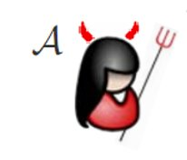
Security - Soundness
Prover P (sk)
Verifier V (pk)
P₁([x]₁)
P₅([x]₅)
P₂([x]₂)
P₄([x]₄)
P₃([x]₃)
w
w <- Commit([x]),
c
c <-_{R} {1, … , 5}
z <- P_{i} forall i ≠ c
z
Check consistency of all opened parties & verify result

Slide 50
Security - Soundness
Prover P (sk)
Verifier V (pk)
P₁([x]₁)
P₅([x]₅)
P₂([x]₂)
P₄([x]₄)
P₃([x]₃)
w
w <- Commit([x]),
c = 4
c <-_{R} {1, … , 5}
z <- P_{i} for i ≠ 4
z
Check consistency of all opened parties & verify result

Slide 51
Security - Soundness
Prover P (sk)
Verifier V (pk)
P₁([x]₁)
P₅([x]₅)
P₂([x]₂)
P₄([x]₄)
P₃([x]₃)
w
w <- Commit([x]),
c ≠ 4
c <-_{R} {1, … , 5}
z <- P_{i} forall i ≠ c
z
Check consistency of all opened parties & verify result

Slide 52
Security - Soundness
Soundness
Only if c = i_{A}, A will go undetected!
Soundness error = 1 / N for N parties
Special soundness:
Valid openings for c₁ ≠ c₂ reveal all P_{i}
=> Can recombine [x]

Slide 53
Security - HVZK
Simulator samples random c first
Generates P_{i}, i ≠ c, honestly, with random inputs
Choses communication of P_{c} such that result is correct
Computes all other parts following protocol

Slide 54
Real life...
We need the random e for multiplication check! (and for SDitH also the points r)
Add a round trip ...

Slide 55
Commit
Share secret [x], generate required number (say t) of multiplication triples ([a],[b],[c])_{i}
Commit to all the shares of one party together.
Send commitments to V

Slide 56
Challenge 1
Send t random values e_{i} for multiplication verification (SDitH: Also t random points r_{i} to evaluate polynomials on)

Slide 57
Response 1
Run MPC protocol using commited shares and e_{i}
Assemble and send communication of all multiplication verifications

Slide 58
Challenge 2
Send random c within {1, … , N}

Slide 59
Response 2
Send all shares of each party P_{i}, i ≠ c

Slide 60
Verify
Run MPC protocol with "opened parties" using communications of unopened party
Check that all communications are consistent
Check that final result is correct (usually, C is built such that result is 0)

Slide 61
Impact on security
HVZK: None – just sample all challenges in advance
Soundness: Two ways of cheating -> guessing an e and manipulating the multiplication test or guessing the second challenge.
Soundness error becomes 1 / |F_{q}| + 1 / N

Slide 62
Optimizations
Generate secret shares using PRG, e.g.: x = [x]₁ + [x]₂ + … + [x]_{N} + Δ for [x]_{i} = PRG(s_{i}) and Δ = x - Σ[x]_{I}
requires to send the Δ in first communication!
Only need to commit to and later open s_{i} which are shorter than [x]_{i}
Generate s_{i} using TreePRG
Allows to open all but one leaf publishing log N seeds in place of N!
Hash commitment message and send unopened commitments in last message: w' = H(w)
Commitment-recoverable IDS
MUCH shorter w, only slightly longer z

Slide 63
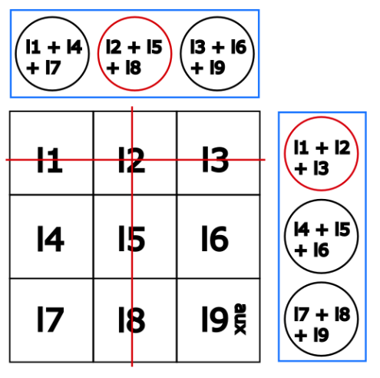
Hypercube verification
Carlos Aguilar-Melchor, Nicolas Gama, James Howe, Andreas Hülsing, David Joseph, and Dongze Yue
"The Return of the SDitH". EUROCRYPT'23

Slide 64
Fiat-Shamir
DSig
IDS
Prover P (sk)
Verifier V (pk)
Fiat-Shamir
w <- Commit(sk)
w
SK
PK
/
c
c <-_{R} CSpace
Sign
Vrfy
z <- Response(sk,w,c)
z
b <- Verify(pk,w,c,z)

Slide 65
Fiat-Shamir Signatures
Sign (sk,m)
Verify (pk, m, sig)
w <- P.commit(sk)
c <- hash(pk, w, m)
z <- P.response(sk, w, c)
Return sig = (w, c, z)
c <- hash(pk, w, m)
b <- V.verify(pk, w, c, z)

Slide 66
Why is this secure?
HVZK -> Forger does not learn anything about the secret (or how to sign a different message) from seeing signatures on chosen messages
Proof idea: (Q)ROM proof.
Answer queries by running HVZK simulator
Program RO to make them consistent (set c <- H(w,m))
Soundness -> Cannot do better than guessing the challenge per hash query / finding a suitable preimage for given challenge
For special case of 3-round commit & open IDS with special soundness doable in QROM, otherwise complicated (massive loss, hard proof)
If the adversary has higher success probability than the soundness error, it must be able to answer for more than one challenge.
All openings must be sound
Implementing the commitment using a random oracle, we can open all commitments using the random oracle table -> can generate two valid transcripts for different c & extract

Slide 67
SDitH in the QROM (Aguilar-Melchor, Hülsing, Joseph, Majenz, Ronen, Yue. SDitH in the QROM. Asiacrypt'23)
Can turn SDitH IDS into 3 round IDS replacing first challenge by hash of first message (FS but easier proof -> search problem)
Get a scheme with query-bounded special soundness
Apply FS for 3-round commit & open IDS in QROM

Slide 68
Summary
OWF
MPC
P₁([x]₁)
x = [x]₁ + [x]₂ + … + [x]_{N}
x
F
y
P₅([x]₅)
P₂([x]₂)
C([x]₁, [x]₂, …, [x]_{N}) = F(x)
P₄([x]₄)
P₃([x]₃)
MPC in the Head
DSig
IDS
Prover P (sk)
Verifier V (pk)
Fiat-Shamir
w <- Commit(sk)
w
SK
PK
/
c
c <-_{R} CSpace
Sign
Vrfy
z <- Response(sk,w,c)
z
b <- Verify(pk,w,c,z)

Slide 69
Conclusion
MPCitH allows to build signature scheme from OWF
Works best for functions with mostly linear steps
Several nice optimizations exist
Quite competitive:
small sk,
small pk,
medium sigs,
fast
allows for online / offline sigs
(Aguilar-Melchor, Hülsing, Joseph, Majenz, Ronen, Yue. SDitH in the QROM. Asiacrypt'23)

