Slide 1
Hash-based Signatures
Andreas Hülsing
Eindhoven University of Technology & Sandbox AQ

Slide 2
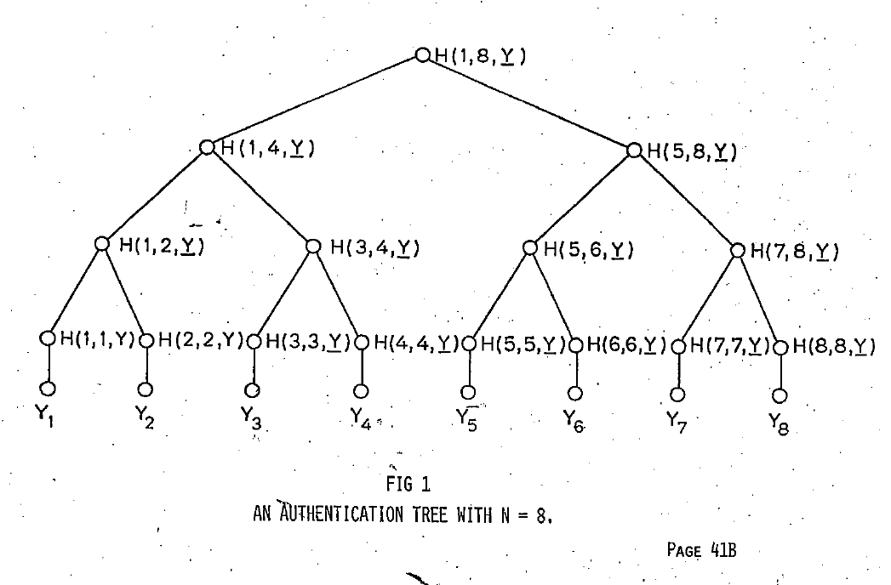
Hash-based Signature Schemes [Mer89]
Post quantum
Only secure hash function
Security well understood
Fast
Standardized

Slide 3
RSA – DSA – EC-DSA...
Intractability Assumption
Cryptographic
hash function
RSA, DH, SVP, MQ, …
Digital signature scheme

Slide 4
Hash function families

Slide 5




(Hash) function families
(aka. keyed functions)
$H:{\text{\{0,1\}}}^{n}×{\text{\{0,1\}}}^{m}→{\text{\{0,1\}}}^{n}$
$H_{k}\left(x\right)=H(k,x)$
Require $m≥n$
and $H_{k}\left(x\right)$ is „efficient“
$${\{0,1\}}^{n}$$
$$H_{k}$$
$${\{0,1\}}^{m}$$

Slide 6
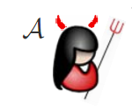



One-wayness
$$H:{\text{\{0,1\}}}^{n}×{\text{\{0,1\}}}^{m}→{\text{\{0,1\}}}^{n}$$
$$k←_{R}{\text{\{0,1\}}}^{n}$$
$$x←_{R}{\{0,1\}}^{m}$$
$$y_{c}=H_{k}\left(x\right)$$
Success if $H_{k}\left(x^{∗}\right)=y_{c}$
$$y_{c},k$$
$$x^{∗}$$

Slide 7

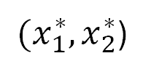

Collision resistance
$$H:{\text{\{0,1\}}}^{n}×{\text{\{0,1\}}}^{m}→{\text{\{0,1\}}}^{n}$$
$$k←_{R}{\text{\{0,1\}}}^{n}$$
Success if
$H_{k}\left(x_{1}^{∗}\right)=H_{k}\left(x_{2}^{∗}\right)$ and
$$x_{1}^{∗}≠x_{2}^{∗}$$
$$k$$
${(x}_{1}^{∗},x_{2}^{∗}$)

Slide 8


Second-preimage resistance
$$H:{\text{\{0,1\}}}^{n}×{\text{\{0,1\}}}^{m}→{\text{\{0,1\}}}^{n}$$
$$k←_{R}{\{0,1\}}^{n}$$
$$x_{c}←_{R}{\{0,1\}}^{m}$$
Success if
$H_{k}\left(x_{c}\right)=H_{k}\left(x^{∗}\right)$ and
$$x_{c}≠x^{∗}$$
$$x_{c},k$$
$$x^{∗}$$
NEW!
Decisional version: Does a valid response exist?

Slide 9

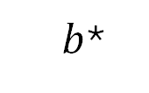
Undetectability
$$H:{\text{\{0,1\}}}^{n}×{\text{\{0,1\}}}^{m}→{\text{\{0,1\}}}^{n}$$
$$k←_{R}{\{0,1\}}^{n}$$
$$b←_{R}\{0,1\}$$
If $b=1$
$x←_{R}{\text{\{0,1\}}}^{m}$
$y_{c}←H_{k}(x)$
else
$y_{c}←_{R}{\text{\{0,1\}}}^{n}$
$$y_{c},k$$
$b$*

Slide 10







Pseudorandomness
$$H:{\text{\{0,1\}}}^{n}×{\text{\{0,1\}}}^{m}→{\text{\{0,1\}}}^{n}$$
$$1^{n}$$
$$b$$
If $b = 1$
$$k←_{R}{\{0,1\}}^{n} \\ g=H_{k}$$
Else
$$g←_{R}F_{m,n}$$
$$x$$
g
$$y = g(x)$$
$b$*

Slide 11
Generic security
„Black Box“ security (best we can do without looking at internals)
  For hash functions: Security of random function family
(Often) expressed in #queries (query complexity)
Hash functions not meeting generic security considered insecure

Slide 12
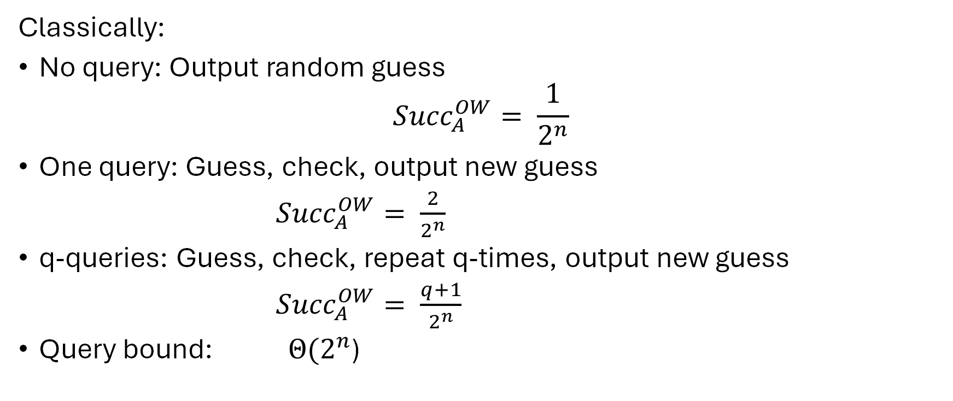
Generic Security - OWF
Classically:
No query: Output random guess
$${Succ}_{A}^{OW}= \frac{1}{2^{n}}$$
One query: Guess, check, output new guess
${Succ}_{A}^{OW}= \frac{2}{2^{n}}$
q-queries: Guess, check, repeat q-times, output new guess
${Succ}_{A}^{OW}= \frac{q+1}{2^{n}}$
Query bound: $Θ(2^{n}$)

Slide 13
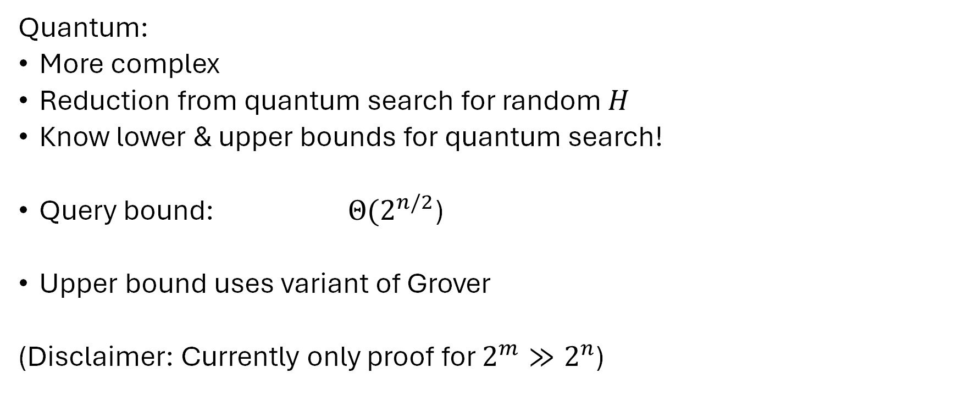
Generic Security - OWF
Quantum:
More complex
Reduction from quantum search for random $H$
Know lower & upper bounds for quantum search!
Query bound: $Θ(2^{n/2}$)
Upper bound uses variant of Grover
(Disclaimer: Currently only proof for ${2^{m}≫2}^{n}$)

Slide 14
Generic Security
 | OW | SPR | CR | UD | PRF
Classical | O(2^{n}) | O(2^{n}) | O(2^{n/2}) | O(2^{n}) | O(2^{n})
Quantum | O(2^{n/2}) | O(2^{n/2}) | O(2^{n/3}) | O(2^{n/2}) | O(2^{n/2})
All matched by attacks

Slide 15
Hash-function properties
stronger / easier to break
Collision-Resistance
Assumption / Attacks
2nd-Preimage-Resistance
One-way
Pseudorandom
weaker /
harder to break

Slide 16
Attacks on Hash Functions
MD5
Collisions
(theo.)
MD5
Collisions
(practical!)
SHA1
Collisions
(practical!)
SHA1
Collisions
(theo.)
MD5 & SHA-1
No (Second-) Preimage Attacks!
2004
2005
2008
2017

Slide 17

Basic Construction

Slide 18
Lamport-Diffie OTS [Lam79]
Message M = b1,…,bm, OWF H = n bit
SK
PK
Sig
*
sk_{1,0}
sk_{1,1}
sk_{m,0}
sk_{m,1}
H
H
H
H
H
H
pk_{1,0}
pk_{1,1}
pk_{m,0}
pk_{m,1}
b1
Mux
b2
Mux
bm
Mux
sk_{1,b1}
sk_{m,bm}

Slide 19






EUF-CMA for OTS
$$pk,1^{n}$$
$$sk$$
$$M$$
SIGN
$$(σ,M)$$
$$(σ^{∗},M^{∗})$$
Success if $M^{∗}≠M$and Verify$\left(pk, σ^{∗},M^{∗}\right)=$ Accept

Slide 20
Security
Theorem:
If H is one-way then LD-OTS is one-time eu-cma-secure.

Slide 21




Merkle’s Hash-based Signatures
PK
SIG = (i=2, , , , , )
H
OTS
H
H
H
H
H
H
H
H
H
H
H
H
H
H
OTS
OTS
OTS
OTS
OTS
OTS
OTS
OTS
SK

Slide 22
Security
Theorem:
MSS is euf-cma-secure if OTS is a one-time eu-cma secure signature scheme and H is a random element from a family of collision resistant hash functions.

Slide 23
Winternitz-OTS

Slide 24
Recap LD-OTS [Lam79]
Message M = b1,…,bm, OWF H = n bit
SK
PK
Sig
*
sk_{1,0}
sk_{1,1}
sk_{m,0}
sk_{m,1}
H
H
H
H
H
H
pk_{1,0}
pk_{1,1}
pk_{m,0}
pk_{m,1}
b1
Mux
b2
Mux
bn
Mux
sk_{1,b1}
sk_{m,bm}

Slide 25
LD-OTS in MSS
SIG = (i=2, , , , , )
Verification:
1. Verify
2. Verify authenticity of
We can do better!

Slide 26


Trivial Optimization
Message M = b1,…,bm, OWF H = n bit
*
SK
sk_{1,0}
sk_{1,1}
sk_{m,0}
sk_{m,1}
H
H
H
H
H
H
PK
pk_{1,0}
pk_{1,1}
pk_{m,0}
pk_{m,1}
b1
Mux
Mux
$¬$b1
bm
Mux
Mux
$¬$bm
Sig
sig_{1,0}
sig_{1,1}
sig_{m,0}
sig_{m,1}

Slide 27
Optimized LD-OTS in MSS
X
SIG = (i=2, , , , , )
Verification:
1. Compute from
2. Verify authenticity of
Steps 1 + 2 together verify

Slide 28

Let‘s sort this
Message M = b₁,…,b_{m}, OWF H
SK: sk₁,…,sk_{m},sk_{m+1},…,sk_{2m}
PK: H(sk₁),…,H(sk_{m}),H(sk_{m+1}),…,H(sk_{2m})
Encode M: M‘ = M||$¬$M = b₁,…,b_{m},$¬$b₁,…,$¬$b_{m}
(instead of b₁, $¬$b₁,…,b_{m},$¬$b_{m} )
sk_{i} , if b_{i} = 1
Sig: sig_{i} =
H(sk_{i}) , otherwise
Checksum with bad performance!

Slide 29

Optimized LD-OTS
Message M = b₁,…,b_{m}, OWF H
SK: sk₁,…,sk_{m},sk_{m+1},…,sk_{m+1+log m}
PK: H(sk₁),…,H(sk_{m}),H(sk_{m+1}),…,H(sk_{m+1+log m})
Encode M: M‘ = b₁,…,b_{m},$¬\sum_{1}^{m}{b_{i}}$
sk_{i} , if b_{i} = 1
Sig: sig_{i} =
H(sk_{i}) , otherwise
IF one b_{i} is flipped from 1 to 0, another b_{j} will flip from 0 to 1

Slide 30



Function chains
Function family: $H:{\text{\{0,1\}}}^{n}×{\text{\{0,1\}}}^{n}→{\text{\{0,1\}}}^{n}$
$$k←_{R}{\{0,1\}}^{n}$$
Parameter $w$
Chain: $c^{i}\left(x\right)=H\left(c^{i−1}\left(x\right)\right)=H∘H∘…∘H(x)$
i-times
c⁰(x) = x
$$c^{w−1}(x)$$
$c1(x) =H_{k}(x)$

Slide 31

WOTS
Winternitz parameter w, security parameter n, message length m, function family $h$
Key Generation: Compute $l$, sample $H_{k}$
c⁰(sk₁) = sk₁
pk₁ = c^{w-1}(sk₁)
c¹(sk₁)
c¹(sk_{l} )
pk_{l} = c^{w-1}(sk_{l} )
c⁰(sk_{l} ) = sk_{l}
Notes:
One promissing group of candidates are hash-based signature schemes
They start from an OTS – a signature scheme where a key pair can only be used for one signature.
The central idea – proposed by Merkle - is to authenticate many OTS keypairs using a binary hash tree
These schemes have many advantages over the beforementioned
Quantum computers do not harm their security – the best known quantum attack is Grovers algorithm – allowing exhaustiv search in a set with n elements in time squareroot of n using log n space.
They are provably secure in the standard model
And they can be instantiated using any secure hash function.
On the downside, they produce long signatures.

Slide 32
WOTS Signature generation
M
b₁
b₂
b₃
b₄
…
…
…
…
…
…
…
b_{m‘}
b_{m‘+1}
b_{m‘+2}
…
…
b_{l}
c⁰(sk₁) = sk₁
pk₁ = c^{w-1}(sk₁)
C
σ₁=c^{b1}(sk₁)
Signature:
σ = (σ₁, …, σ_{l} )
pk_{l} = c^{w-1}(sk_{l} )
c⁰(sk_{l} ) = sk_{l}
σ_{l} =c^{bl} (sk_{l} )
Notes:
Well, this work is concerned with the OTS.
There are several OTS schemes. LD, Merkle-OTS which is a specific instance of the W-OTS, the BM-OTS and Biba and HORS.
The most interesting one is the Winternitz OTS as it allows for a time-memory trade-off and even more important
- It is possible to compute the public verification key given a signature. This reduces the signature size of a hash based signature scheme as normaly the public key of the OTS has to be included in a signature of the scheme. Now for WOTS this isn‘t necessary anymore.

Slide 33





WOTS Signature Verification
      Verifier knows: M, w
b₁
b₂
b₃
b₄
…
…
…
…
…
…
…
b_{m‘}
b_{m‘+1}
b_{l 1+2}
…
…
b_{l}
$c^{1}$ (σ₁)
$c^{3}$(σ₁)
pk₁
=?
σ₁
$c^{2}$(σ₁)
$c^{w−1−b_{1}}$ (σ₁)
Signature:
σ = (σ₁, …, σ_{l} )
pk_{l}
=?
σ_{l}
$c^{w−1−b_{l}}$ (σ_{l} )
Notes:
Well, this work is concerned with the OTS.
There are several OTS schemes. LD, Merkle-OTS which is a specific instance of the W-OTS, the BM-OTS and Biba and HORS.
The most interesting one is the Winternitz OTS as it allows for a time-memory trade-off and even more important
- It is possible to compute the public verification key given a signature. This reduces the signature size of a hash based signature scheme as normaly the public key of the OTS has to be included in a signature of the scheme. Now for WOTS this isn‘t necessary anymore.

Slide 34

WOTS Function Chains
For $x∈{\left\{0,1\right\}}^{n}$define $c^{0}\left(x\right)=x$ and
WOTS: $c^{i}\left(x\right)=H_{k}(c^{i−1}\left(x\right))$
WOTS⁺: $c^{i}\left(x\right)=H_{k}(c^{i−1}\left(x\right) ⨁{ r}_{i})$

Slide 35
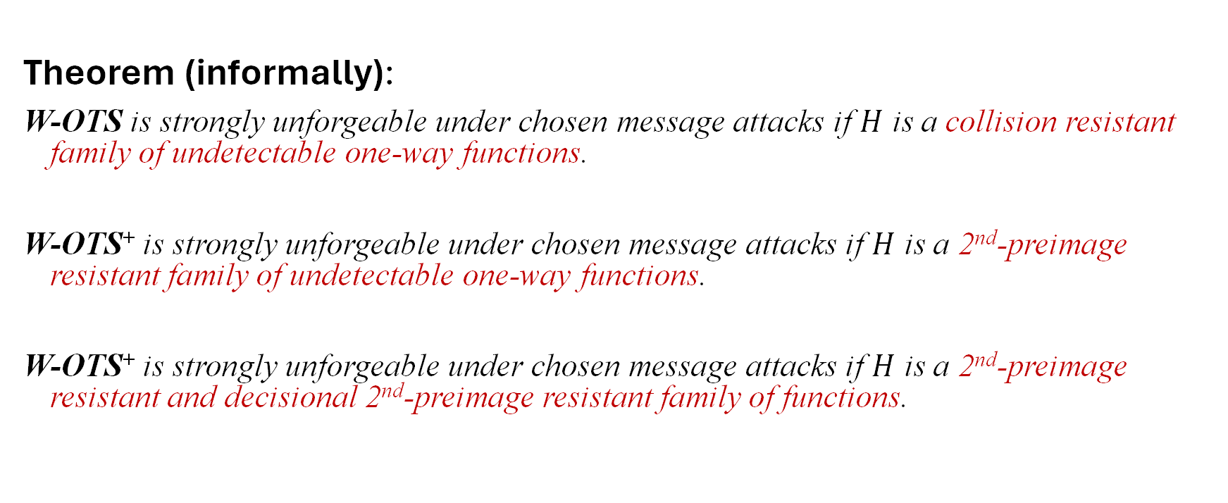
WOTS Security
Theorem (informally):
W-OTS is strongly unforgeable under chosen message attacks if $H$ is a collision resistant family of undetectable one-way functions.
W-OTS⁺ is strongly unforgeable under chosen message attacks if $H$ is a 2nd-preimage resistant family of undetectable one-way functions.
W-OTS⁺ is strongly unforgeable under chosen message attacks if $H$ is a 2nd-preimage resistant and decisional 2nd-preimage resistant family of functions.
Notes:
In our work we showed that we can slightly change the original WOTS construction, such that it uses a function family instead of the hash function family. The resulting scheme is existentially unforgeable under chosen message attacks, if the function family is pseudorandom.
This result has two implications:

Slide 36
XMSS

Slide 37
XMSS
Tree: Uses bitmasks
Leafs: Use binary tree
with bitmasks
OTS: WOTS⁺
Message digest:
Randomized hashing
Collision-resilient
-> signature size halved
b_{i}

Slide 38

Multi-Tree XMSS
Uses multiple layers of trees
-> Key generation
(= Building first tree on each layer)
$$Θ(2h) → Θ(d⋅2^{h/d})$$
-> Allows to reduce
worst-case signing times
$$Θ(h/2) → Θ(h/2d)$$

Slide 39
Multi-target attacks

Slide 40
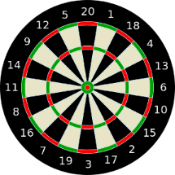
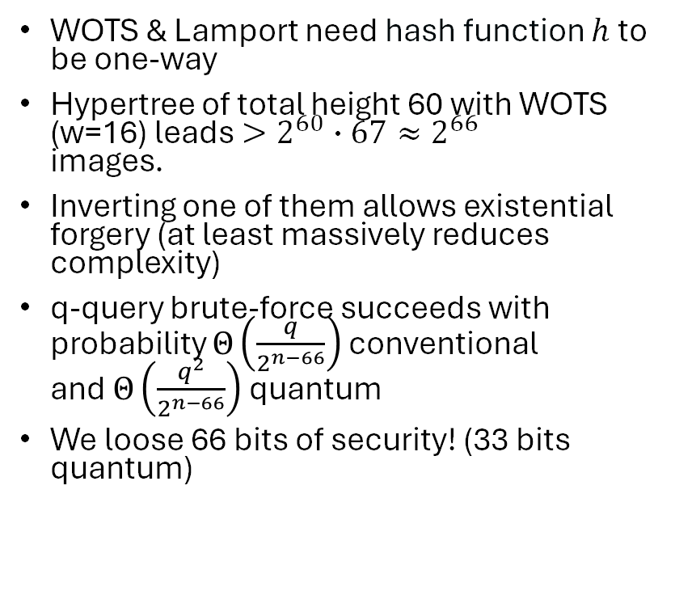
Multi-target attacks
WOTS & Lamport need hash function $h$ to
be one-way
Hypertree of total height 60 with WOTS
(w=16) leads $>2^{60}∙67≈2^{66}$
images.
Inverting one of them allows existential
forgery (at least massively reduces complexity)
q-query brute-force succeeds with probability $Θ\left(\frac{q}{2^{n−66}}\right)$ conventional
and $Θ\left(\frac{q^{2}}{2^{n−66}}\right)$ quantum
We loose 66 bits of security! (33 bits quantum)

Slide 41
Multi-target attacks: Mitigation
Mitigation: Separate targets [HRS16]
Common approach:
  In addition to hash function description
  and „input“ take
    Hash „Address“
    (uniqueness in key pair)
    Hash „key“ used for all hashes of one key pair
    (uniqueness among key pairs)

Slide 42
Multi-target attacks: Mitigation
Mitigation: Separate targets [HRS16]
Common approach:
  In addition to hash function description
  and „input“ take
    Hash „Address“
    (uniqueness in key pair)
    Hash „key“ used for all hashes of one key pair
    (uniqueness among key pairs)

Slide 43
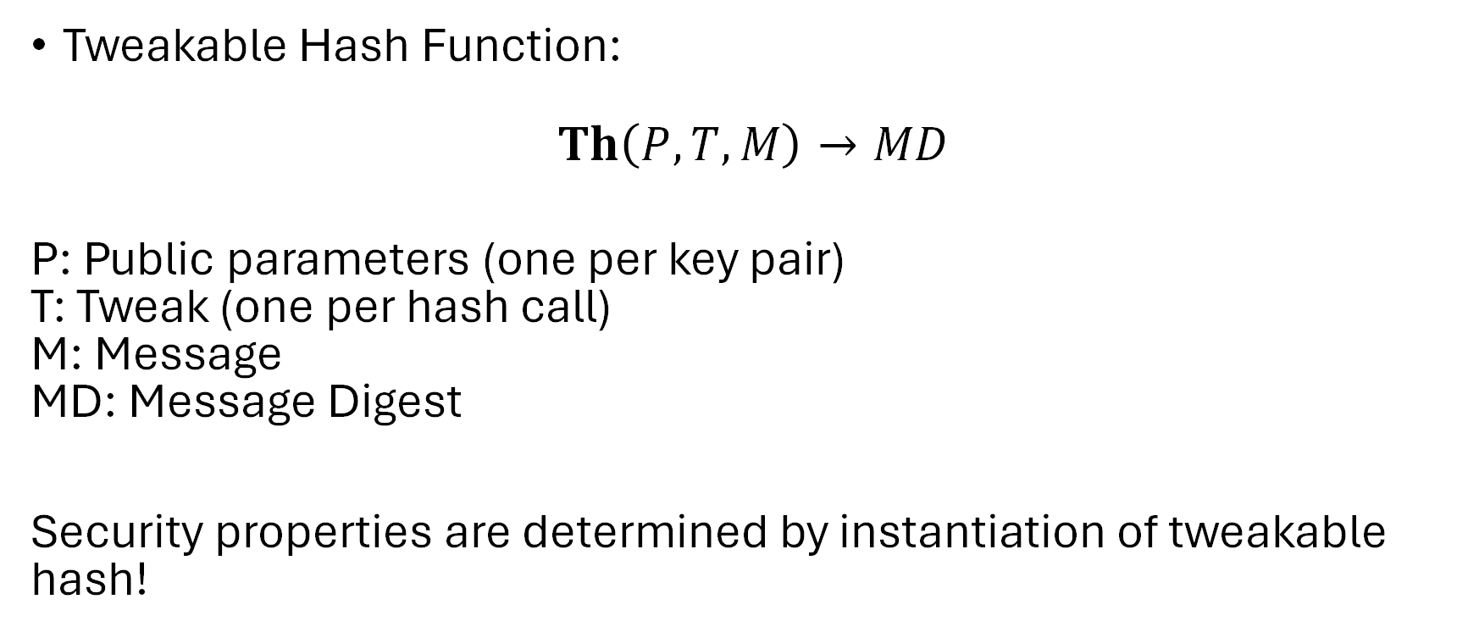
New intermediate abstraction:
Tweakable Hash Function
Tweakable Hash Function:
$$Th\left(P, T, M\right)→MD$$
P: Public parameters (one per key pair)
T: Tweak (one per hash call)
M: Message
MD: Message Digest
Security properties are determined by instantiation of tweakable hash!

Slide 44
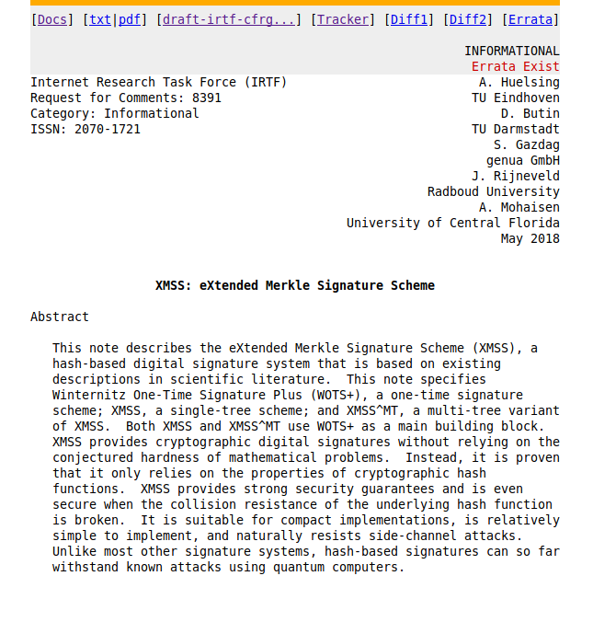
XMSS in practice

Slide 45
RFC 8391 -- XMSS: eXtended Merkle Signature Scheme
Protecting against multi-target attacks / tight security
  n-bit hash => n bit security
Small public key (2n bit)
  At the cost of (Q)ROM for proving PK compression secure
Function families based on SHA2 & SHAKE (SHA3)
Equal to XMSS-T [HRS16] up-to message digest

Slide 46
XMSS / XMSS-T Implementation
C Implementation, using OpenSSL [HRS16]
 | Sign (ms) | Signature (kB) | Public Key (kB) | Secret Key (kB) | Bit Security classical/ quantum | Comment
XMSS | 3.24 | 2.8 | 1.3 | 2.2 | 236 / 118 | h = 20, d = 1,
XMSS-T | 9.48 | 2.8 | 0.064 | 2.2 | 256 / 128 | h = 20, d = 1
XMSS | 3.59 | 8.3 | 1.3 | 14.6 | 196 / 98 | h = 60, d = 3
XMSS-T | 10.54 | 8.3 | 0.064 | 14.6 | 256 / 128 | h = 60, d = 3
Intel(R) Core(TM) i7 CPU @ 3.50GHz
XMSS-T uses message digest from Internet-Draft
All using SHA2-256, w = 16 and k = 2
Notes:
2013: 80 bit
84 -> 2019
87 -> 2022
157 -> 2113

Slide 47
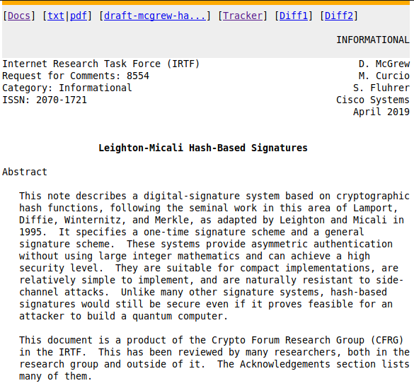
The LMS proposal

Slide 48
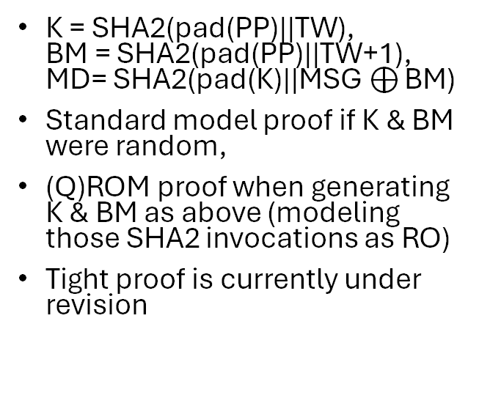
Instantiating the tweakable hash
(for SHA2)
XMSS
LMS
K = SHA2(pad(PP)||TW),
BM = SHA2(pad(PP)||TW+1),
MD= SHA2(pad(K)||MSG$⊕$ BM)
Standard model proof if K & BM were random,
(Q)ROM proof when generating K & BM as above (modeling those SHA2 invocations as RO)
Tight proof is currently under revision
MD = SHA2(PP||TW||MSG)
QROM proof assuming SHA2 is QRO
ROM proof assuming SHA2 compression function is RO
Proofs are essentially tight

Slide 49
Instantiating the tweakable hash
LMS is factor 3 faster but leads to slightly larger signatures at same security level
LMS makes somewhat stronger assumptions about the security properties of the used hash function
More research on direct constructions needed

Slide 50
Machine-Checked Security for XMSS as in RFC 8391 and SPHINCS+. (Barbosa, Dupressoir, Grégoire, Hülsing, Meijers, Strub. CRYPTO 2023)
There was a subtle issue in the tight security proof of XMSS
Issue fixed for SPHINCS+ in Hülsing, Kudinov. "Recovering the tight security proof of SPHINCS+". Asiacrypt'22
Fixed issue for XMSS extending same approach to XMSS.
Specification of XMSS in EasyCrypt
Security proof of XMSS in EasyCrypt

Slide 51
SPHINCS

Slide 52

About the statefulness
Works great for some settings
However....
... back-up
... multi-threading
... load-balancing

Slide 53
How to Eliminate the State

Slide 54
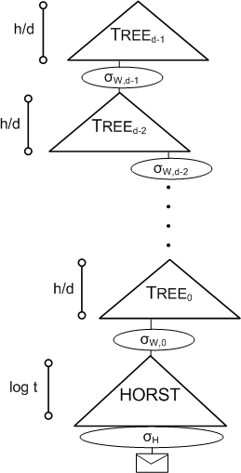
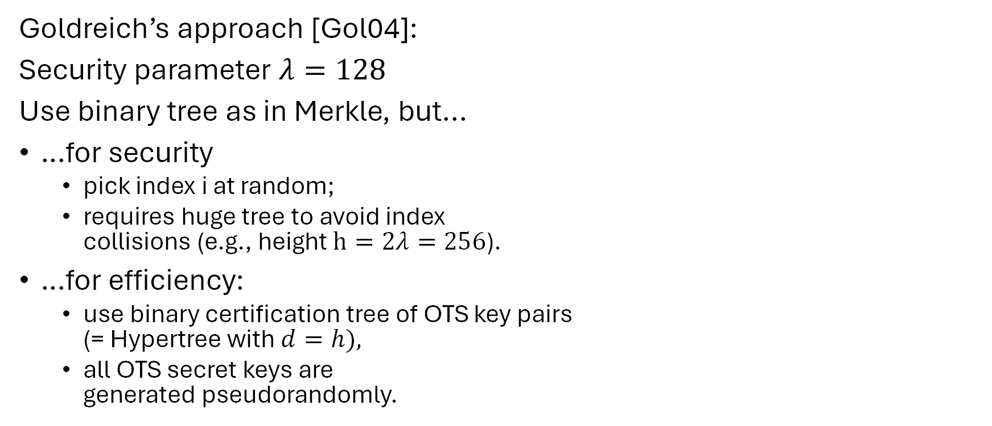
Stateless hash-based signatures [NY89,Gol87,Gol04]
OTS
Goldreich’s approach [Gol04]:
Security parameter $λ=128$
Use binary tree as in Merkle, but...
…for security
  pick index i at random;
  requires huge tree to avoid index
  collisions (e.g., height $h=2λ=256$).
…for efficiency:
  use binary certification tree of OTS key pairs
  (= Hypertree with $d=h),$
  all OTS secret keys are
  generated pseudorandomly.
OTS
OTS
OTS
OTS
OTS
OTS
OTS
OTS

Slide 55
SPHINCS [BHH⁺15]
Select index pseudo-randomly
Use a few-time signature key-pair on
leaves to sign messages
  Few index collisions allowed
  Allows to reduce tree height
Use hypertree: Use d << h.

Slide 56

Few-Time Signature Schemes

Slide 57
Recap LD-OTS
Message M = b1,…,bn, OWF H = n bit
SK
PK
Sig
*
sk_{1,0}
sk_{1,1}
sk_{n,0}
sk_{n,1}
H
H
H
H
H
H
pk_{1,0}
pk_{1,1}
pk_{n,0}
pk_{n,1}
b1
Mux
b2
Mux
bn
Mux
sk_{1,b1}
sk_{n,bn}

Slide 58
HORS [RR02]
Message M, OWF H, CRHF H’ = n bit
Parameters t=2ª,k, with m = ka (typical a=16, k=32)
SK
PK
*
sk₁
sk₂
sk_{t-1}
sk_{t}
H
H
H
H
H
H
pk₁
pk₁
pk_{t-1}
pk_{t}

Slide 59
HORS mapping function
Message M, OWF H, CRHF H’ = n bit
Parameters t=2ª,k, with m = ka (typical a=16, k=32)
*
M
H’
b₁
b₂
b_{a}
b_{ar}
i₁
i_{k}

Slide 60
HORS
Message M, OWF H, CRHF H’ = n bit
Parameters t=2ª,k, with m = ka (typical a=16, k=32)
*
SK
sk₁
sk₂
sk_{t-1}
sk_{t}
H
H
H
H
H
H
PK
pk₁
pk₁
pk_{t-1}
pk_{t}
H’(M)
b₁
b₂
b_{a}
b_{a+1}
b_{ka-2}
b_{ka-1}
b_{ka}
i₁
Mux
Mux
i_{k}
sk_{i1}
sk_{ik}

Slide 61
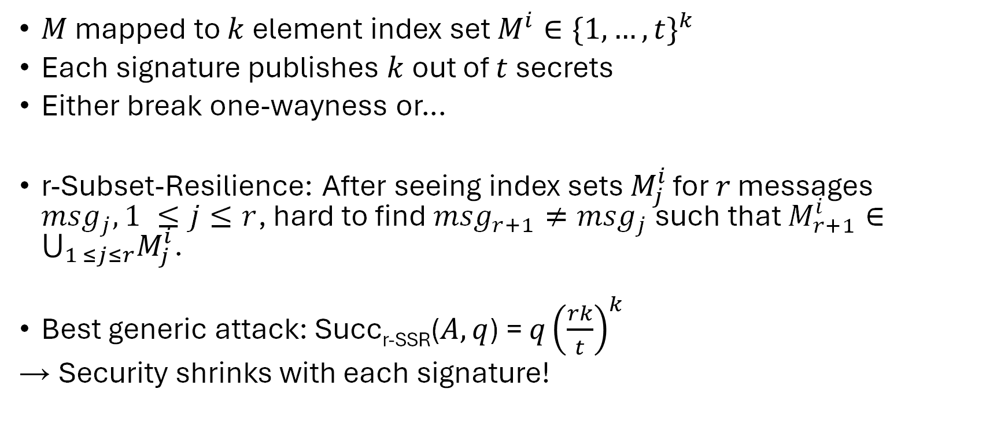
HORS Security
$M$ mapped to $k$ element index set $M^{i}∈{\{1,…,t\}}^{k}$
Each signature publishes $k$ out of $t$ secrets
Either break one-wayness or…
r-Subset-Resilience: After seeing index sets $M_{j}^{i}$ for $r$ messages ${msg}_{j}, 1 ≤j≤r$, hard to find ${msg}_{r+1}≠{msg}_{j}$ such that $M_{r+1}^{i}∈⋃_{1 ≤j≤r}M_{j}^{i}$.
Best generic attack: Succ_{r-SSR}($A,q$) = $q{\left(\frac{rk}{t}\right)}^{k}$
→ Security shrinks with each signature!

Slide 62
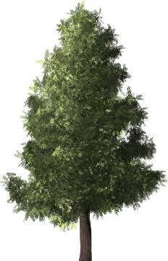

TREE

Slide 63
HORST
Using HORS with MSS requires adding PK (tn) to MSS signature.
HORST: Merkle Tree on top of HORS-PK
New PK = Root
Publish Authentication Paths for HORS signature values
PK can be computed from Sig
With optimizations: tn → (k(log t − x + 1) + 2^{x})n
  E.g. SPHINCS-256: 2 MB → 16 KB
Use randomized message hash

Slide 64
SPHINCS
Stateless Scheme
XMSS^{MT} + HORST
+ (pseudo-)random index
Collision-resilient
Deterministic signing
SPHINCS-256:
  128-bit post-quantum secure
  Hundrest of signatures / sec
  41 kb signature
  1 kb keys

Slide 65
SPHINCS⁺
Joint work with Jean-Philippe Aumasson, Daniel J. Bernstein, Ward Beullens, Christoph Dobraunig, Maria Eichlseder, Scott Fluhrer, Stefan-Lukas Gazdag, Panos Kampanakis, Stefan Kölbl, Tanja Lange, Martin M. Lauridsen, Florian Mendel, Ruben Niederhagen, Christian Rechberger, Joost Rijneveld, Peter Schwabe, Bas Westerbaan

Slide 66
SPHINCS⁺ (coming SLH-DSA)
Strengthened security gives smaller signatures
Collision- and multi-target attack resilient
Fixed length signatures
Small keys, medium size signatures (lv 3: 17kB)
Sizes can be much smaller if q_sign gets reduced
The conservative choice

Slide 67
TREES

Slide 68
FORS (Forest of random subsets)
Parameters t, a = log t, k such that ka = m
...
...
...
...
...

Slide 69
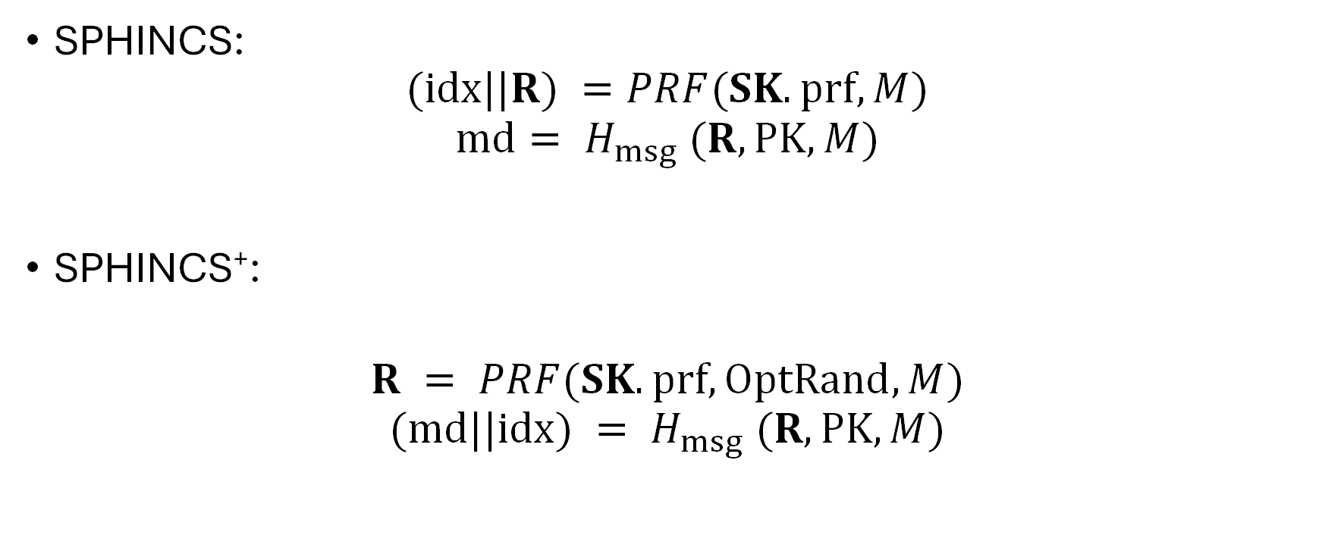
Verifiable index selection
(and optionally non-deterministic randomness)
SPHINCS:
$$(idx||R) =PRF(SK.prf,M)$$
$$md= H_{msg} (R, PK, M)$$
SPHINCS⁺:
$$R = PRF(SK.prf, OptRand, M)$$
$$(md||idx) = H_{msg} (R, PK, M)$$

Slide 70
Verifiable index selection
Improves FORS security
SPHINCS:
Attacks can target „weakest“ HORST key pair
SPHINCS⁺:
Every hash query also selects FORS key pair
  Leads to notion of interleaved target subset resilience

Slide 71
Instantiations
(after second round tweaks)
SPHINCS⁺-SHAKE256-robust
SPHINCS⁺-SHAKE256-simple
SPHINCS⁺-SHA-256-robust
SPHINCS⁺-SHA-256-simple
SPHINCS⁺-Haraka-robust
SPHINCS⁺-Haraka-simple
NEW!
NEW!
NEW!

Slide 72
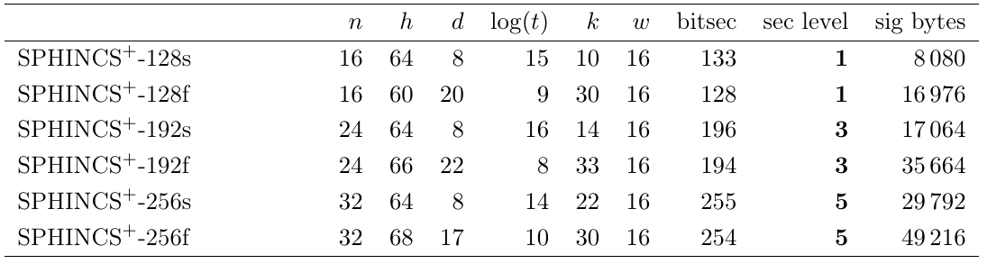
Instantiations (small vs fast)

Slide 73
Hash-based Signatures in NIST „Competition“
SPHINCS⁺
  FORS as few-time signature
  XMSS-T tweakable hash
Gravity-SPHINCS (R.I.P.)
  PORS as few-time signature
  Requires collision-resistance
  Vulnerable to multi-target attacks
(PICNIC)

Slide 74
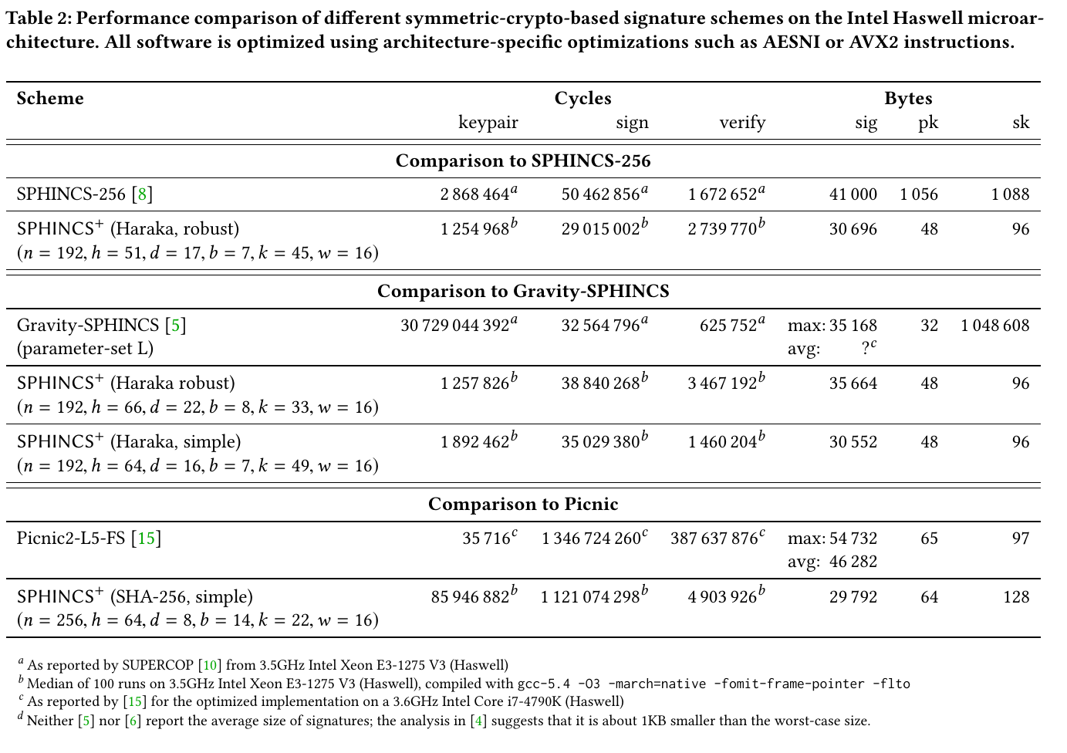

Slide 75
Conclusion
We do not need new assumptions to build signatures!
If you can live with a state, you have PQ signatures available with XMSS & LMS
For stateless you will have SLH-DSA (SPHINCS⁺)

Slide 76

Thank you!
Questions?
For references & further literature see
https://huelsing.net/wordpress/?page_id=165

Slide 77
Authentication path computation

Slide 78
TreeHash
(Mer89)

Slide 79
TreeHash
TreeHash(v,i): Computes node on level v with leftmost descendant L_{i}
Public Key Generation: Run TreeHash(h,0)
L₀ L₁ L₂ L_{3 . . .} L₇
=
v = h = 3
v = 2
h
v = 1
v = 0

Slide 80
TreeHash
TreeHash(v,i)
1: Init Stack, N1, N2
2: For j = i to i+2^{v}-1 do
3: N1 = LeafCalc(j)
4: While N1.level() == Stack.top().level() do
5: N2 = Stack.pop()
6: N1 = ComputeParent( N2, N1 )
7: Stack.push(N1)
8: Return Stack.pop()

Slide 81
TreeHash
TreeHash(v,i)
L_{i} Li+1 . . . L_{i+2v-1}

Slide 82
Efficiency?
Key generation: Every node has to be computed once.
cost = 2^{h} leaves + 2^{h}-1 nodes
=> optimal
Signature: One node on each level 0 <= v < h.
cost 2^{h}-1 leaves + 2^{h}-1-h nodes.
Many nodes are computed many times!
(e.g. those on level v=h-1 are computed 2^{h-1} times)
-> Not optimal if state allowed

Slide 83
The BDS Algorithm
[BDS08]

Slide 84
Motivation
(for all Tree Traversal Algorithms)
No Storage:
Signature: Compute one node on each level 0 <= v < h.
Costs: 2^{h}-1 leaf + 2^{h}-1-h node computations.
Example: XMSS with SHA2-256 and h = 20 -> approx. 15min
Store whole tree: 2^{h}n bits.
Example: h=20, n=256; storage: 2²⁸bits = 32MB
Idea: Look for time-memory trade-off!

Slide 85
Use a State

Slide 86
Authentication Paths

Slide 87
Observation 1
Same node in authentication path is recomputed many times!
Node on level v is recomputed for 2^{v} successive paths.
Idea: Keep authentication path in state.
-> Only have to update “new” nodes.
Result
Storage: h nodes
Time: ~ h leaf + h node computations (average)
But: Worst case still 2^{h}-1 leaf + 2^{h}-1-h node computations!
-> Keep in mind. To be solved.

Slide 88
Observation 2
When new left node in authentication path is needed, its children have been part of previous authentication paths.

Slide 89
Computing Left Nodes
v = 2
i

Slide 90
Result
Storing nodes
all left nodes can be computed with one node computation / node

Slide 91
Observation 3
Right child nodes on high levels are most costly.
Computing node on level v requires
2^{v} leaf and 2^{v}-1 node computations.
Idea: Store right nodes on top k levels during key generation.
Result
Storage: 2^{k}-2 n bit nodes
Time: ~ h-k leaf + h-k node computations (average)
Still: Worst case 2^{h-k}-1 leaf + 2^{h-k}-1-(h-k) node computations!

Slide 92
Distribute Computation

Slide 93
Intuition
Observation:
For every second signature only one leaf computation
Average runtime: ~ h-k leaf + h-k node computations
Idea: Distribute computation to achieve average runtime in worst case.
Focus on distributing computation of leaves

Slide 94
TreeHash with Updates
TreeHash.init(v,i)
1: Init Stack, N1, N2, j=i, j_max = i+2^{v}-1
2: Exit
TreeHash.update()
1: If j <= j_max
2: N1 = LeafCalc(j)
3: While N1.level() == Stack.top().level() do
5: N2 = Stack.pop()
6: N1 = ComputeParent( N2, N1 )
7: Stack.push(N1)
8: Set j = j+1
9: Exit
One leaf per update

Slide 95
Distribute Computation
Concept
Run one TreeHash instance per level 0 <= v < h-k
Start computation of next right node on level v when current node becomes part of authentication path.
Use scheduling strategy to guarantee that nodes are finished in time.
Distribute (h-k)/2 updates per signature among all running TreeHash instances

Slide 96
Distribute Computation
Worst Case Runtime
Before:
2^{h-k}-1 leaf and 2^{h-k}-1-(h-k) node computations.
With distributed computation:
(h-k)/2 + 1 leaf and 3(h-k-1)/2 + 1 node computations.
Add. Storage
Single stack of size h-k nodes for all TreeHash instances.
+ One node per TreeHash instance.
= 2(h-k) nodes

Slide 97
BDS Performance
Storage:
n bit nodes
Runtime:
(h−k)/2+1 leaf and
3(h−k−1)/2+1 node computations.

