Slide 1
Fiat-Shamir with Aborts
Andreas Hülsing Eindhoven University of Technology & SandboxAQ

Slide 2
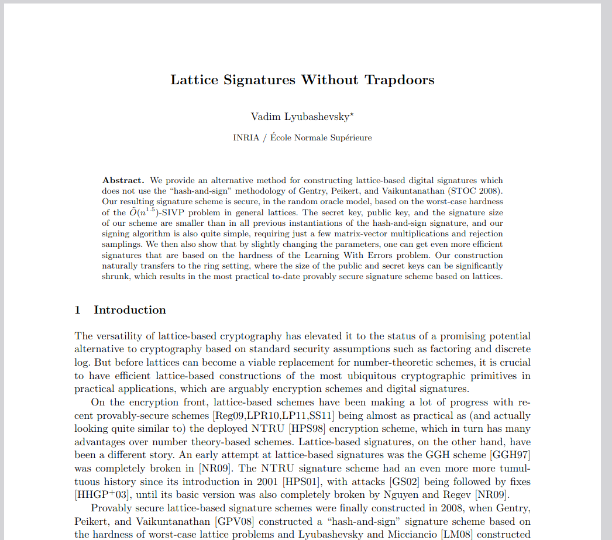
Fiat-Shamir with Aborts (Lyubashevsky, Eurocrypt 2012)
Technique to build Schnorr-style signatures from lattices
Uses Fiat-Shamir like Schnorr
Difference: Requires "rejection sampling"
Underlying BLISS, Dilithium, and many more

Slide 3
Outline
Identification Schemes / Schnorr
Fiat-Shamir: Signatures from Identification
The case of Dilithium / Identification with abort
A subtle proof-issue

Slide 4
Identification Schemes
IDS
Prover P (sk)
Verifier V (pk)
w <- Commit(sk)
w
c
c <-_{R} CSpace
z <- Response(sk,w,c)
z
b <- Verify(pk,w,c,z)

Slide 5
Identification Schemes (IDS) / Zero-knowledge proofs (ZKP)
Invented by Shafi Goldwasser, Silvio Micali and Charles Rackoff in 1985
Interactive proof systems
Prove knowledge of a secret without revealing any information about the secret
[For people that like classifications: The IDS we discuss are actually Honest-Verifier Zero-Knowledge Arguments of Knowledge]

Slide 6
Identification schemes (3-round, public coin)
Prover P (sk)
Verifier V (pk)
w <- Commit(sk)
w
c
c <-_{R} CSpace
z <- Response(sk,w,c)
z
b <- Verify(pk,w,c,z)
Also called a "Sigma Protocol"

Slide 7
Commitment Scheme
COM = (com, open)
w, x <- com(in; rand)
in' <- open(w, x)
Binding: hard to find x ≠ x' s.th. open(w, x) ≠ open(w, x')
Hiding: com(in; rand) ~ com(in'; rand')
One-way: hard to learn in from w
Examples:
H(in;rand), rand <- com(in;rand) [hiding + binding]
w <- g^{in} <- com(in) [one-way & binding]

Slide 8
Security Properties
Soundness: A prover that does not know the secret will get caught with high probability (1 – e) where e is called soundness error
Special soundness: There exists an efficient extractor E that given two transcripts with same w but different c, extracts sk.
Honest verifier zero-knowledge (HVZK): There exists an efficient simulator ZKSim that, given only the public key, outputs transcripts which are indistinguishable from transcripts of honest protocol runs

Slide 9
Schnorr Identification scheme
Prover P (sk = s)
Verifier V (pk = t = g^{s})
r <-_{R} Z_{q}
w <- g^{r}
w
c
c <-_{R} Z_{q}
z <- r + sc
z
return g^{z}t^{-c} = w
Correctness: g^{z}t^{-c} = g^{r+sc}g^{(-cs)} = g^{r} = w

Slide 10
Security - Soundness
Special soundness:
Given valid ((w, c, z), (w, c', z')) we have (in Z_{q})
z - z' = (r + sc) - (r + sc') = s(c-c')
and so
(z-z')(c-c')⁻¹ = s
Soundness:
Rewinding – If A has better than 1/q chance of winning per w, they must be able to respond to more than one c.

Slide 11
Security - HVZK
[Recall verify checks g^{z}t^{-c} = w]
Trick: Transcript does not enforce order
ZKSim(pk = t = q^{s}):
Trans(sk = s):
c <-_{R} Z_{q}
z <-_{R} Z_{q}
w <- g^{z}t^{-c}
Output(w, c, z)
r <-_{R} Z_{q}
w <- g^{r}
c <-_{R} Z_{q}
z <- r + sc
Output(w, c, z)

Slide 12
Fiat-Shamir
DSig
IDS
Prover P (sk)
Verifier V (pk)
w <- Commit(sk)
w
Fiat-Shamir
c
c <-_{R} CSpace
SK
PK
/
z <- Response(sk,w,c)
z
b <- Verify(pk,w,c,z)
Sign
Vrfy

Slide 13
Identification schemes (3-round, public coin)
Prover P (sk)
Verifier V (pk)
w <- Commit(sk)
w
c
c <-_{R} CSpace
z <- Response(sk,w,c)
z
b <- Verify(pk,w,c,z)

Slide 14
Fiat-Shamir Signatures
Sign<H> (sk,m)
Verify<H> (pk, m, sig)
w <- P.Commit(sk)
c <- H(pk, w, m)
z <- P.Response(sk, w, c)
Return sig = (w, z)
c <- H(pk, w, m)
b <- V.Verify(pk, w, c, z)

Slide 15
existential UnForgability under adaptive Chosen Message Attacks (UF-CMA)
PK, 1^{n}
SK
M_{i}
SIGN
(σ_{i}, M_{i})
(σ*, M*)

Slide 16
existential UnForgability under No-Message Attacks (UF-NMA)
PK, 1^{n}
(σ*, M*)

Slide 17
Proof outline
Reprogramming
(in ROM)
Soundness
UF-NMA
UF-CMA
Forking Lemma
(in ROM)
HVZK

Slide 18
Proof outline
Reprogramming
(in ROM)
Soundness
UF-NMA
UF-CMA
Forking Lemma
(in ROM)
HVZK

Slide 19
Indirection: The random oracle model (ROM)

Slide 20
Reduction
Problem
Transform Problem
PK, 1^{n}
M_{i}
SIGN
ImplementSIGN
(σ_{i}, M_{i})
Solution
Extract Solution
(σ*, M*)

Slide 21
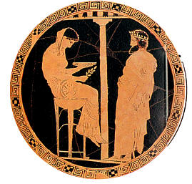
Reduction in the random oracle model
M_{j}
Problem
H(M_{j})
Transform Problem
PK, 1^{n}
M_{i}
M_{j}
SIGN
H(M_{j})
ImplementSIGN
(σ_{i}, M_{i})
RO
Solution
Extract Solution
(σ*, M*)

Slide 22
Reduction in the random oracle model
M_{j}
Problem
H(M_{j})
Transform Problem
PK, 1^{n}
M_{i}
M_{j}
SIGN
H(M_{j})
ImplementSIGN
(σ_{i}, M_{i})
RO
ImplementRO
Solution
Extract Solution
(σ*, M*)

Slide 23
RO Reprogramming

Slide 24
RO Reprogramming

Slide 25
Proof intuition
y is independtly, uniformly distributed.
Reprogramming is perfectly indistinguishable if distinguisher D did not query H(x) before programming!
Max probability of x is p_{max}.
Pr[D queried H(x) before programming] = qp_{max}.

Slide 26
Back to the proof!

Slide 27
Proof outline
Reprogramming
(in ROM)
Soundness
UF-NMA
UF-CMA
Forking Lemma
(in ROM)
HVZK

Slide 28
Game setup
Game_{i}(A)
SignO₀(sk, M)
(pk,sk) <- KeyGen()
(M*, σ*) <- A^{SignOi,H}(pk)
Return (Verify(pk, M*, σ*) && && M* \notin L_{M})
L_{M} U {M}
w <- P.Commit(sk)
c <- H(pk, w, m)
z <- P.Response(sk, w, c)
Return sig = (w, z)
Game hopping proof: A^{SignO0,H}(pk) ~ A^{SignO1,H}(pk) ~ A^{SignO2,H}(pk) ~ A^{SignO3,H}(pk)

Slide 29
Hop 1
SignO₀(sk, M) [CMA-Sign]
SignO₁(sk, M)
L_{M} U {M}
w <- P.Commit(sk)
c <- H(pk, w, m)
z <- P.Response(sk, w, c)
Return sig = (w, z)
L_{M} U {M}
w <- P.Commit(sk)
c <-_{R} CSpace
Set H(pk, w, m) -> c
z <- P.Response(sk, w, c)
Return sig = (w, z)
RO Reprogramming => A^{SignO0,H}(pk) ~ A^{SignO1,H}(pk)

Slide 30
Hop 2
SignO₁(sk, M)
SignO₂(sk, M)
L_{M} U {M}
w <- P.Commit(sk)
c <-_{R} CSpace
Set H(pk, w, m) -> c
z <- P.Response(sk, w, c)
Return sig = (w, z)
L_{M} U {M}
(w,c,z) <- Trans(sk)
Set H(pk, w, m) -> c
Return sig = (w, z)
A^{SignO1,H}(pk) = A^{SignO2,H}(pk)

Slide 31
Hop 3
SignO₂(sk, M)
SignO₃(pk, M)
L_{M} U {M}
(w,c,z) <- Trans(sk)
Set H(pk, w, m) -> c
Return sig = (w, z)
L_{M} U {M}
(w,c,z) <- Sim(pk)
Set H(pk, w, m) -> c
Return sig = (w, z)
HVZK => A^{SignO2,H}(pk) ~ A^{SignO3,H}(pk)

Slide 32
M^{A} against NMA using A against CMA
M^{A}(pk)
SignO₃(pk, M)
(M*, σ*) <- A^{SignO3,H(pk, . )}(pk)
Return (M*, σ*)
L_{M} U {M}
(w,c,z) <- Sim(pk)
Set H(pk, w, m) -> c
Return sig = (w, z)
A^{SignO0,H}(pk) ~ A^{SignO3,H}(pk) => UF-CMA(A) ~ UF-NMA(M^{A})

Slide 33
Fiat-Shamir with Aborts

Slide 34
Lattice-based Schnorr identification
Prover P (sk = S)
Verifier V (pk = T = AS)
y <- D_{0,s}^{m}
w <- Ay
w
c
c <-_{R} {-1, 0, 1}^{k}
z <- Sc + y
z
return Az - Tc = w && z "short"
Correctness: Az – Tc = ASc + Ay – ASc = Ay = w

Slide 35
Lattice-based Schnorr identification
Prover P (sk = S)
Verifier V (pk = T = AS)
y <- D_{0,s}^{m}
w <- Ay
w
c
c <-_{R} {-1, 0, 1}^{k}
z <- Sc + y
z
z leaks S over time!
(Follows a Gaussian with center Sc for public c)
return Az - Tc = w && z "short"
Correctness: Az – Tc = ASc + Ay – ASc = Ay = w

Slide 36
FIXED Lattice-based Schnorr identification
Prover P (sk = S)
Verifier V (pk = T = AS)
y <- D_{0,s}^{m}
w <- Ay
w
c
c <-_{R} {-1, 0, 1}^{k}
z <- Sc + y Accept z with probability min(D_{0,s}^{m}(z) / MD_{Sc,s}^{m}(z), 1)
z
return Az - Tc = w && z "short"

Slide 37
FIXED Lattice-based Schnorr identification
Prover P (sk = S)
Verifier V (pk = T = AS)
y <- D_{0,s}^{m}
w <- Ay
w
c
c <-_{R} {-1, 0, 1}^{k}
z <- Sc + y Accept z with probability min(D_{0,s}^{m}(z) / MD_{Sc,s}^{m}(z), 1)
z
return Az - Tc = w && z "short"
Rejection sampling (output statistically close to D_{0,s}^{m})

Slide 38
Security - HVZK (Soundness out of scope)
[Recall verify checks Az - Tc = w]
ZKSim(pk = T = AS):
Trans(sk = S):
c <-_{R} {-1, 0, 1}^{k}
z <-_{R} D_{0,s}^{m}
w <- Az – Tc
Output(w, c, z)
Repeat until accept:
y <- D_{0,s}^{m}
w <- Ay
c <-_{R} {-1, 0, 1}^{k}
z <- Sc + y
Accept z with probability min(D_{0,s}^{m}(z) / MD_{Sc,s}^{m}(z), 1)
Output (w, c, z)

Slide 39
A subtle issue in the proof
Fixing and Mechanizing the Security Proof of Fiat-Shamir with Aborts and Dilithium. [pdf]
joint work with Manuel Barbosa, Gilles Barthe, Christian Doczkal, Jelle Don, Serge Fehr, Benjamin Grégoire, Yu-Hsuan Huang, Yi Lee, and Xiaodi Wu
CRYPTO 2023

Slide 40
Proof outline
Reprogramming
(in ROM)
Soundness
UF-KOA
UF-CMA
Forking Lemma
(in ROM)
HVZK

Slide 41
The oracles (for an abstract proof)

Slide 42
The oracles (for an abstract proof)
Issue 1: Potentially unlimited # of iterations

Slide 43
The oracles (for an abstract proof)
Issue 1: Potentially unlimited # of iterations
Issue 2: Trans only reprograms on "accepting (w,c)"

Slide 44
Solving issue 1
Fine-grained hybrid argument (one hop per hash call made by sign -> nested-hybrid over sign calls, and over hash calls in sign)
Can bound distinguishing advantage between switching a full sign call considering that later hash calls are only reached with decreasing probability -> can neglect contributions of those hybrids to bound as the probability they are reached is vanishing.

Slide 45
The hybrids (for one sign call)

Slide 46
Solving issue 2
Break game hop into two steps:
Program all RO calls
Unprogram RO calls that are rejected
Intuition:
- Step 1 is undetectable if A did not query H(w,m) before (w only known afterwards & w has high entropy)
- Step 2 is undetectable if A does not query H(w,m) after for rejected w (rejected w not published & w has high entropy)

Slide 47
Results (see https://eprint.iacr.org/2023/246.pdf)
ROM & QROM bound for Fiat-Shamir with aborts
Mechanized ROM proof for Dilithium
Detailed analysis of the impact on concrete parameters (no impact)
Concurrent work: Julien Devevey, Pouria Fallahpour, Alain Passelègue, Damien Stehlé. A Detailed Analysis of Fiat-Shamir with Aborts. Crypto'23 Observed issue 2 by manual inspection.

Slide 48
Conclusion
The security proof of Dilithium, BLISS, Lyu12, and other FSwA signature schemes was subtly flawed
We observed the flaw when machine-checking the proof, fixed it, finished machine-check, and ensured that there is no practical impact
Did not touch on soundness in this talk
Dilithium: essentially rephrased as assumption;
[KLS'18]: with slightly different params, proof via lossy-IDS (dual-mode instance generator)
PQ adds complexity which can introduce subtle flaws in proofs (even in without considering the QROM!)
Issues went unnoticed for 10 years!
-> machine-checking these parts can guarantee absence of such issues.

